Slide 1



Per- and Polyfluoroalkyl Substances (PFAS) in the Stratham Town Center
Prepared for: The Town of Stratham, New Hampshire
James P. Ricker, P.G.
Wilcox & Barton, Inc.
September 10, 2019

Slide 2

Objectives
So what the heck is ‘PFAS’?
PFAS detections statewide
How did we get here?
NHDES Request for a Focused Site Investigation
Findings and analytical results in groundwater and drinking water
Stratham Municipal Landfill
What’s next?
Q&A

Slide 3

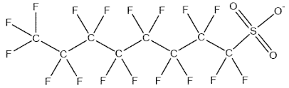
What is PFAS?
“Per- and Polyfluoroalkyl Substances” (PFAS)
4,500+ different synthesized compounds (fluorine-carbon)
  “per” = fully-fluorinated
  “poly” = Not fully-fluorinated
Manufactured by companies like 3M and DuPont (1940s)
Non-stick, waterproof, & stain- and grease-resistant products:
  Teflon, GoreTex, StainMaster, Scotchgard, sandwich wrappers,
  wire coating, cosmetics, lip balm,
  ski and car wax, microwave popcorn bags, pizza boxes, aluminum foil, chrome plating, etc.
Used in Class-B fire-fighting foams (“AFFF”) - Petroleum-based fires

Slide 4
What is PFAS?
“Per- and Polyfluoroalkyl Substances” (PFAS)
Bioaccumulate in blood serum
  Fish
  Polar bears
Possible health effects (based largely on animal testing):
  Certain cancers (bladder, kidney)
  Changes in thyroid hormone levels
  Higher cholesterol
  Lower birth weight for infants
  Changes in hormone levels that could affect reproductive development
  Still developing studies in humans
Half-life of between 2 and 9 years

Slide 5
Alphabet Soup – Full List by Method 537.1
  Perfluorobutanoic Acid (PFBA)
  Perflourobutane Sulfonate (PFBS)
  Perfluoropentanoic Acid (PFPeA)
  Perfluorohexanoic Acid (PFHxA)
  Perfluorohexane sulfonate (PFHxS)
  Perfluoroheptanoic Acid (PFHpA)
  Perfluoroheptane Sulfonate (PFHpS)
  Perfluorooctanoic Acid (PFOA)
  Perfluorooctane Sulfonate (PFOS)
  Perfluorooctane Sulfonamide (PFOSA) Perfluorononanoic Acid (PFNA)
  “The Forever Chemicals”
  Perfluorodecanoic Acid (PFDA)
  Perfluorodecane Sulfonate (PFDS)
  Perfluoroundecanoic Acid (PFUnA)
  Perfluorododecanoic Acid (PFDoA)
  Perfluorotridecanoic Acid (PFTRDA)
  Perfluorotetradecanoic Acid (PFTEDA
  6:2 Fluorotelomer Sulfonate
  8:2 Fluorotelomer Sulfonate
  N-ethyl perfluorooctanesulfonamido acetic acid
  N-methyl perfluorooctanesulfonamido acetic acid

Slide 6
PFAS in New Hampshire
Pease AFB/International Tradeport
  Haven, Smith, and Harrison public water supply wells (2014)
Saint-Gobain, Merrimack
  Specialty coatings on paper
Saint-Gobain “spin-offs”
  TCI, Amherst
Coakley Landfill, Rye/Hampton
And many others – including landfills and fire stations….

Slide 7
Regulatory History in New Hampshire
May 2016: NHDES follows the EPA Health Advisory level of 70 ppt, establishes AGQS (for PFOA or PFOS or a combination of the two).
  How small a number is 70 ppt? (“ppt” = parts per trillion)
November 2016: NHDES requests statewide sampling for PFAS
April 2017: Leaned a bit harder – no later than 2018
Spring 2019: NHDES considered lowering/creating standards (for 4 PFAS) in the 23-85 ppt range
June 28, 2019: Announced final rulemaking for AGQS/MCLs

Slide 8
Adopted Standards (effective 9/30/19)
Only PFOA, PFOS, PFHxS, and PFNA currently have MCLs/AGQS* established by the NHDES.
  Carboxylic Acids:
  PFOA: Perfluorooctanoic Acid 12 nanograms per liter (parts per trillion)
  PFNA: Perfluorononanoic Acid 11 ppt
  Sulfonic Acids:
  PFOS: Perfluorooctane Sulfonic Acid 15 ppt
  PFHxS: Perfluorohexane Sulfonic Acid 18 ppt
  * MCL: Maximum Contaminant Level (drinking water)
  * AGQS: Ambient Groundwater Quality Standard (groundwater)
  Note: There is currently no regulatory standard for soil

Slide 9
PFAS Sites in New Hampshire
Merrimack Landfill
Souhegan Landfill
Bedford Landfill
Grove Road Landfill – Rye
LL&S Landfill – Salem
Trowbridge Drive – Merrimack
Hampstead Middle School
Marlow Elementary School
Franklin Wastewater Treatment Facility
East Kingston Biological Recycling Site
Rockingham County Complex/Fire Training Facility – Brentwood
Meadowood Fire Training Facility – Fitzwilliam, Troy
Kingston Fire Department
New Boston Air Force Station Former Fire Department
Gilford Municipal Complex/Fire Department
Windham Fire Department
Mammoth Road – Londonderry
Central Metal Finishing – Windham
Madbury Metals
Lydall Performance Materials, Inc. - Rochester

Slide 10
So Why Stratham? How Did We Get Here?
NHDES statewide sampling program focused on municipal fire stations
Public drinking water supply wells
NHDES sampling in Spring 2019
  March: 6 wells, including fire station
  April: 12 wells
  May: 9 wells
PFAS detected >AGQS* in 11 of the 27 samples
  PFOS detected at concentrations as high as 206 ppt; fire station well 149 ppt
April 26, 2019: NHDES issues request for a “Focused Site Investigation”
June 2019: Town selects Wilcox & Barton, Inc.

Slide 11
Focused Site Investigation
Purpose was to identify possible source(s) of the PFAS and identify additional potential receptors
Wilcox & Barton, Inc. Scope of Work (SOW) included the following:
  Sensitive receptor survey
  Installation of five overburden groundwater monitoring (GW) wells
  The collection of GW and additional drinking water samples
  Historical review of fire department operations and interviews
  Summary of all data and results into an FSI Report (due 9/30/19)
  Participation in public outreach/meetings
Field investigation conducted in June and July; lab results followed

Slide 12
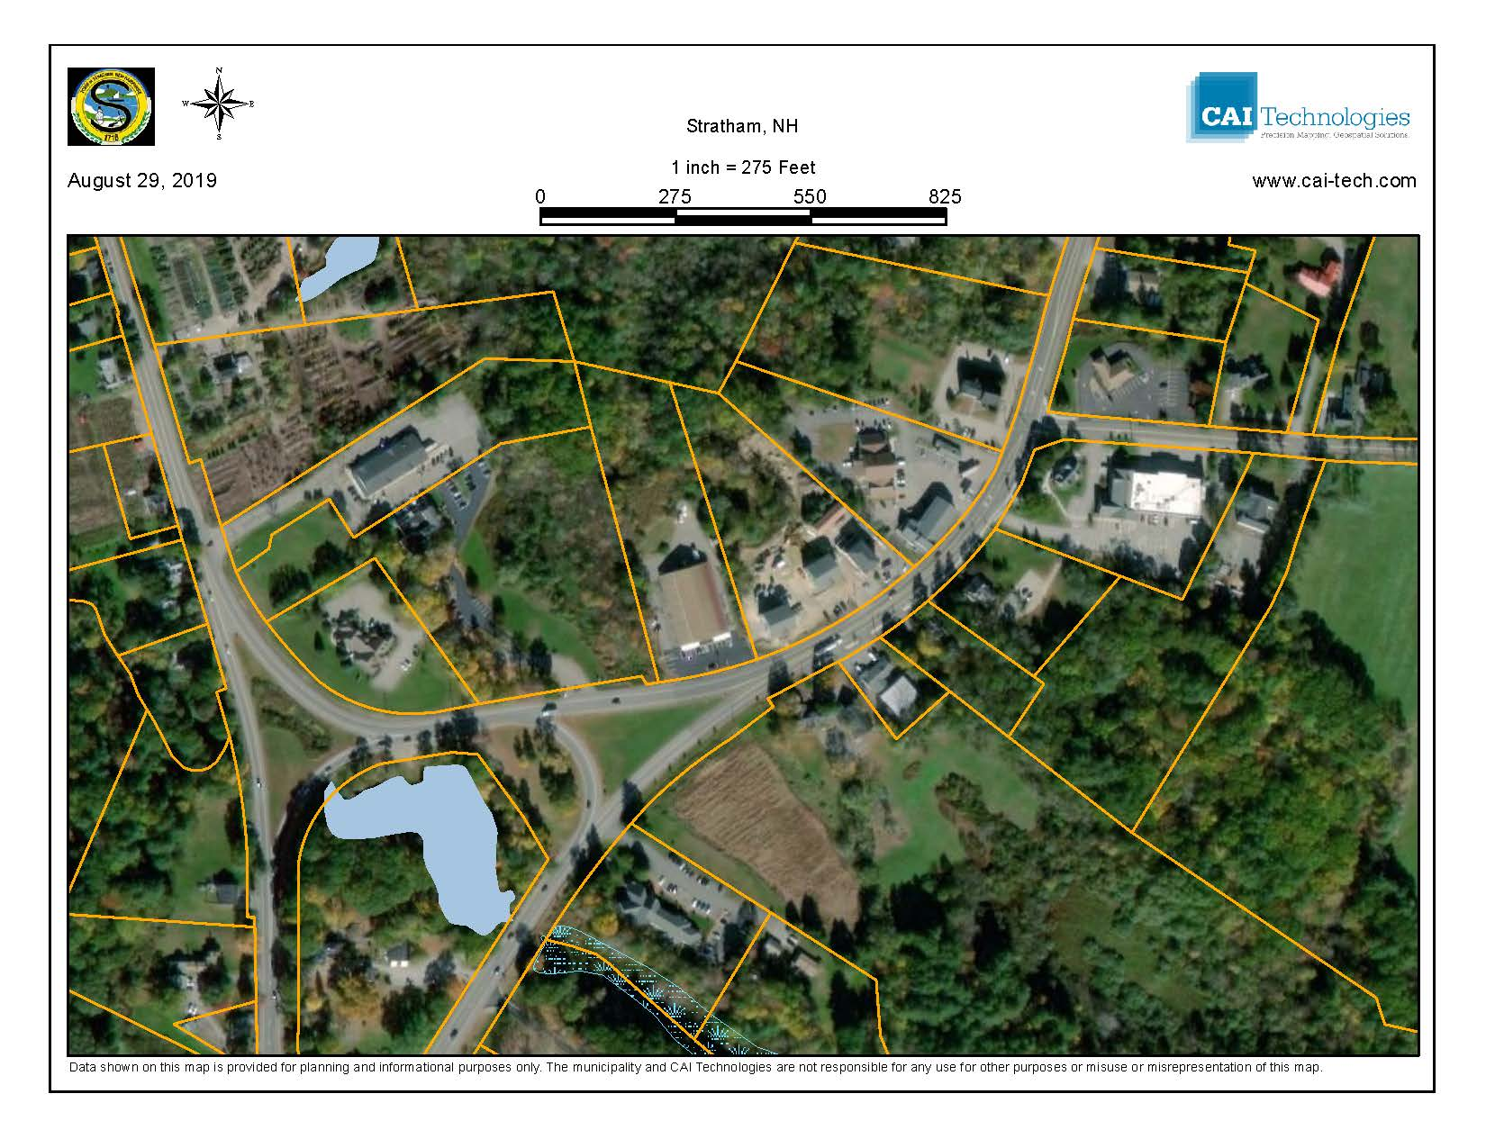

Slide 13
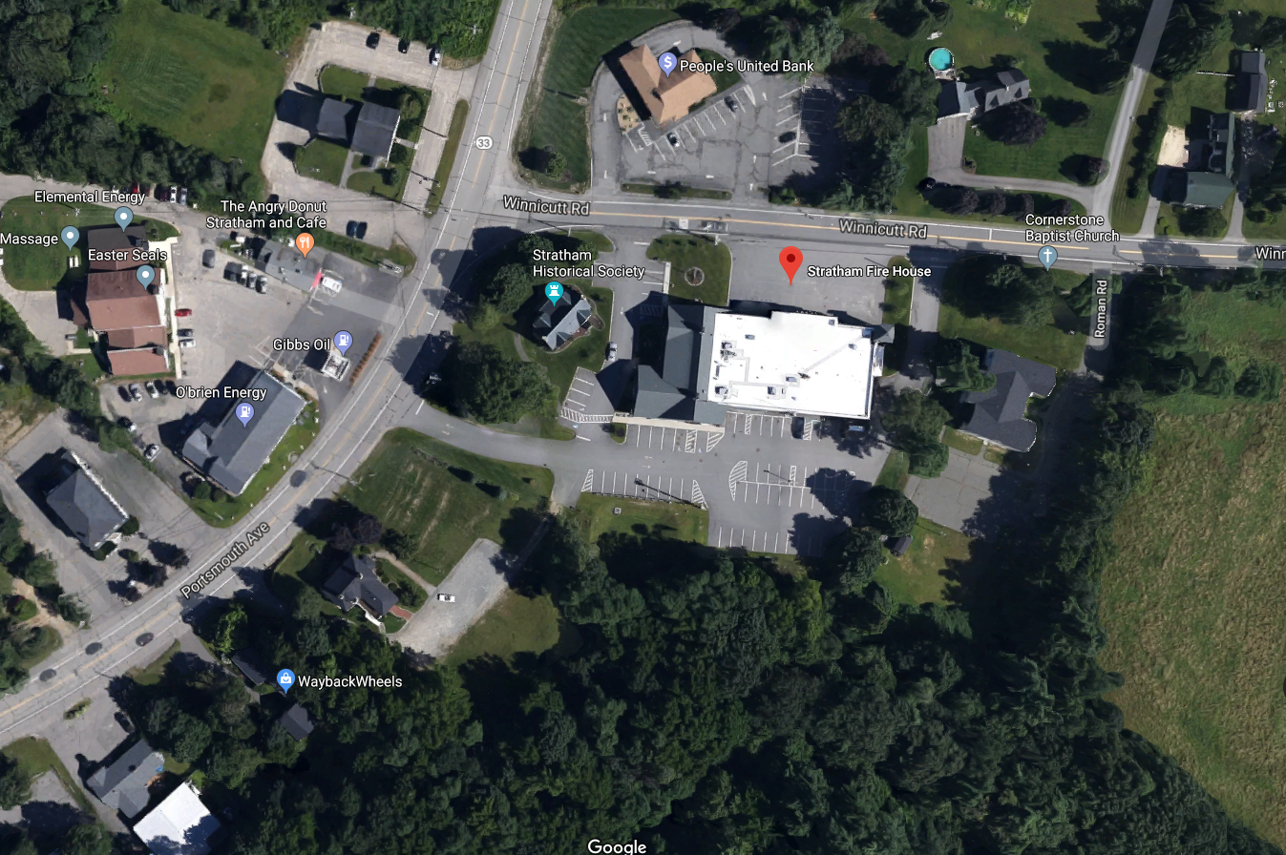

Slide 14
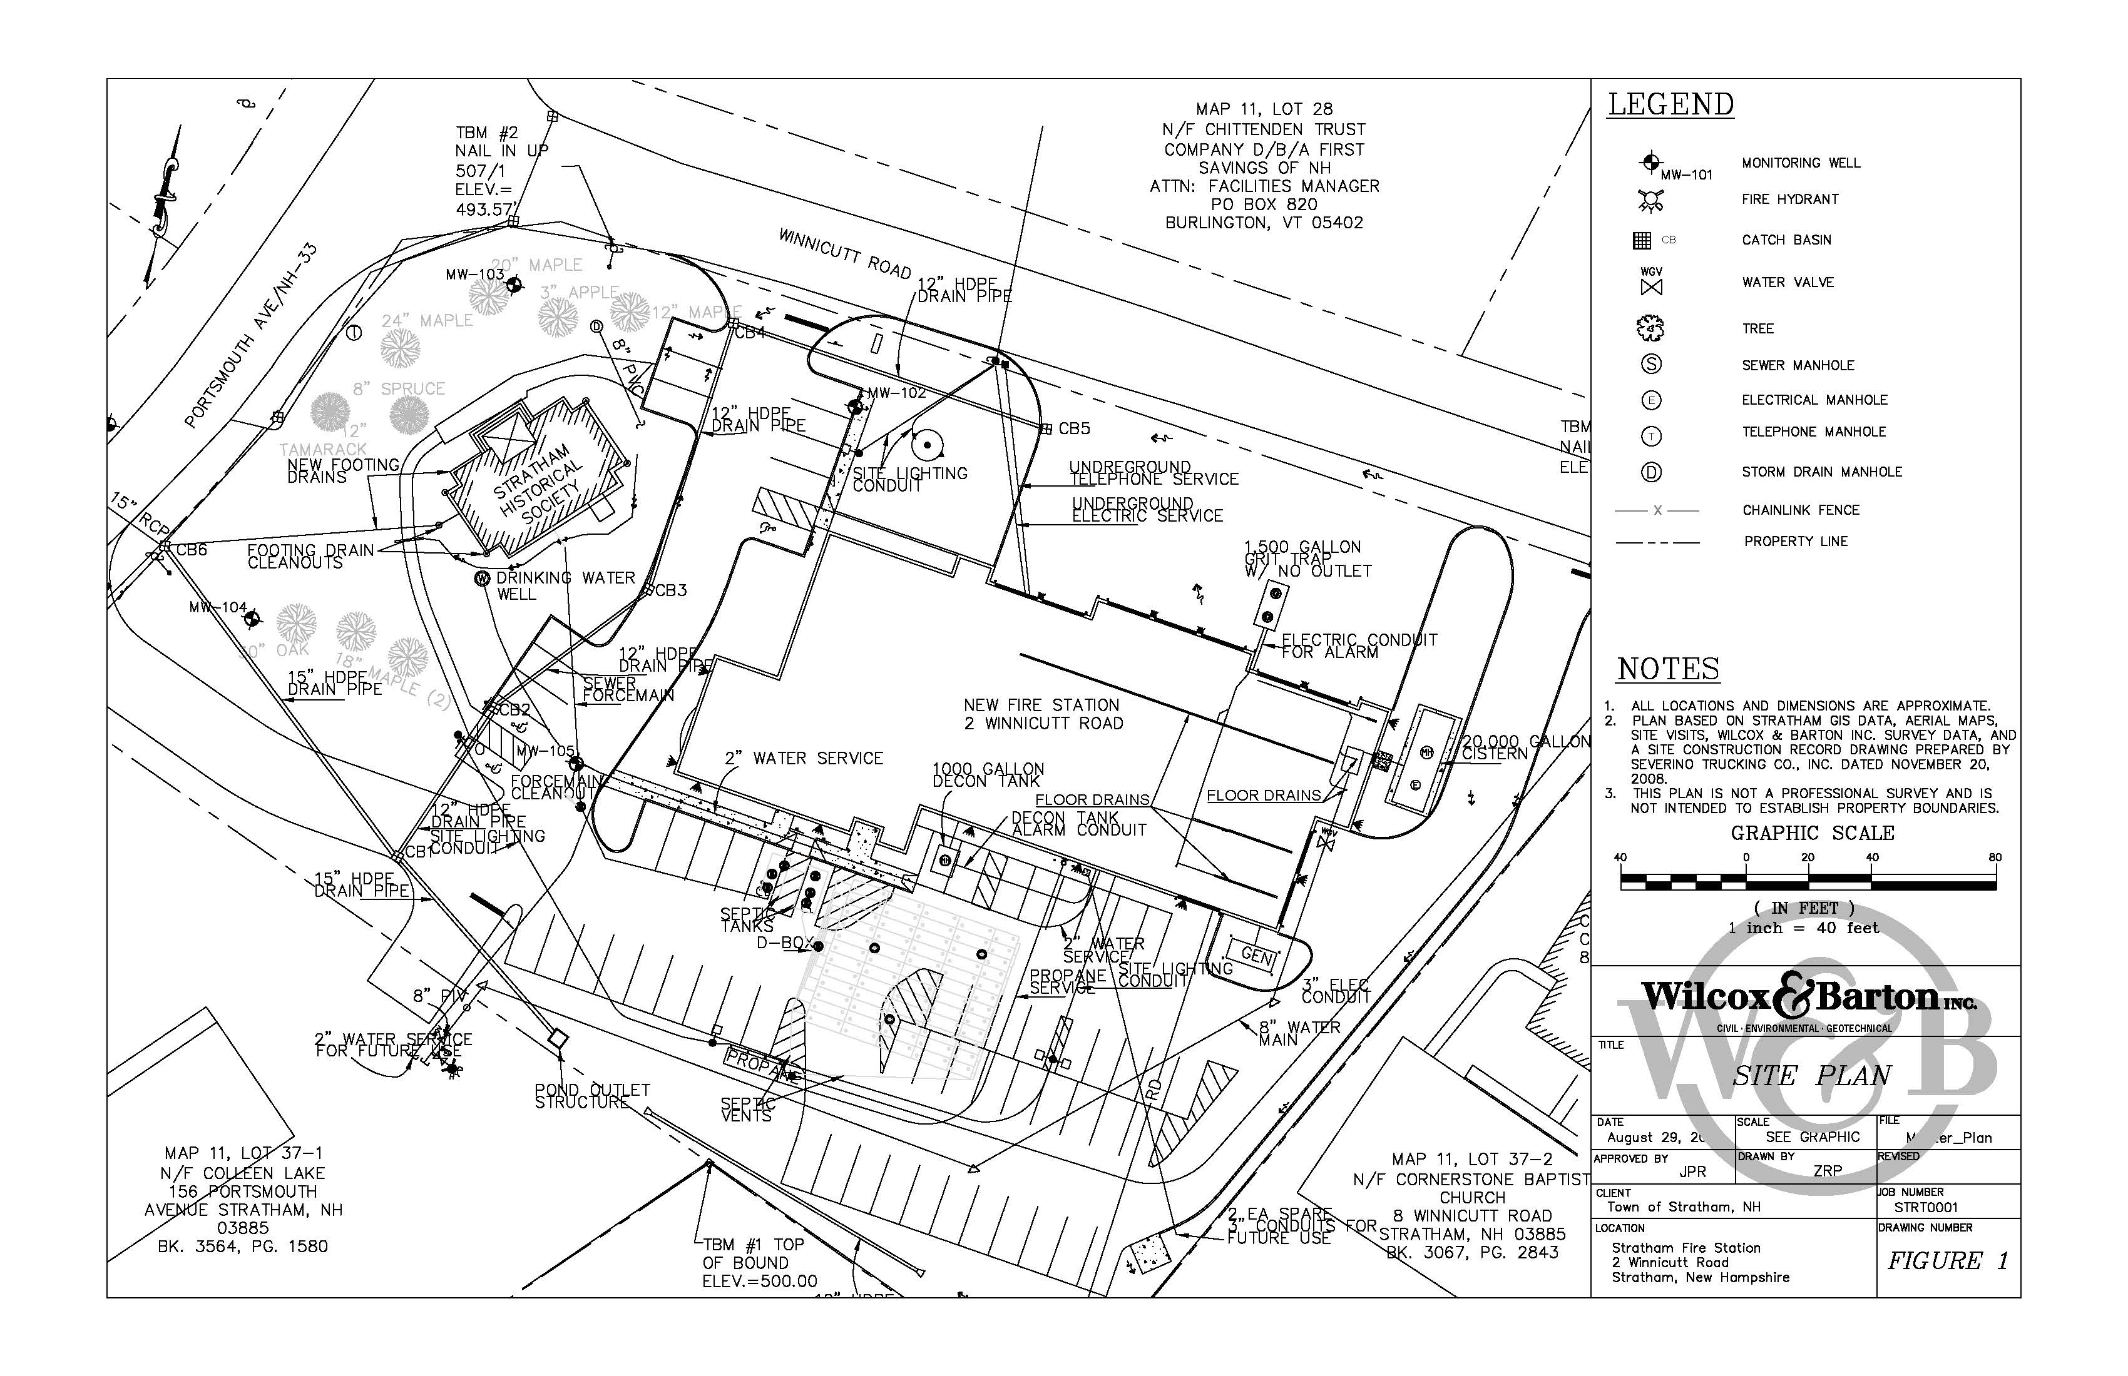

Slide 15
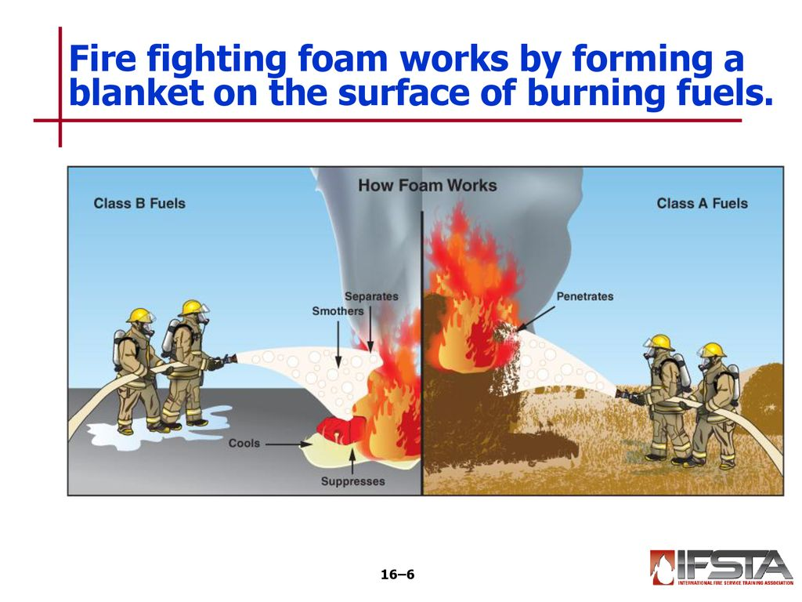
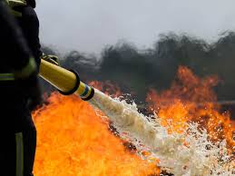
Before we continue…
Use of Class B fire-fighting foams…everywhere
SFD use of foam
“Universal Gold”
EA-500 (fluorine-free)
Construction of new Fire Station

Slide 16
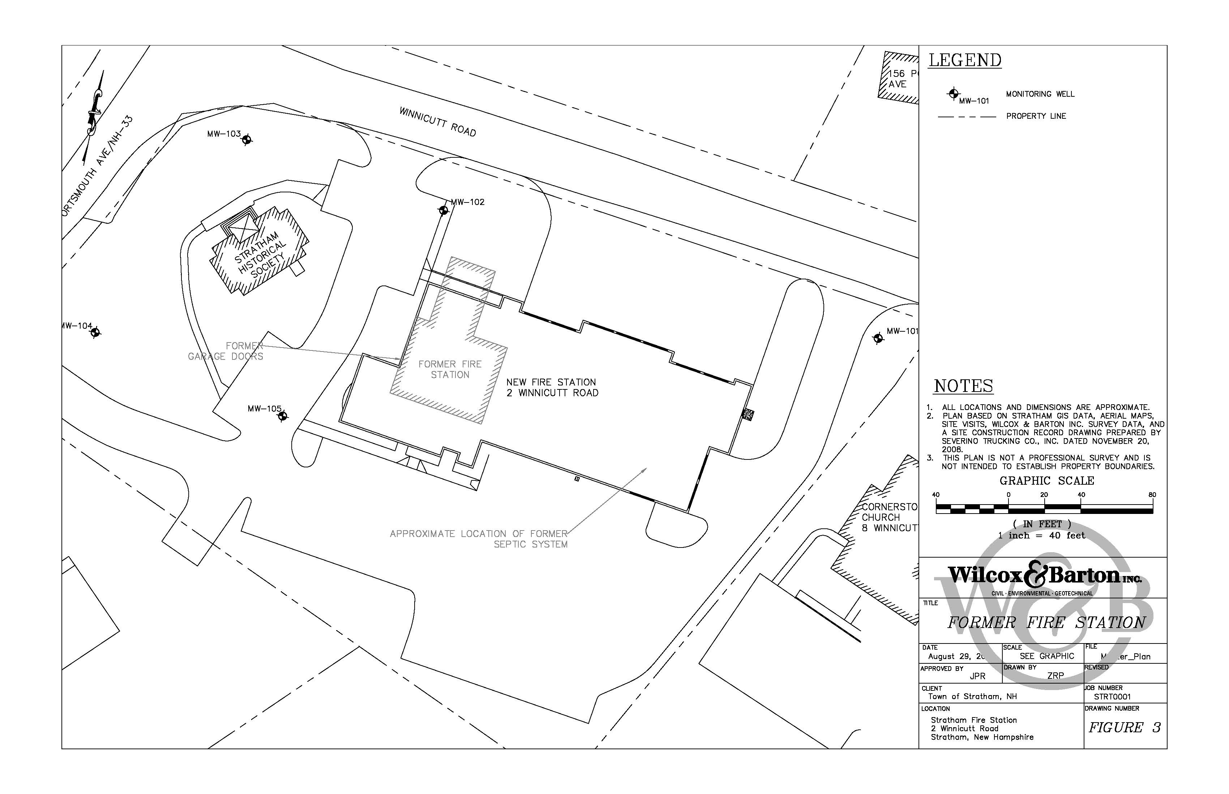

Slide 17
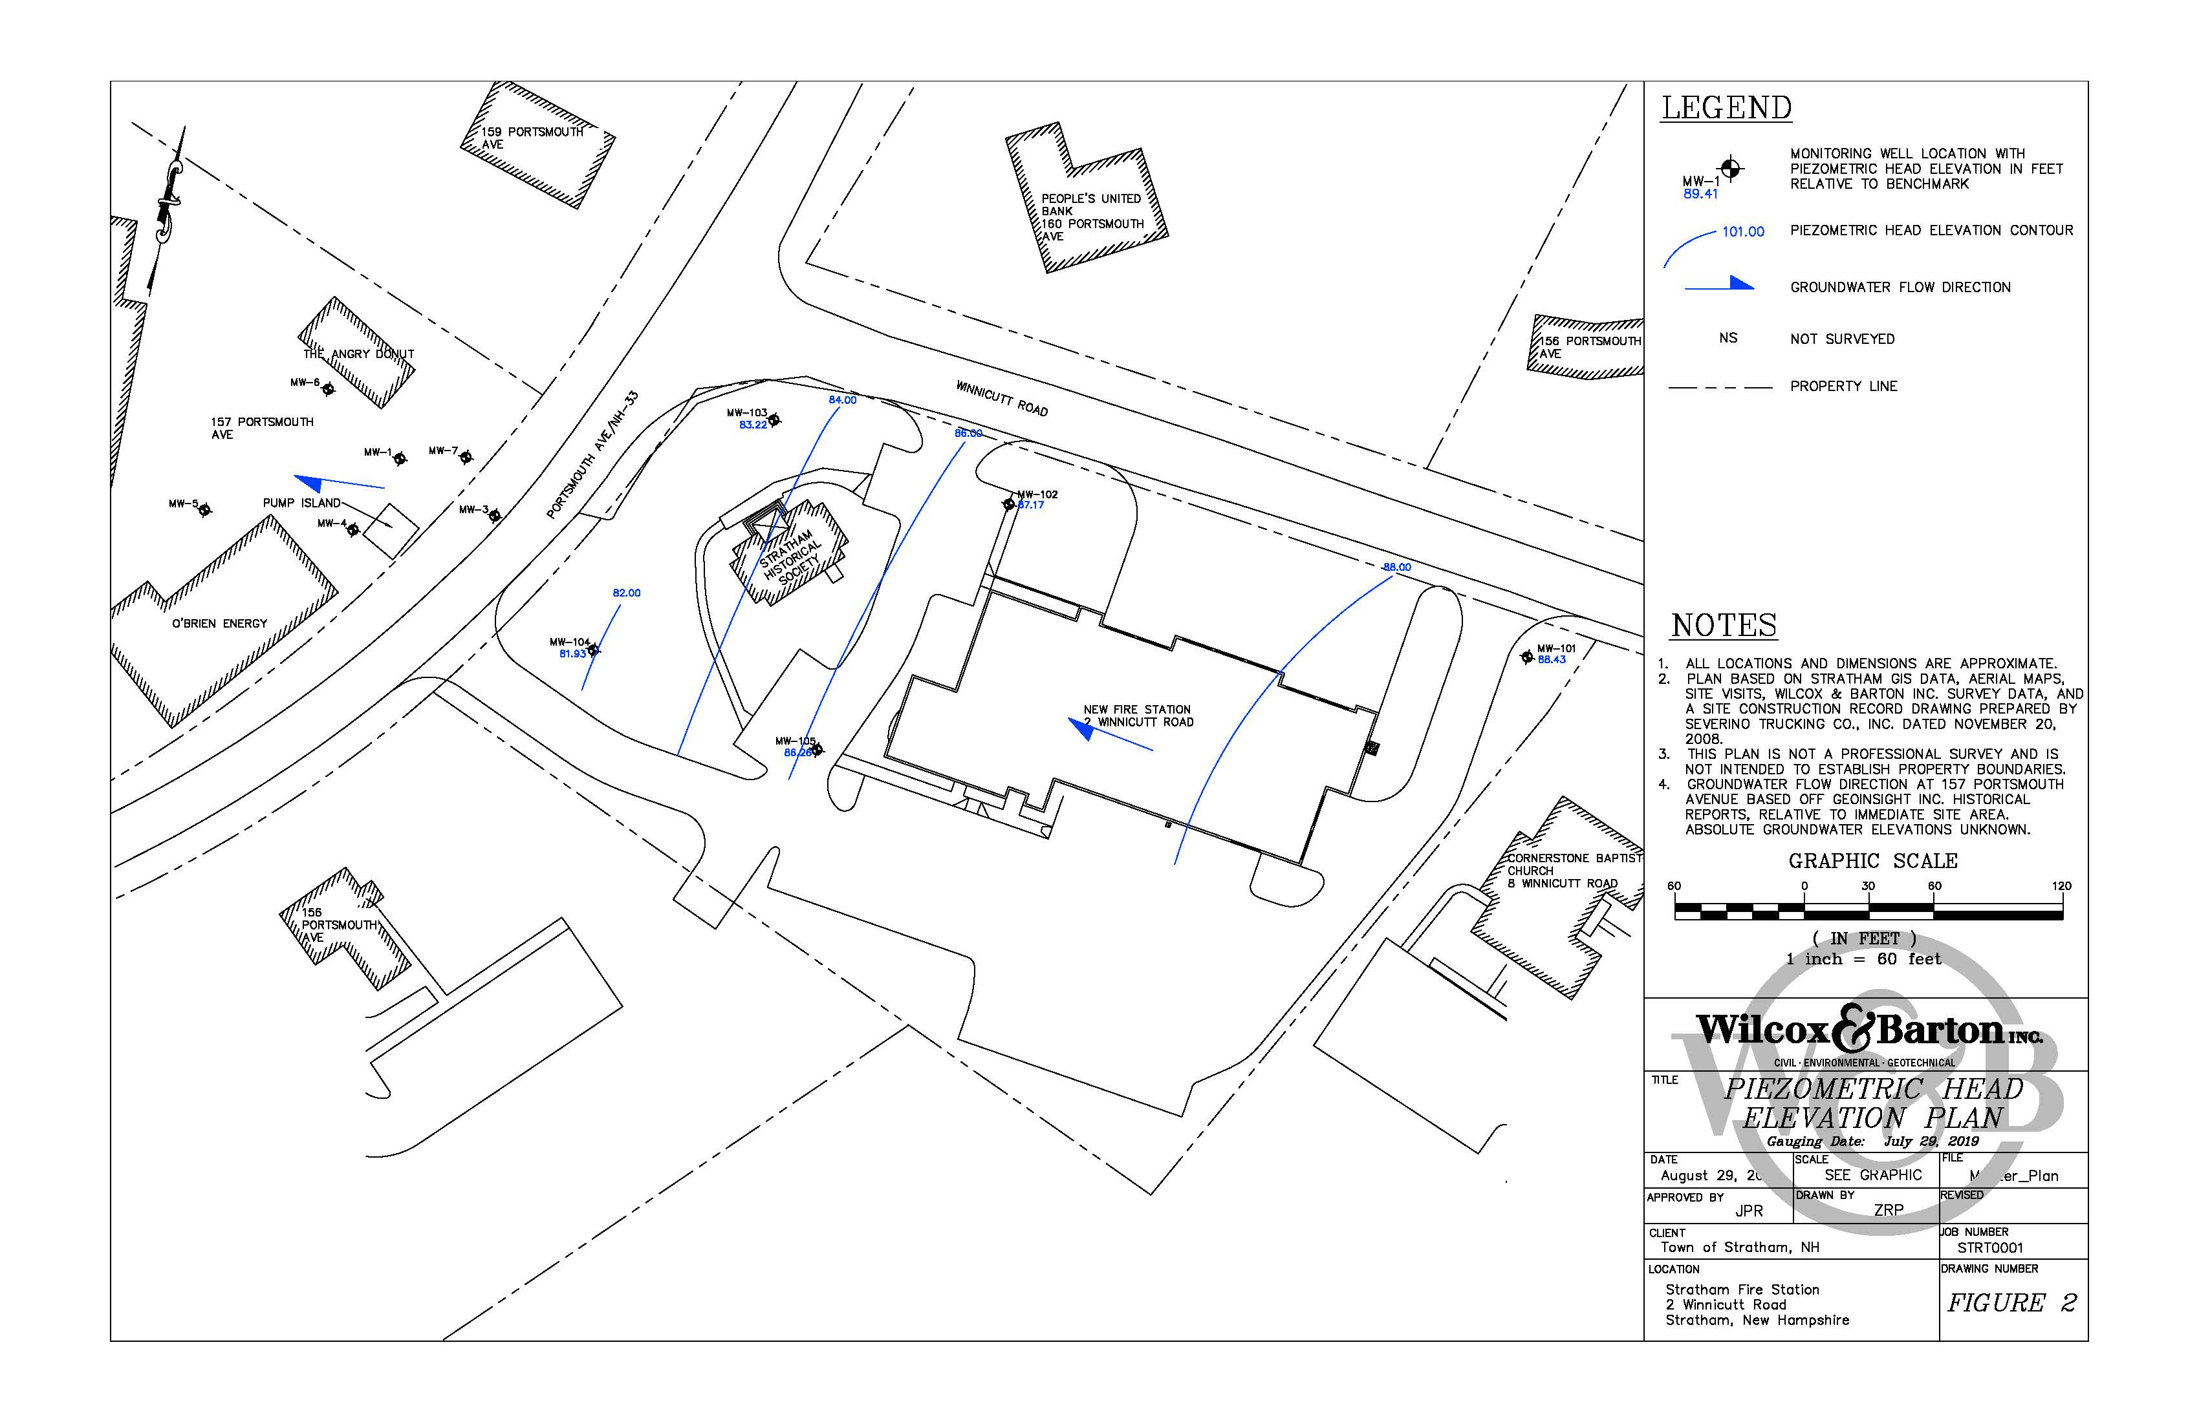

Slide 18
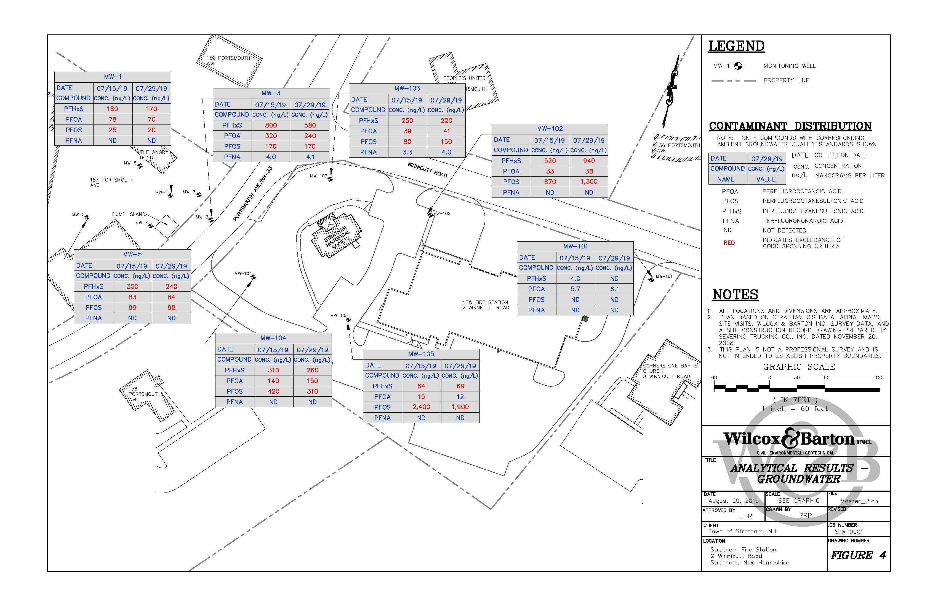
AGQS
PFHxS: 18 ppt
PFOA: 12 ppt
PFOS: 15 ppt
PFNA: 11 ppt

Slide 19
GW Flow

Slide 20
Stratham Municipal Landfill
25 Union Road
PFAS sampling included in May 2018 monitoring event
  Included one MW and two homeowner wells
    PFOA, PFOS >AGQS; PFHxS >current AGQS in MW
    No detections in homeowner wells
Additional PFAS testing in May 2019
  Included four MWs and three homeowner wells
    PFOA, PFOS, PFHxS >AGQS in two of the four MWs
    No detections in homeowner wells

Slide 21
What’s Next?
Focused Site Investigation Report to NHDES end of Sept.
NHDES to review findings of the FSI; recommendations?
Town to continue providing bottled water
Continued water supply well testing – “4 quarters rule”?
Evaluate long-term solution for impacted supplies
  Point-of-entry (POE) treatment systems
  Stand-alone water supply well/system?
  Municipal water line extension?
  Many communities are having these discussions (GWDW Trust Fund)
Continue “Best Management Practices” w/r/t/ PFAS foams
Soil sampling?

Slide 22
What’s Next?
Increased focus and investigation of PFAS
May 29, 2019: NH announces lawsuit against PFAS manufacturers
Sept 3, 2019: Gov. Sununu signs bills to ban PFAS
Sept 4, 2019: Denmark bans PFAS in food packaging
Surface Water Quality Standards – 2020
Soil standards? Leachability standards?
Continued evaluation of health risks by state and NHDES toxicologist

Slide 23

Thank you
James P. Ricker, P.G.
Wilcox & Barton, Inc.
Questions?

