Slide 1
NHRS: Past, Present & Future

Slide 2
Past – 1967: In the beginning…
RSA 100-A enacted, establishing NHRS
Consolidates four separate plans for teachers, police officers, firefighters and employees of the state and political subdivisions
Creates Group I for teachers and employees and Group II for police officers and firefighters, each with its own benefit structure
State pays 40% of employer contributions on behalf of teachers

Slide 3
Past – 1977: The Employer Subsidy
State reduces employer contribution subsidy for teachers to 35% from 40%
State creates 35% employer contribution subsidy for police officers and firefighters employed by political subdivisions
Subsidy remained in place until it was reduced beginning in 2009 and then eliminated in 2011

Slide 4
Past – 1983: Heads I win, tails you lose
Legislature creates Special Account to fund future COLA and OPEB benefits
Funded by ‘excess earnings’ – or ‘gain-sharing’ – when investment return exceeded the assumed rate of return by a set percentage
Subsequently determined to be in contravention of the Internal Revenue Code as it shifted funds from the pension trust and contributed to a structural unfunded liability

Slide 5
Past – 1984: A Granite (State) Foundation
NH Constitution amended (Part I, Article 36-a)
Establishes that pension funds are for the exclusive benefit of NHRS members and are not to be diverted for any other purpose
Requires Trustees to set actuarially sound employer contribution rates and employers to pay the rates in full
Distinguishes NHRS from many systems where annual funding level is at the discretion of the legislature (e.g. Illinois, New Jersey, Kentucky)

Slide 6
Past – 1985: Autonomy from the State
NH Supreme Court rules in Sununu v NHRS
Issue: Whether or not NHRS contracts had to be approved by the Governor & Executive Council
Decision: NHRS is not an Executive Branch agency and operates for the exclusive benefit of its members – largely taking retirement system management and administration out of the political realm

Slide 7
Past – 1991: Digging the Hole
Following an actuarial valuation in 1989 which indicated a dramatic increase in unfunded liability from $3.9 million to $217.5 million, the legislature in 1991 adopts the ‘Open Group Aggregate’ actuarial method and sets the assumed rate of return at 9.75%, both done for the purpose of reducing employer contribution rates
Infringement of Board’s fiduciary duty to set actuarially sound rates
Resulted in artificially depressed employer contribution rates from 1991 to 2009

Slide 8
Past – 2007: The Great Awakening
Legislature replaces Open Group Aggregate with ‘Entry Age Normal’ actuarial method and creates 30-year amortization of liability to begin in FY 2010
Unfunded liability is determined to be $2.4 billion
Funding for Special Account limited
Legislature creates HB 876 Commission to examine all aspects of the retirement system; the first ‘Decennial Commission’

Slide 9
Past – 2008: Rebuilding the Foundation
Legislature enacts HB 1645
Establishes Independent Investment Committee
Transfers $250 million from Special Account to Pension Trust
Changes method of funding the Medical Subsidy and freezes the 8% escalator for four years
Revises definition of earnable compensation
Followed by litigation; AFT v State of NH

Slide 10
Past – 2009: Unfunded Mandate?
Legislature reduces subsidy to political subdivisions for teacher, police officer and firefighter employer contributions from 35%, to 30% in FY 10 and 25% in FY 11
Followed by litigation in 2010; City of Concord v State of NH
Legislature in 2011 repealed subsidy entirely and provided one-time $3.5M appropriation

Slide 11
Past – 2011: Back to the Drawing Board
HB 2 enacted
Increases contribution rates for all members by 2% - 2.5% of payroll
Changes benefit provisions for some current members and all future members by:
Increasing retirement ages and reducing benefit formulas for non-vested and future members
Amending definition of earnable compensation
Increasing AFC from 3 to 5 years for some members
Limits on working after retirement
Changes the composition of the Board of Trustees
Followed by litigation; PFFNH v State of NH (1&2)

Slide 12
Past – 2012-2016: The Court Speaks
NH Supreme Court decides in favor of the State of NH in four separate cases
Against the City of Concord in its claim that eliminating the employer contribution subsidy was effectively the imposition of an unfunded mandate
Against PFFNH (1&2) and AFT in their claims that increasing member contributions, revising the definition of earnable compensation, and eliminating or reducing benefits represented an unconstitutional breach of contract rights
Adopts, for the first time, the ‘unmistakability doctrine’

Slide 13
Past – 2017: Decennial Commission Redux
Decennial Commission meets for several months and generates recommendations, some of which are subsequently the basis for legislation
Revisions to Working After Retirement provisions, limiting the number of hours that can be worked and simplifying the approach
Adoption of layered amortization, a mechanism to reduce volatility by amortizing future asset gains or losses over 20-year periods
One-time $500 retiree payment
Increasing terms of NHRS Trustees from 2 to 3 years, mitigating turn-over and creating more continuity

Slide 14
Past – 2017: Decennial Commission Redux
Decennial Commission also hires the Center for Retirement Research at Boston College to assess NHRS, which found:
NHRS uses among the most conservative assumptions for mortality and rate of return in comparison to other large state and local plans
NHRS investment returns exceed most other plans
NHRS benefits are modest compared to other plans
Total government costs for NHRS was about 15% of payroll compared to a national average of about 18%
UAAL growth since 2007 was driven by losses in great financial crisis, level-percent amortization, and reductions to assumed rate of return

Slide 15
Present – Most Recent Facts & Figures
As of 11/1/21
$11.5+ billion in Assets
29.4% investment return in FY 2021
13 years into a 30-year amortization
As of 6/30/20
Unfunded Liability: $6 Billion; Funded Ratio: 61.0%
48,479 members
39,612 benefit recipients
$860 million in annual pension and medical subsidy benefits; Nearly 80% of recipients live in NH

Slide 16
Present – Most Recent Facts & Figures

Slide 17
Present – Most Recent Facts & Figures
6/30/21 is unaudited

Slide 18
Present – Most Recent Facts & Figures
Funded ratio relative to peers – FY 2010-19
Denotes reduction to assumed rate of return
Source: NASRA, Nov. 2020

Slide 19
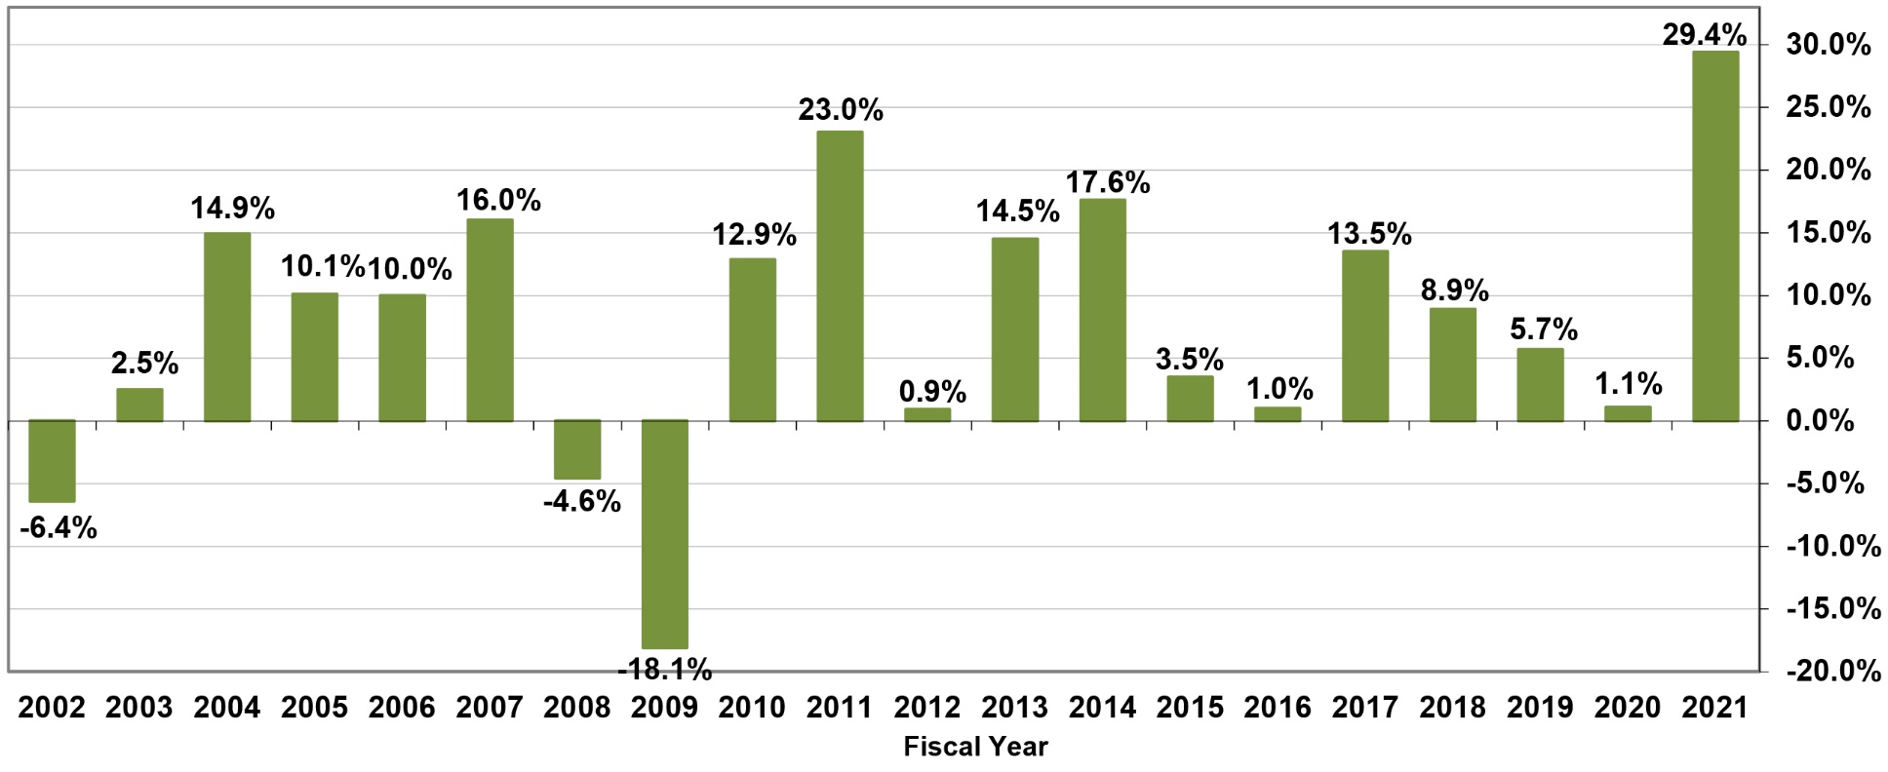
Present – Most Recent Facts & Figures
20-Year Investment Performance

Slide 20
Present – Most Recent Facts & Figures
Member Category | Pension: Normal Cost | Pension: UAAL | UAAL as a % of Total Pension Cost | Medical Subsidy | Total Employer Rate
Emp. – State | 2.58% | 11.17% | 81.2% | 0.78% | 14.53%
Emp. – P. Sub. | 2.58% | 11.17% | 81.2% | 0.31% | 14.06%
Teacher | 2.82% | 16.66% | 85.5% | 1.54% | 21.02%
Police | 6.72% | 23.95% | 78.1% | 3.21% | 33.88%
Fire | 7.07% | 22.71% | 76.3% | 3.21% | 32.99%
Member Contribution Rates: Employee/Teacher: 7%; Police: 11.55%; Fire 11.8%
Member share of normal cost: Employee: 73%; Teacher: 71%; Police: 63%; Fire: 63%

Slide 21
Present – What’s Important
NHRS has a constitutional and statutory foundation which is designed to protect its financial future
Constitutional protections of Part I, Article 36-a assure that contribution rates are actuarially sound and paid by employers; and, that the pension trust is used solely for the benefit of NHRS members
Statutory provisions of 100-A have been amended to address structural issues which undermined the financial security of the system

Slide 22
Future – Paying down the UAAL
GRS

Slide 23
Future – Paying down the UAAL
 | Maine PERS | NHRS
Participants | Teachers & State Employees | Employees, Teachers, Police, Fire
Active Members | 40,395 | 48,479
Retirees/Beneficiaries | 37,151 | 39,612
Average Pension | $23,143 | $20,841
State Constitution | Requires normal cost to be funded on a sound actuarial basis; new unfunded liabilities funded over 20 years (layered); any benefit improvements must be fully paid for in the year they are passed | Requires employer contribution rates be based upon sound actuarial valuation and practice and paid in full
Amortization of UAAL | 31-year closed (1997-2028); Layered 20-year amortization of new gains and losses beginning in FY 97 | 30-year closed (2010-2039); Layered 20-year amortization of new gains and losses beginning in FY 19
Actuarial Method | Entry Age Normal | Entry Age Normal
Assumed rate of investment return | 6.75% | 6.75%
Funded Ratio at start of amortization period | 51% (FY 96) | 57.4% (FY10)
FY 2020 Funded Ratio | 82.4% | 61.0%

Slide 24
Future – Issues to Watch
Legislative
Benefit changes
COLA
Alternative retirement plans
Economic
Assumed rate of return
Short- and long-term market outlook
Interest rates/Inflation
Demographic
School-age population
‘Graying’ of NH

Slide 25
Questions?

