Slide 1
2019 Revaluation/Statistical Update

Slide 2
The following is a general outline and explanation of each phase of the project.
The project will be conducted by Town Assessor, Andrea Lewy and temporary staff Christine Murdough, both Certified New Hampshire Assessors.

Slide 3
There are four major phases to a Revaluation/ Statistical Update that are being utilized.
Market Analysis
Valuation
Field Review
Informal Hearings

Slide 4
PHASE 1: MARKET ANALYSIS
A variety of resources are used to analyze the real estate market.
Information gathered from the Rockingham County Registry of Deeds, property managers, developers, and local real estate professionals.

Slide 5
PHASE 1: MARKET ANALYSIS
Appraisal personnel will be analyzing each qualified sale that took place since April 1, 2017 through March 31, 2019, to determine which market factors influenced property values.
An inspection of the exterior of the sale properties will be conducted and if possible an interior inspection as well.

Slide 6
PHASE 1: MARKET ANALYSIS
Personnel will have proper identification, which includes, a photo ID, business cards, and Stratham’s Town Seal on the side of the car.
Information is also available at the Stratham Assessor’s Office, Assessing website and Stratham’s Police Department.

Slide 7
PHASE 1: MARKET ANALYSIS
Once all the data is collected and reviewed for accuracy, the Assessor will determine land and building values.

Slide 8
PHASE 2: VALUATION
Valuation is done using one of the three recognized methods
Cost Approach
Income Approach
Sales Comparison Approach
The Sales Comparison is the most widely used approach, and most easily explained to the taxpayer. During this phase, individual characteristics of the building are analyzed using information gathered in Phase 1. Each property is compared to other comparable properties with similar characteristics. Then the market value of the improvements is added to the land value that was previously determined. This value is the final estimate for each property.

Slide 9
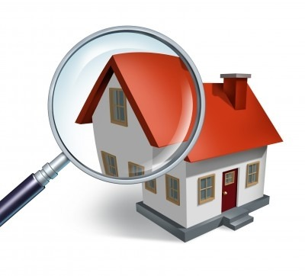
PHASE 3: FIELD REVIEW
Field Review is the method of checking and re-checking both the values that have been determined and the data for accuracy. During this review phase, properties are viewed in the field by the Assessors who double-check for uniformity and accuracy of information

Slide 10
PHASE 4: INFORMAL HEARINGS
Once the Field Review is complete, a notice of “preliminary values” will be mailed to each property owner. At this time, anyone with questions concerning the revaluation process, about the data on their property, or their assessed value will have an opportunity to meet with an Assessors to discuss their questions

Slide 11
After all four phases are completed, all necessary reports, as well as a required manual will be assembled and sent to the Department of Revenue, Property Appraisal Division. After reviewing and verifying the data, a letter will be sent to the Town with their findings.

Slide 12
In addition to the Assessing Department’s field work, the DRA will also be conducting field reviews of certain Stratham properties.
Randomly chosen properties will be identified by the DRA, and owners will be notified in advance for that review process by a yellow postcard.

Slide 13
If you have any questions during this process, please feel free to contact the Stratham Assessing Office at 772-7391 ext. 184
or if you prefer email:
alewy@strathamnh.gov
jjoseph@strathamnh.gov

Slide 14
Thank You!

