Slide 1
Stratham Community Power
Public Hearing
June 22, 2023

Slide 2
Agenda
Introduction for Stratham Community Power Charlie Case
Community Power Coalition of New Hampshire Henry Herndon
Questions and Answers Paul Deschaine

Slide 3
Mission Statement
Develop an Electric Aggregation Plan in accordance with RSA 53-E
The plan shall be prepared for the Select Board’s consideration to advance to a Town Meeting.
We will introduce what Community Power is and our efforts to develop a plan.

Slide 4
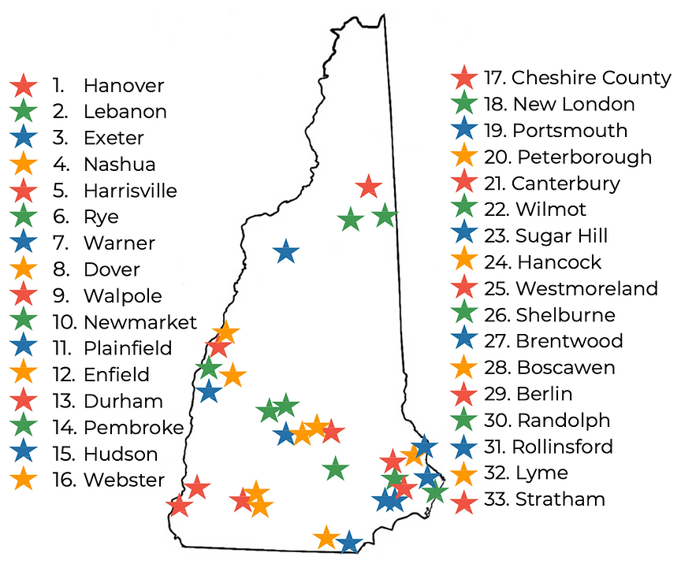
Why Communities are Starting Community Power
Community Power enables cities and towns to:
Lower rates
Local control of energy choices
Choice
Clean Energy
33 counties, cities & towns representing 22% of New Hampshire’s population have started Community Power Programs

Slide 5
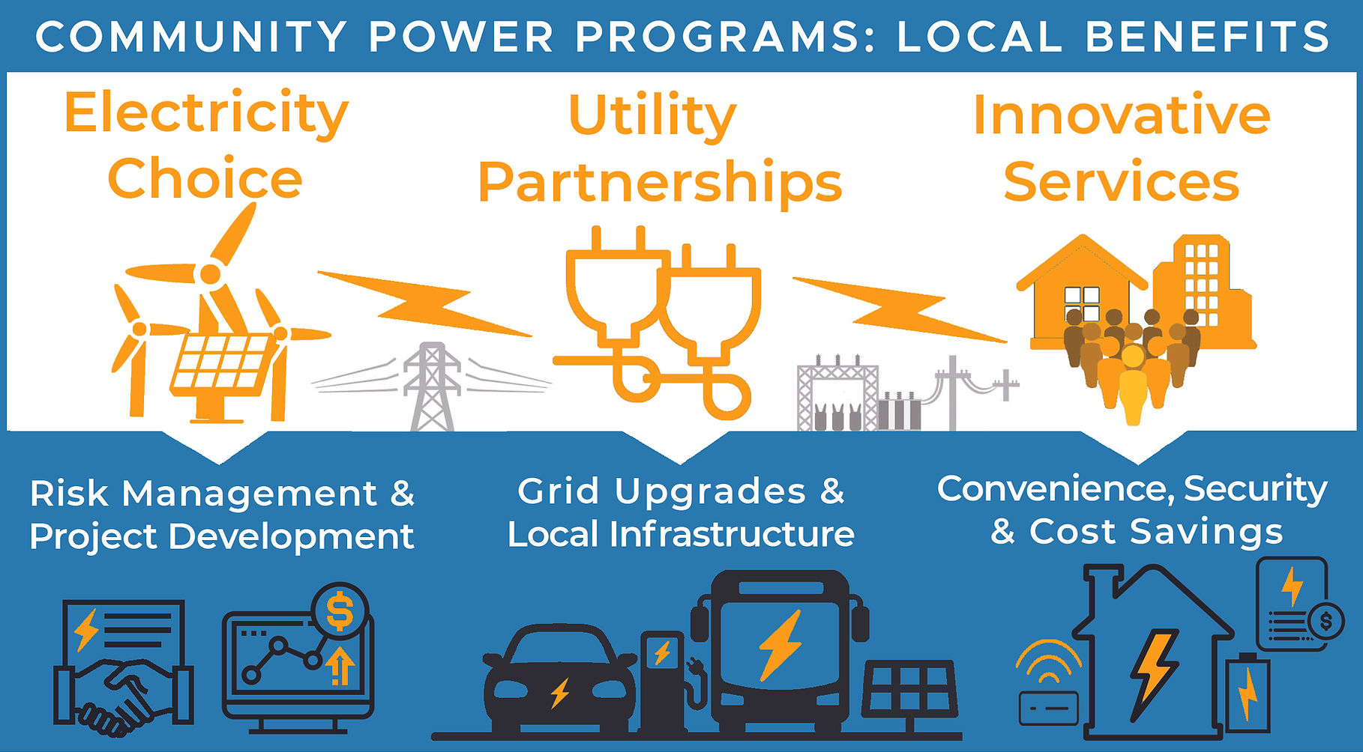
How Community Power Works
No additional cost to Stratham taxpayers.
Customers using Unitil’s default supply will automatically be included, but can opt-out.
If you receive power from an alternate provider, you will not be included unless you opt-in.
Unitil would continue to deliver electricity, maintain the lines and equipment and handle billing.

Slide 6
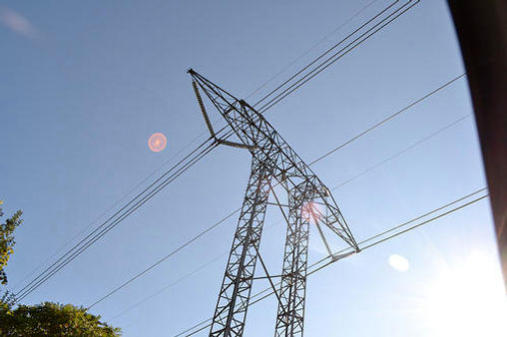
Stratham’s Success With Electricity Aggregation and Solar Power
Stratham is already participating in electricity aggregation through the Rockingham Planning Commission for Town Buildings.
Stratham installed solar power on the police station in 2019.

Slide 7
Stratham Has Reviewed a Variety of Community Power Options
Type of Company Control Help set up Community Power Renewable Power Innovative Solutions
Third Party Brokers For Profit Company No Yes No
Good Energy/Std Power For Profit Company Yes Yes No
Freedom Energy For Profit Company Advisory Yes No
CPCNH Non-Profit Members Yes Yes Yes
CPCNH Offers Advantages to Stratham Over Other Options With Non-Profit Member Control & Long-Term Innovative Solutions

Slide 8
Community Power in New Hampshire
Community Power programs (at least 14 municipalities have started their programs) contract with an energy.
Stratham has joined CPCNH as a member and joins 33 NH counties, cities & towns.
Community Power would allow the Town through an “aggregator” to control the purchase of electricity.

Slide 9
Need Community Feedback on Priorities for Stratham Community Power
Lower Rates
Expanded Choices for Renewable Energy and Other Innovations
Fiscal Stability and Financial Reserves
Consumer Protections
Public Advocacy
Cleaner Local Power
Community Resilience
Regional Collaboration
Risk and Liability

Slide 10
Next Steps
A Community Power Plan must be approved by the Select Board and by a Town Meeting vote
GET INFORMED
GIVE INPUT
VOTE
PARTICIPATE

