Slide 1
Stratham Community Power
Public Hearing: Electric Aggregation Plan
May 25, 2023 | 7:00 PM | Stratham Municipal Center

Slide 2
Table of Contents
1
How Community Power Works
2
Electric Aggregation Plan
3
Community Power Coalition of New Hampshire
4
Implementation Process & Timeline
5
Questions & Discussion
2

Slide 3
What is Community Power?
Community Power programs pool, or aggregate, the demand of customers in a community and purchase electric power on behalf of that community with the goal of lowering costs and expanding access to renewable energy and other innovations.
Community Power programs are enabled by New Hampshire’s updated Community Power law RSA 53-E, Relative to Aggregation of Electric Customers by Municipalities & Counties (enacted as the first in the nation in 1996 and updated in 2019 and 2021).
The Legislature’s intent in enacting RSA 53-E was to “encourage voluntary, cost effective and innovative solutions to local needs with careful consideration of local conditions and opportunities”.

Slide 4
What is Community Power?
New Hampshire cities, towns, and counties can become default electricity provider for their residents + businesses and provide related services.
Pooled Purchasing Power
for Energy Supply
Utility Company
Delivers Power
Communities Benefit from Value Added Services & Programs
Lower Rates & Product Choices
Economies of Scale
Grid Reliability
RSA 53-E, Relative to Aggregation of Electric Customers by Municipalities & Counties
Customers may switch back to utility default supply or take service from a Competitive Supplier
Community Power programs must be paid for out of revenues received from participating customers

Slide 5
Benefits of Community Power
Local
Control
Lower
Costs
Clean
Energy
Resilience & Innovation
Democratizing energy procurement to the community level
Demonstrated lower rates than regulated utilities
Build and buy clean energy
Support more local renewables
New technologies
Market competition
Price signals
Customer empowerment
“Stratham Community Power will only launch if it is able to initially offer residential default rates that are lower than those offered by Unitil.”
(Page 2 of proposed Electric Aggregation Plan)

Slide 6
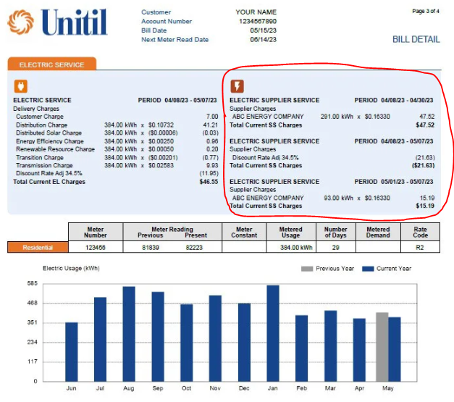
Unitil
Electric Bill:
Supply & Delivery
New Layout
As of April 2023

Slide 7
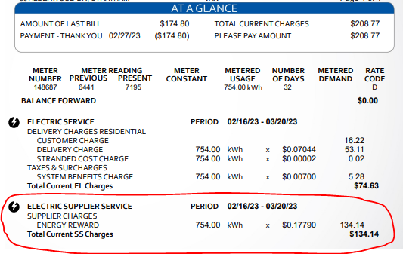
Unitil
Electric Bill:
Supply & Delivery
Old Layout
Prior to April 2023
Supplier
Community Power

Slide 8
Key Points
If/when Your Community Power launches, most Unitil default electric supply customers will be automatically enrolled in the same service for a lower price. Community Power will be the new default electricity supplier for your Town’s customers.
Participation in Community Power is voluntary. Customers can choose to opt-out and to stay with Unitil for electric supply, or shop for another market option.
Unitil will continue to deliver electricity using their poles and wires, provide billing services, and ensure reliability.
Customers shopping with third-party suppliers will remain with their supplier unless they choose to opt-in to Community Power.
Community Power will be self-funded by rates paid by participating customers. No taxes will be used to cover program expenses.

Slide 9
2. The Electric Aggregation Plan

Slide 10
What is the Electric Aggregation Plan?
Select Board establishes a Committee pursuant to RSA 53-E to oversee development of the Electric Aggregation Plan (EAP).
EAP details how the Community Power program will operate and comply with state legal requirements.
There will be two Public Hearings on May 25, 2023 and June 22, 2023 to educate the Community about the Plan and to receive community input.

Slide 11
Purpose of the Electric Aggregation Plan
Defines program goals and objectives
Defines governance; implementation; customer noticing, enrollment, options
Commits Stratham to comply with applicable statutes and regulations:
(a) Providing universal access, reliability, and equitable treatment of all classes of customers;
(b) Meeting, at a minimum, the basic environmental and service standards established by the Public Utilities Commission and other applicable agencies and laws and rules.
The Plan does:
Address issues required to be considered by RSA 53-E including:
How net metering will be provided;
How customers enrolled in the Electric Assistance Program will receive their discount.
The Plan does not:
Otherwise commit the Town to any defined course of action; or
Impose any financial commitment or liability on the Town or its taxpayers.

Slide 12
Electric Aggregation Plan Outline
Chapters:
Appendices:
Introduction
Overview of Community Power
Goals & Objectives
Statutory Requirements
CPCNH
Net Metering
Load Serving Entity Services
Customer Data Protection Plan
Abbreviations

Slide 13
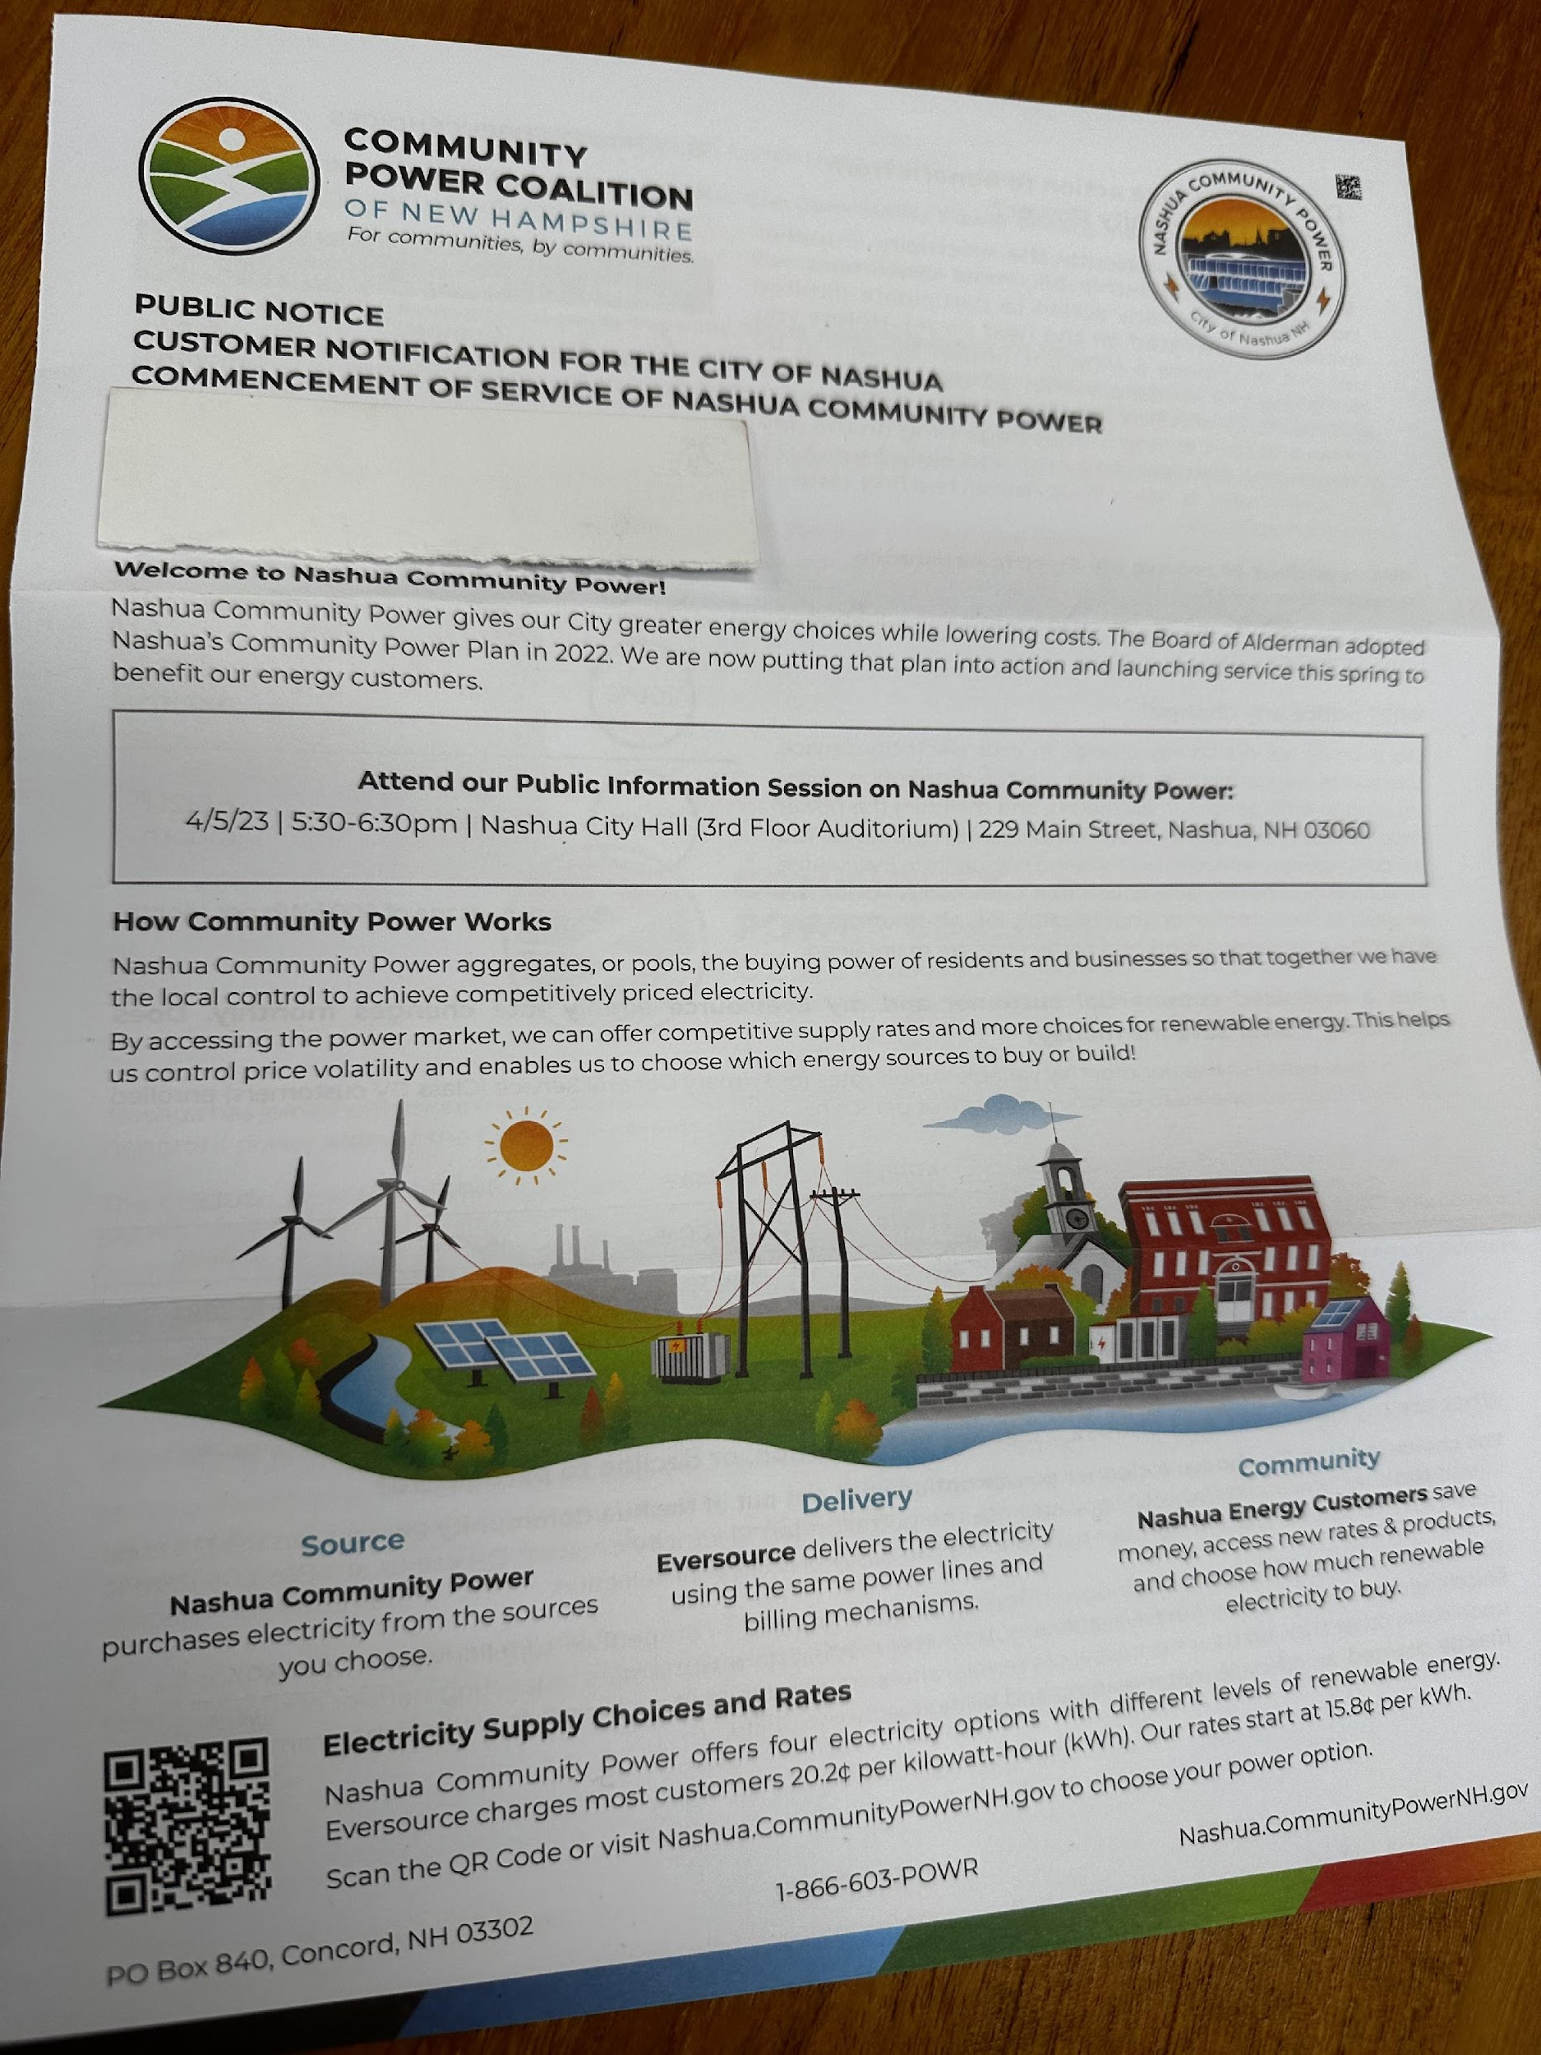
Customer Notification and Enrollment Process

Slide 14
Customer Notification and Enrollment Process
At least 30 days before program launch all electric customers will be mailed notifications that will include the initial fixed rate for Community Power service compared with Unitil.
Customers currently on default energy service provided by Unitil will be able to decline participation or “opt-out” of Community Power by visiting CommunityPowerNH.gov emailing info@CommunityPowerNH.gov, or by calling 1-866-603-7697 (POWR).
If a customer is already getting their power from a competitive supplier, nothing will change unless they choose to switch and “opt-in” to Community Power.
New utility customers will get similar opt-out notices.
All Community Power default service customers will always be able to know the fixed rate at least 30 days in advance and be able to switch supplier at next meter read upon request with no penalty or exit fee.

Slide 15
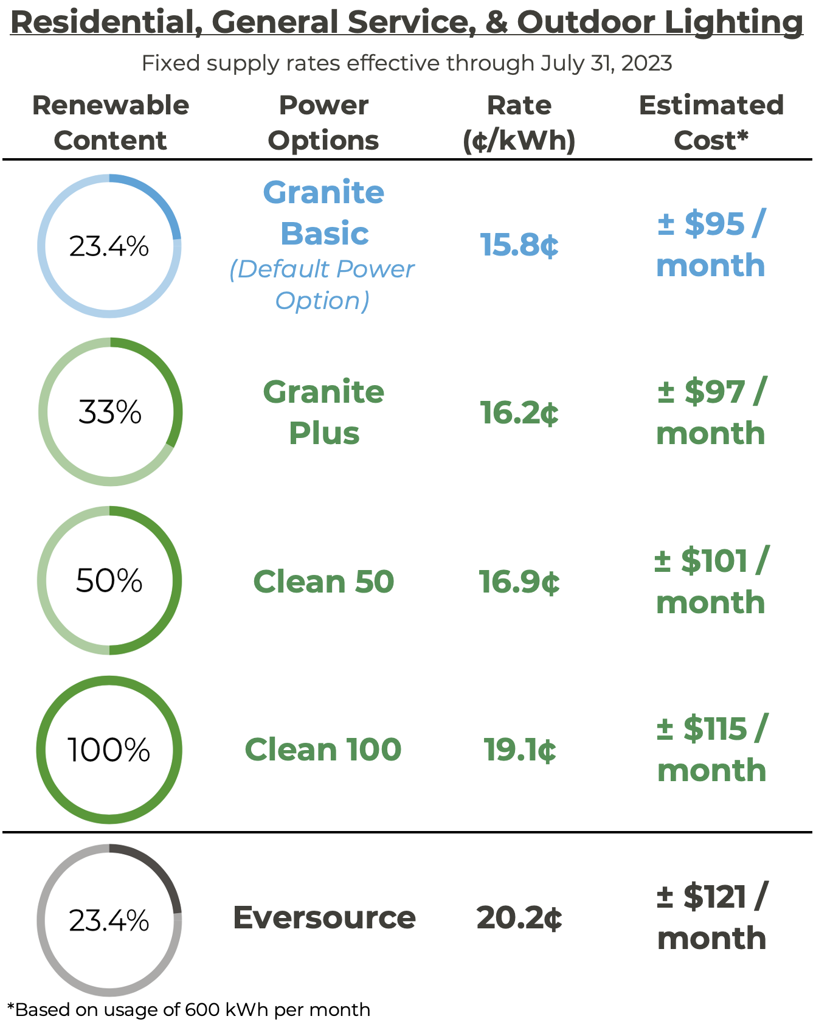
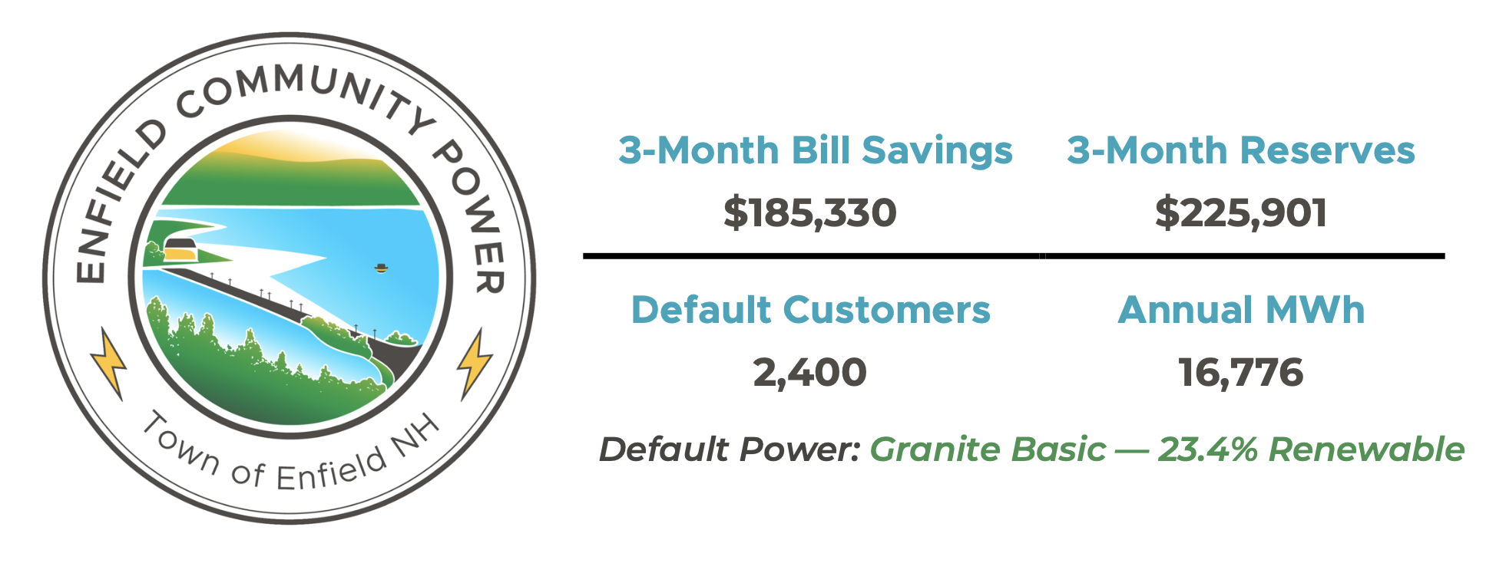
Customer Rates and Optional Products + Example Savings
Savings: $26 / month / customer

Slide 16
3. Community Power Coalition of New Hampshire

Slide 17
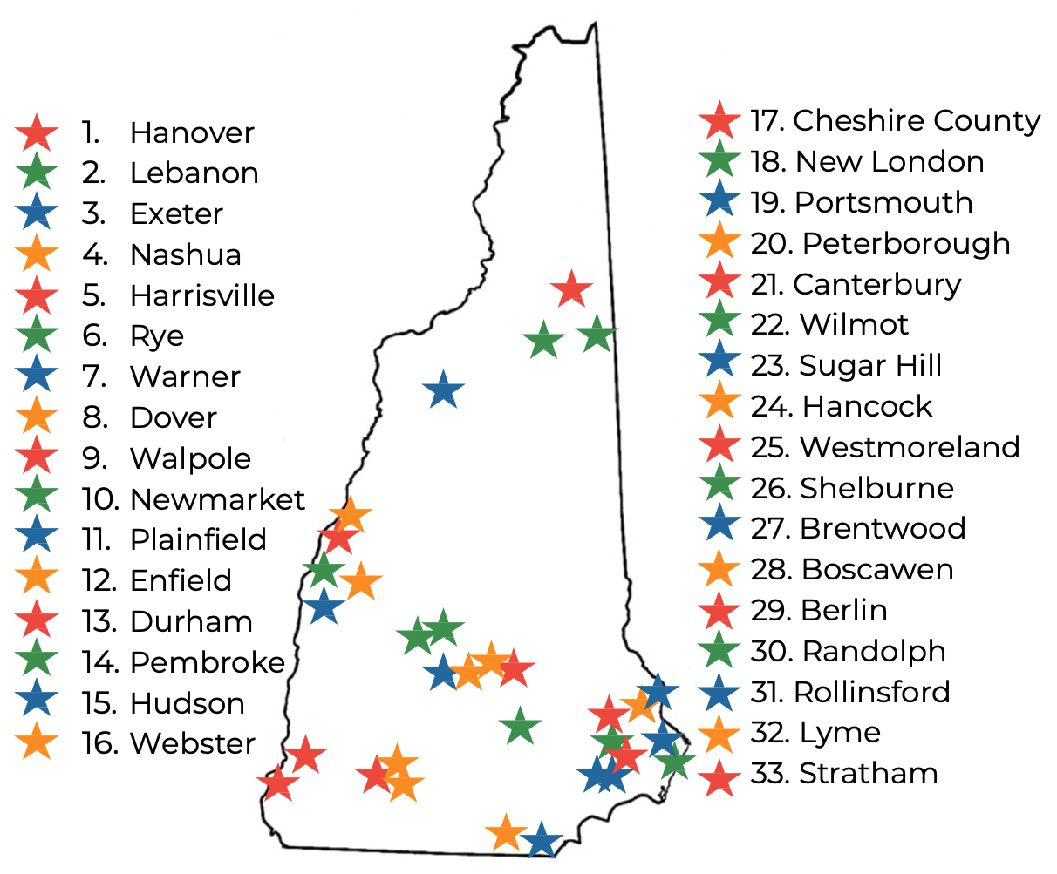
Community Power Coalition of New Hampshire
Community-governed power supplier — launched 1st 12 Community Power programs Spring 2023
Our Mission
To foster resilient New Hampshire communities by empowering them to realize their energy goals.
Nonprofit Joint Power Agency formed 10/1/21
33 Members | 23% of NH population
12 of 33 Members launching 2023
~75,000 customers
~400,000 MWh in 2023 (APR – DEC)
~$51 million 2023 revenues (controlled by communities)
Remaining & new Members to launch 2024+
All New Hampshire cities, towns, and counties are invited to join the Coalition.

Slide 18
Board of Directors:
Community Governance
Local elected officials, former utility executives, energy finance & development professionals, municipal managers, teachers, & much more.
Clifton Below
Lebanon
Assistant Mayor
Kim Quirk
Enfield
Energy Cmte
Kevin Charette
Portsmouth
Energy Advisory Cmte
Evan Oxenham
Plainfield
Energy Cmte.
Kathleen Kelley
Randolph
AVEC
Clyde Carson
Warner
Finance Director
Andrew Hodson
Harrisville
Select Board
Lisa Sweet
Rye
Energy Cmte.
Paul Looney
Walpole
Community Power
Cmte.
Joseph Lamattina
Newmarket
Town Council
Jackson Kaspari
Dover
Resilience Manager
April Salas
Hanover
Sustainability Dir.
Matt Miller
Pembroke
Energy Cmte
Bruce Tucker
Peterborough
Energy Cmte.
Doria Brown
Nashua
Energy Manager
Terry Clark
Cheshire County
Commissioner
Jamie Hess
New London
Energy Cmte.
Nick Devonshire
Exeter
Energy Cmte.
David Hemenway
Webster
Select Board
Steve Holmgren
Durham
Energy Cmte.

Slide 19
Chief Executive Officer: Brian Callnan
Mr. Callnan was selected as most uniquely qualified candidate from nationally competitive search.
Former Vice President of Power Resources & Access at NH Electric Co-op
Managed portfolio of wholesale power contracts to consistently deliver lower rates than investor-owned utilities.
Led Co-op’s “virtual power plants” program, harnessing home batteries & electric vehicles to lower customer power costs.
Previously Director of Power Supply and Transmission at Vermont Public Power Supply Authority

Slide 20
Operated by Expert Contractors
CPCNH is operated by a team of industry-leading advisors and professional service providers experienced in launching and operating Community Power Agencies.
Energy Hedging, Planning &
Portfolio Risk Management
ISO-NE Market Participant
+ Retail Customer Services
Member Services &
Public Engagement
General Counsel & Legal Services
Start-up Consultants
Revenue Controls & Accounting Services
(Coalition in process of enlisting accounting services)

Slide 21
Streamlined CPA Program Implementation
Step-by-step plans, custom logos & websites, FAQs & community outreach materials (etc.)
www.CommunityPowerNH.gov

Slide 22
Implementation Process Steps
Form Committee 🡪 Research & Planning 🡪 Town Meeting 🡪 Launch!
1. Form Committee & Join Coalition “Joint Powers Agency”
Select Board voted to join CPCNH on March 24, 2023
Select Board established Committee on December 19, 2022
2. Electric Aggregation Committee | Research & Planning
Committee conducted research and drafted “Electric Aggregation Plan”
Public hearings to collect community input
3. Town Meeting | Warrant Article
Town Meeting adoption of EAP authorizes (but does not require) the Select Board to contract for services to finance, launch, & operate Community Power.
4. Launch!

Slide 23
Questions & Answers
https://www.strathamnh.gov/energy-aggregation-committee
www.cpcnh.org
CommunityPowerNH.gov

