Slide 1
Safe Routes to School
Enabling and encouraging students in kindergarten through 8th grade to safely walk and/or ride bicycles between home and school.
Applies to the area within two miles of school.
Includes children with disabilities.

Slide 2
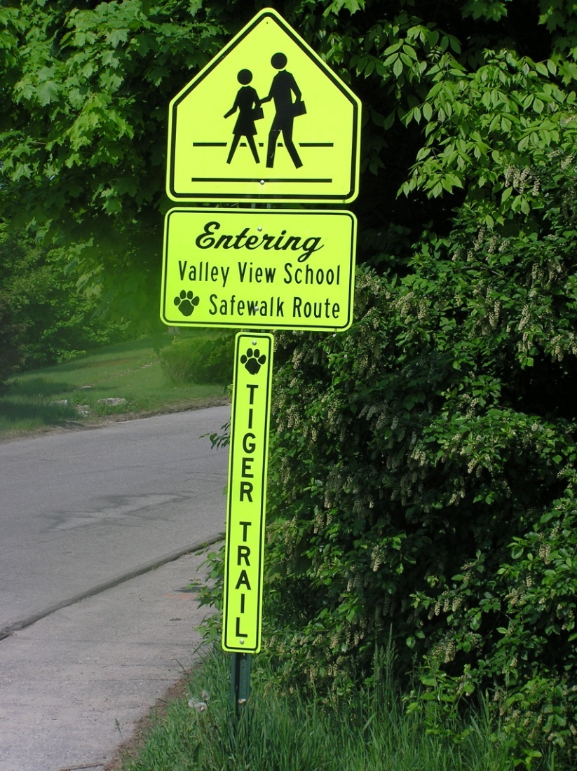
Safe Routes to School
First word is “Safe.”
Physical fitness.
Reduced congestion.
Clean air.
A fun way to get to school.

Slide 3
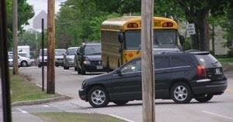
The Problem is Obvious
Too Many Private Vehicles
School Buses Are Not the Issue: Public Transportation for School Systems

Slide 4
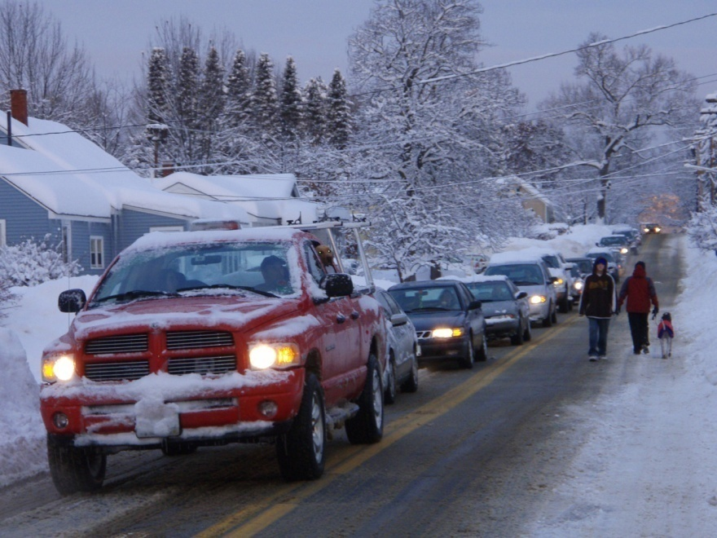
Too Much Congestion
No place to safely walk or ride a bicycle

Slide 5
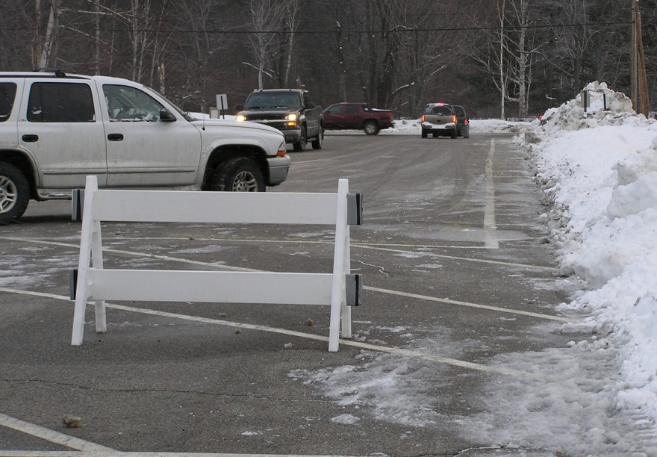
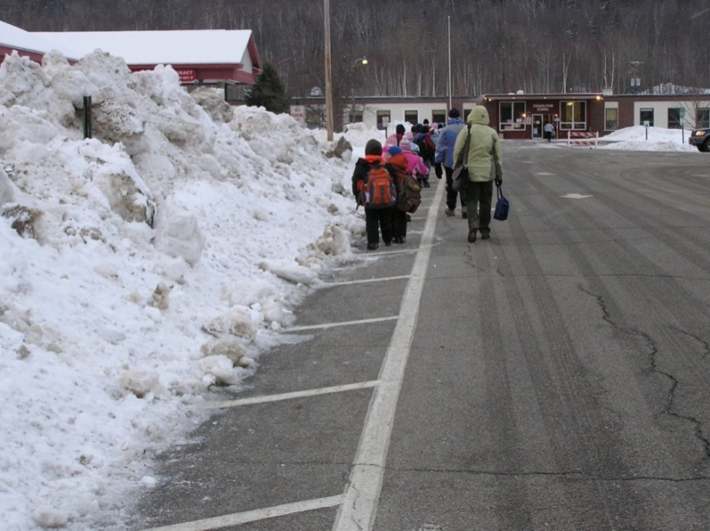
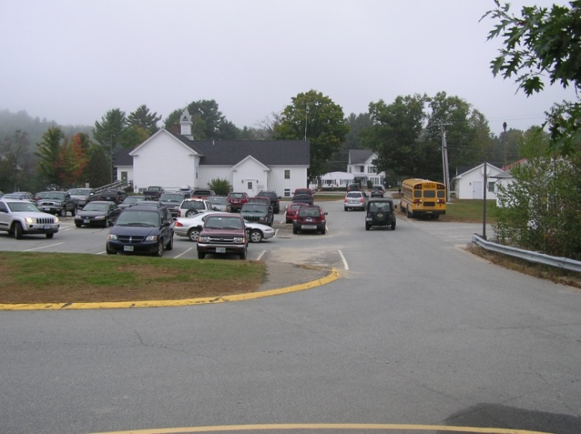
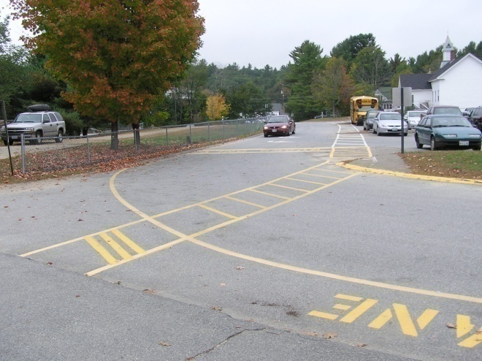
Conflict Between Traffic and Arriving Walkers and Cyclists on School Grounds

Slide 6
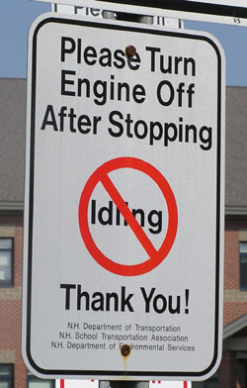
Environmental Consequences

Slide 7
Serious Health Consequences for a New Generation of Children

Slide 9
Is it Safer to Drive Kids to School?
Motor vehicle crashes are the leading cause of death among children ages 3 to 14

Slide 10
Safe Routes to School:
Part of the Solution
Getting Kids Outside and Active

Slide 11
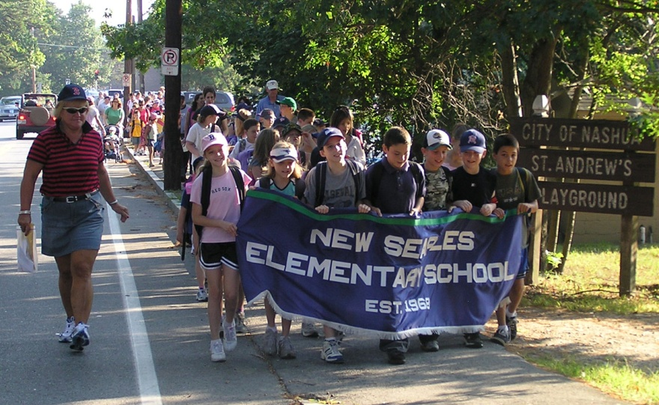
Background
A federal program administered by the N.H. Department of Transportation.
SAFETEA-LU (Safe, Accountable, Flexible, Efficient Transportation Equity Act: A Legacy for Users). Now FAST Act.
Currently 100 percent reimbursement for local projects. Drops to 80 percent under FAST Act.
About $8 million to be awarded.

Slide 12
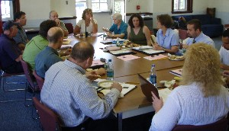
SRTS Task Force
Identify barriers and craft solutions.
Develop broad community support and involvement.
Schools, municipality, parents, children, organizations.

Slide 13
The 5Es
Evaluation
Education
Encouragement
Enforcement
Engineering

Slide 14
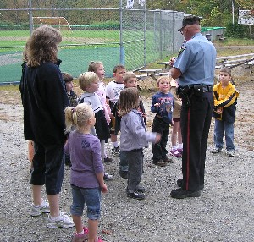
Non-infrastructure
Surveys
Pedestrian and bicycling safety education
Encouragement programs
Motorist education and enforcement

Slide 15
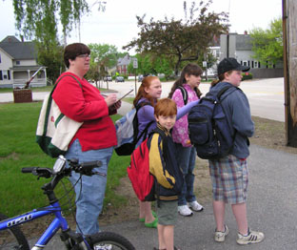
Evaluation
First step: In-class and parental surveys.
Web-based system for national database.
Map “connects the dots” between neighborhoods and schools.
Identify potential and existing safe routes.
Walkability and bikeability observations to confirm.
Surveys repeated to determine effectiveness of program.

Slide 16
Education
How do children develop the skills to safely navigate their home neighborhoods?
Training in pedestrian and bicycling safety.
Younger children need to learn to look left, look right, look left.
Teach young cyclists the “rules of the road” before they take driver’s education.

Slide 17
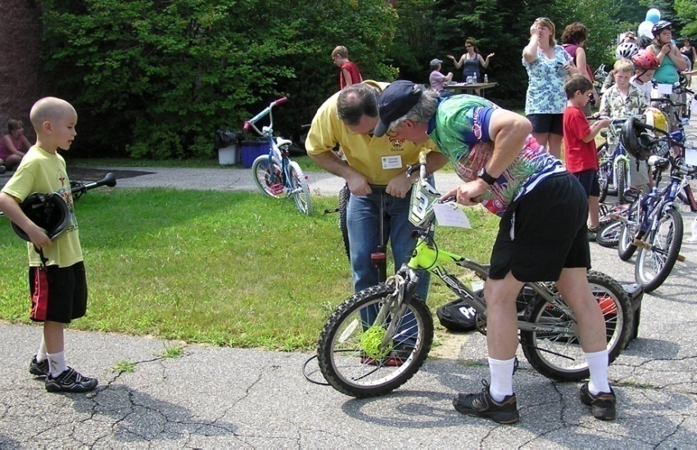
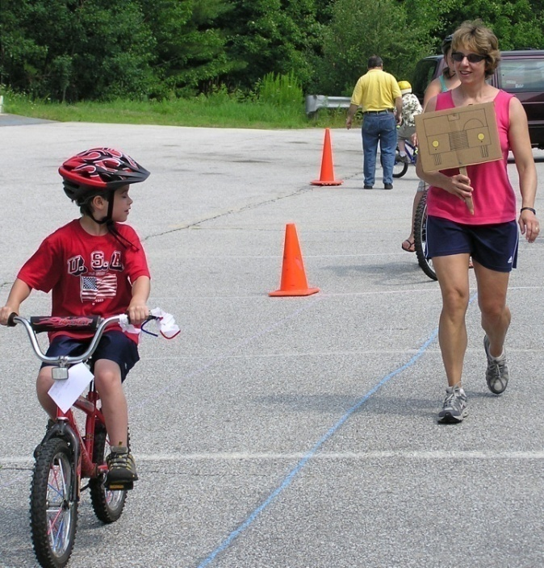
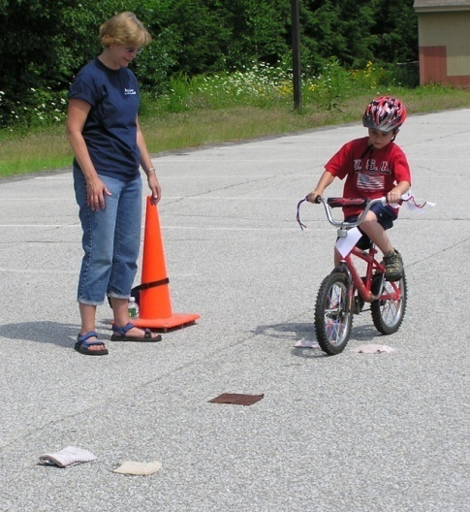
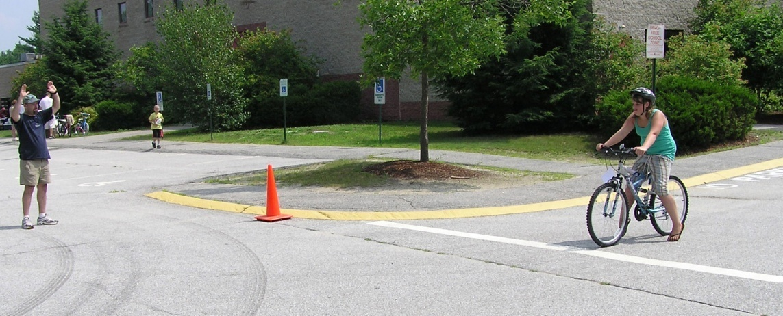
Bike Rodeos

Slide 18
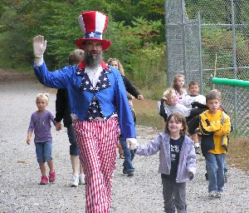
Encouragement
School and community programs to support walking and bike riding.
School assemblies.
Walking and riding clubs with small rewards.

Slide 19
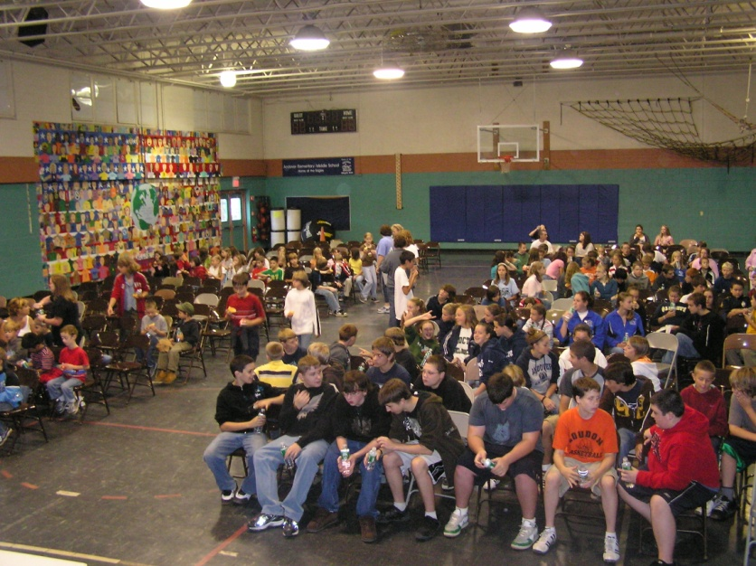
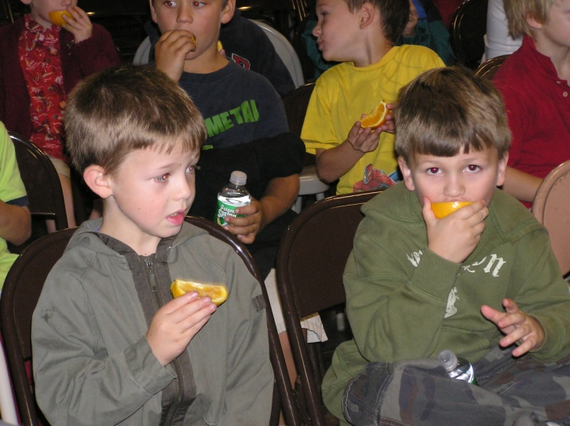
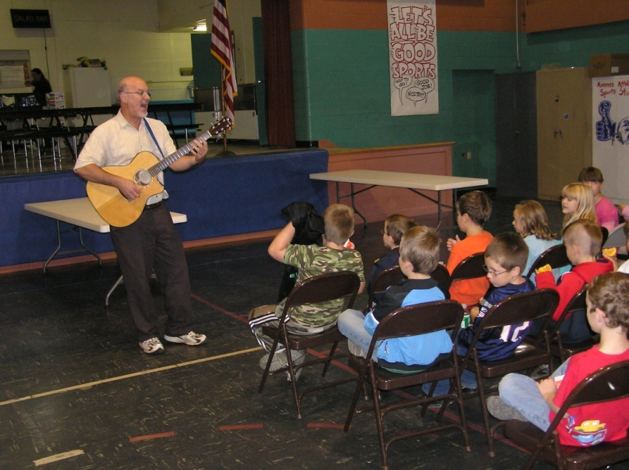
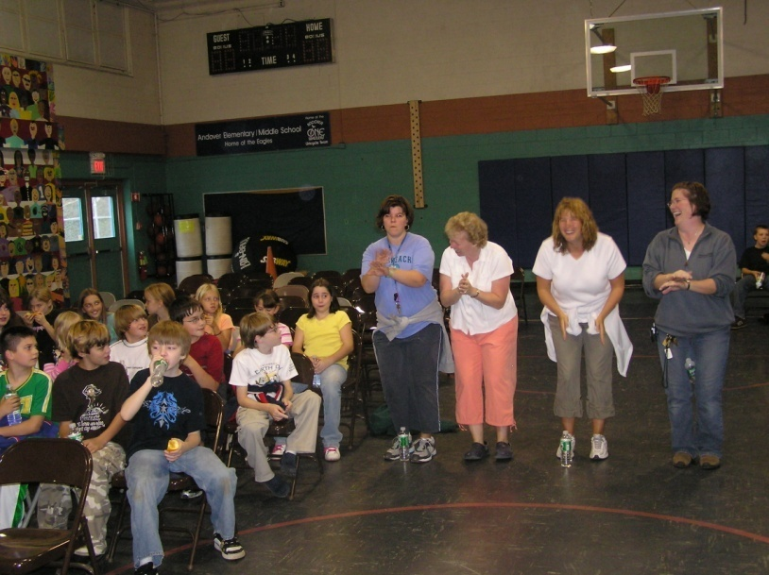
School Assemblies

Slide 20
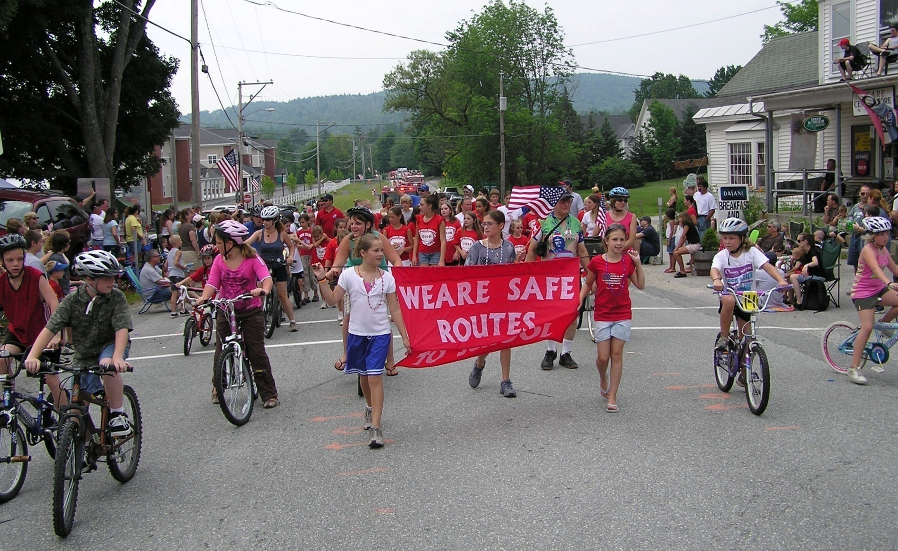
Public Events

Slide 21
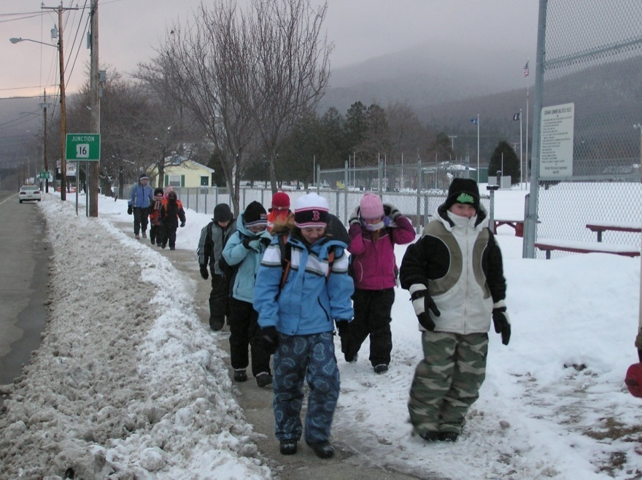
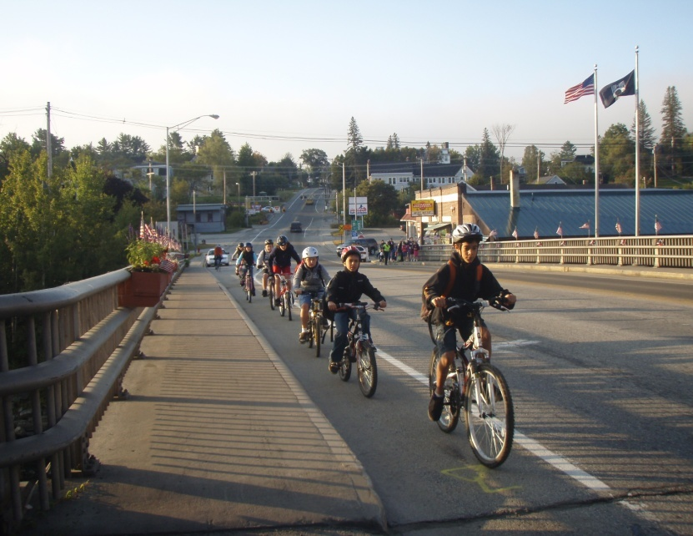
Escort Programs
Walking School Bus
Rolling Bike Train
Safety in numbers as we take back our streets

Slide 22
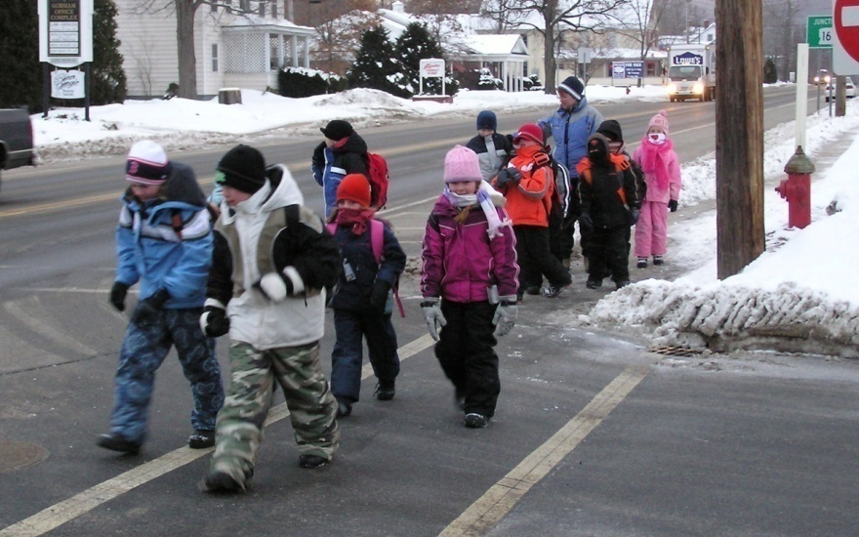
Adult Supervision = Safety

Slide 23
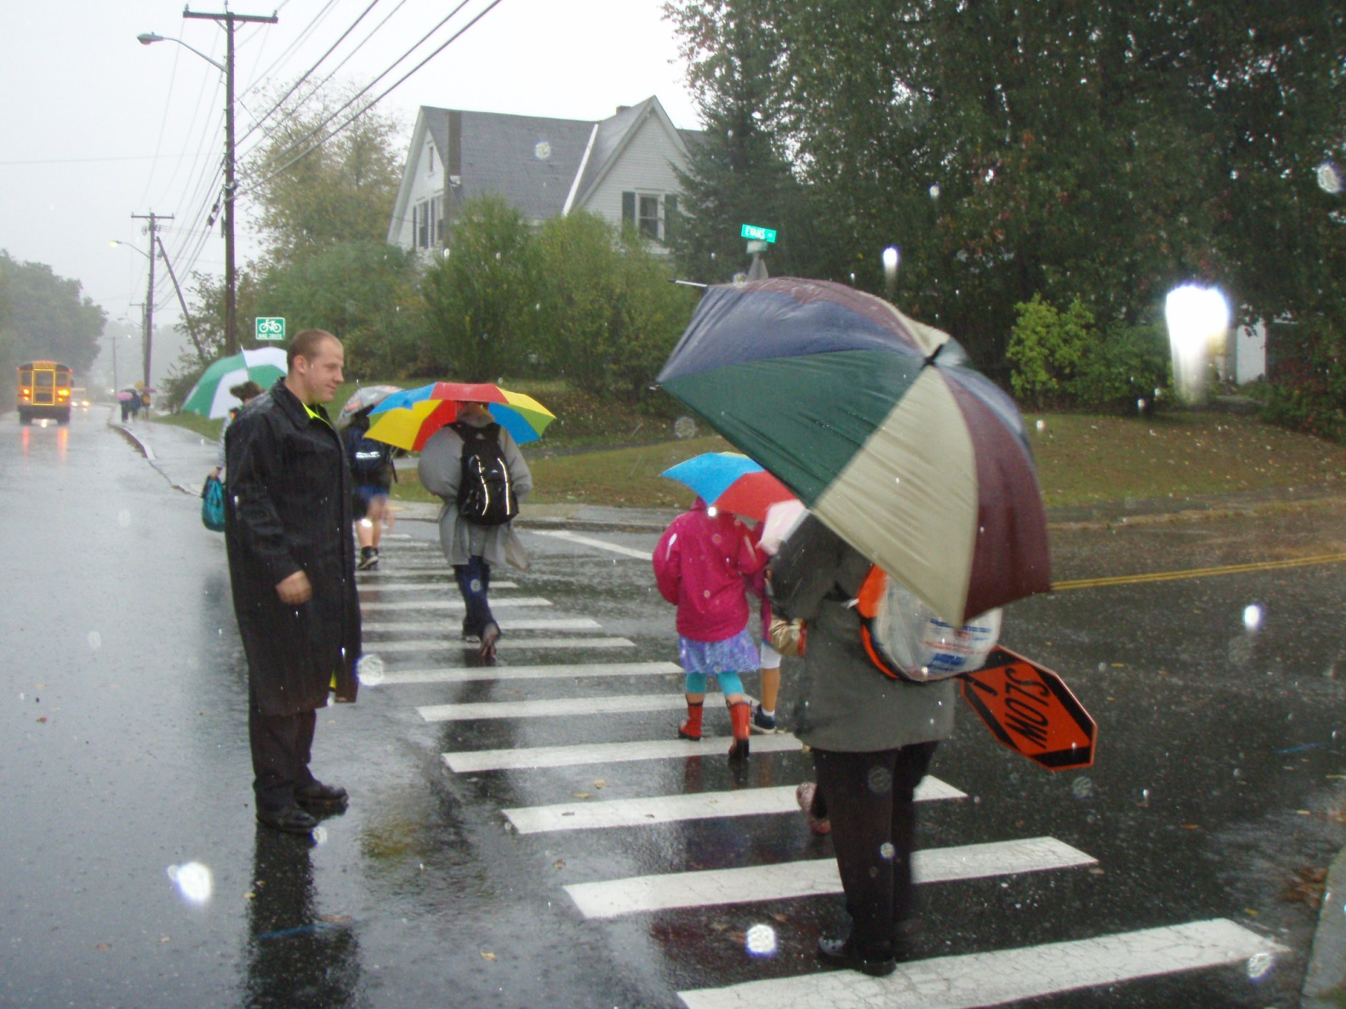
October is International
Walk-to-School Month

Slide 24
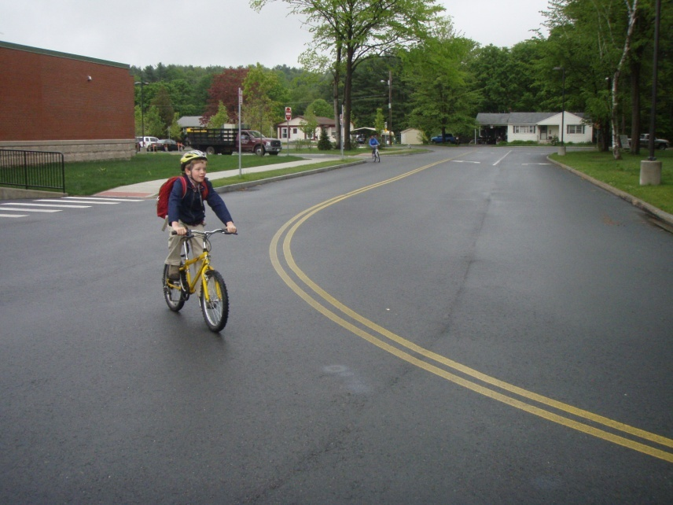
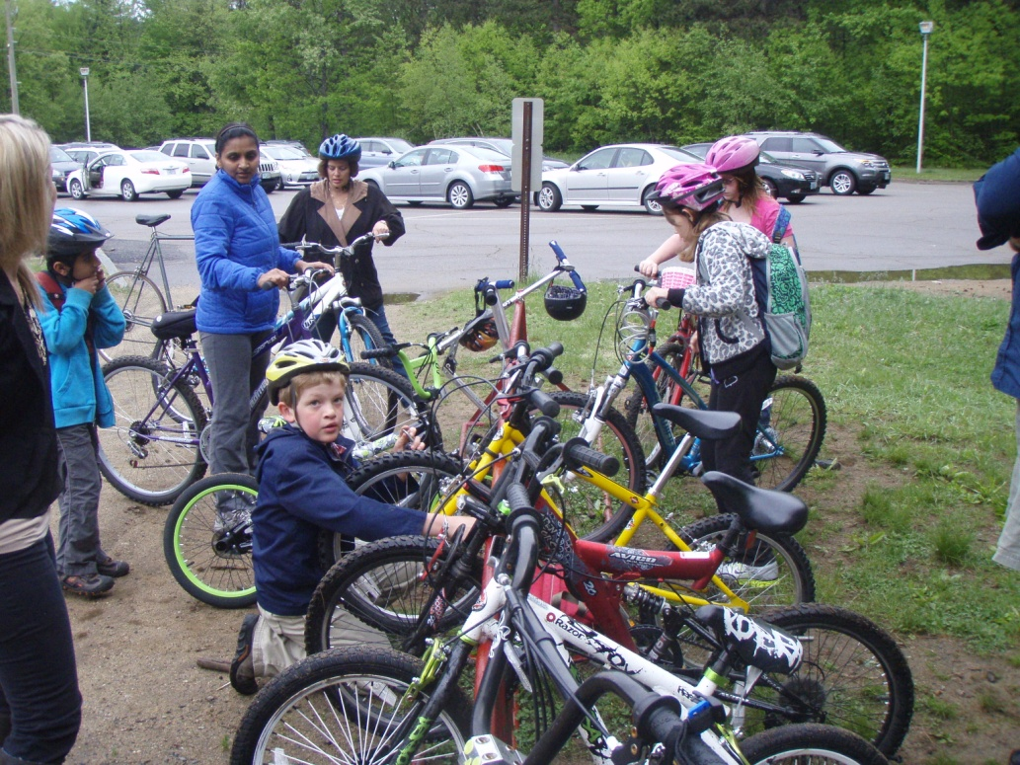
May is Bike to School Month

Slide 25
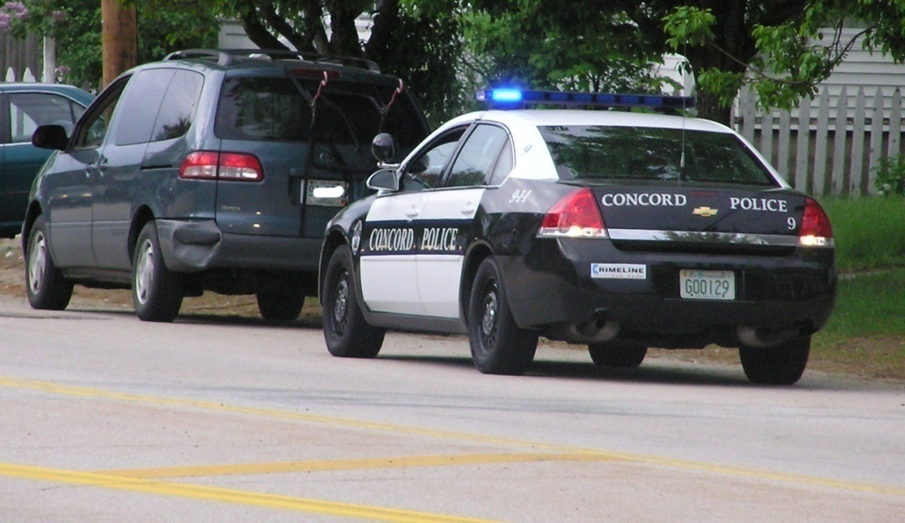
Enforcement
Role of local police is essential.
Speeding motorists.
Failure to stop in crosswalks.
Key safety accessory: the view of a blue light in the rear-view mirror.

Slide 26
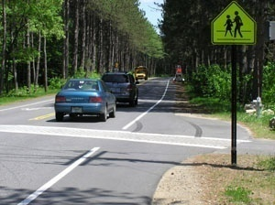
Infrastructure
Physical changes to encourage walking and biking
Sidewalks
Bike routes and bike paths
Signs, signals and stripes

Slide 27
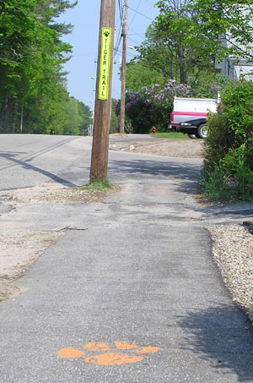
Sidewalks

Slide 28
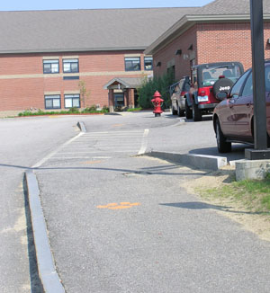
A Safe Route All the Way to School

Slide 29
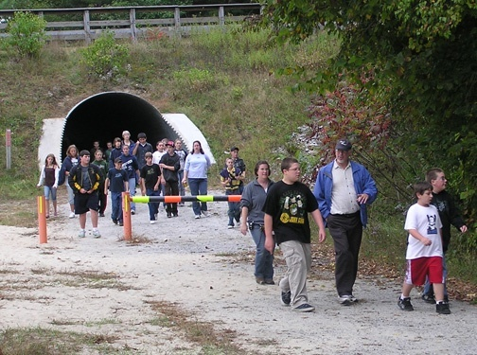
Bike Paths and Shared Routes
Separate from Traffic

Slide 30
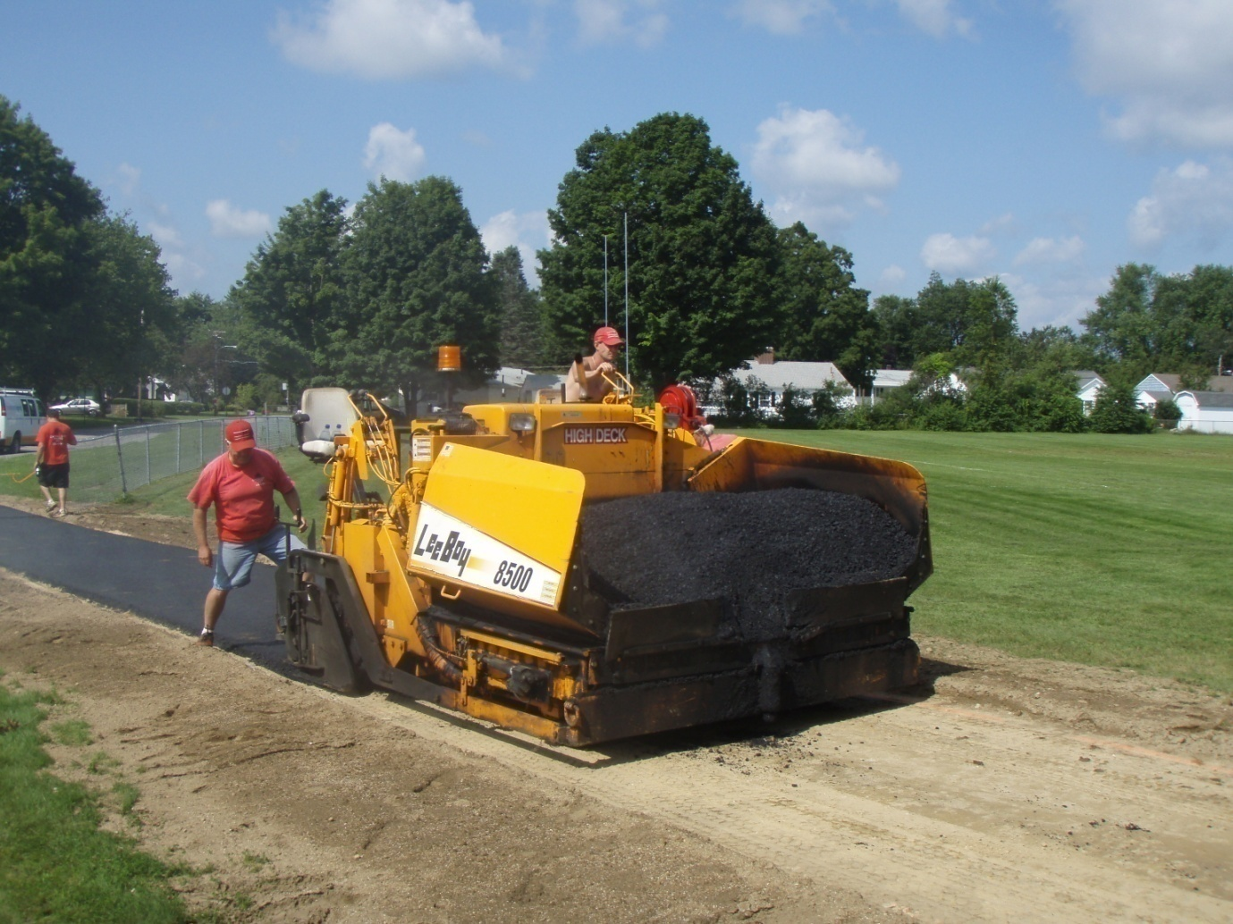
First Projects On
School Campuses

Slide 31
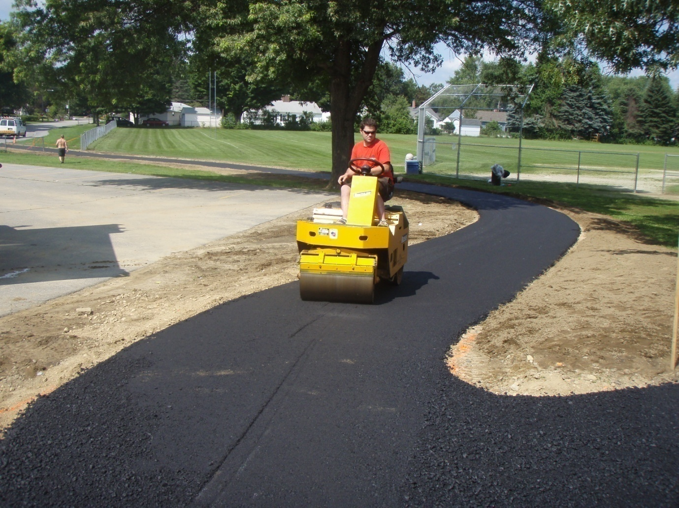

Slide 32
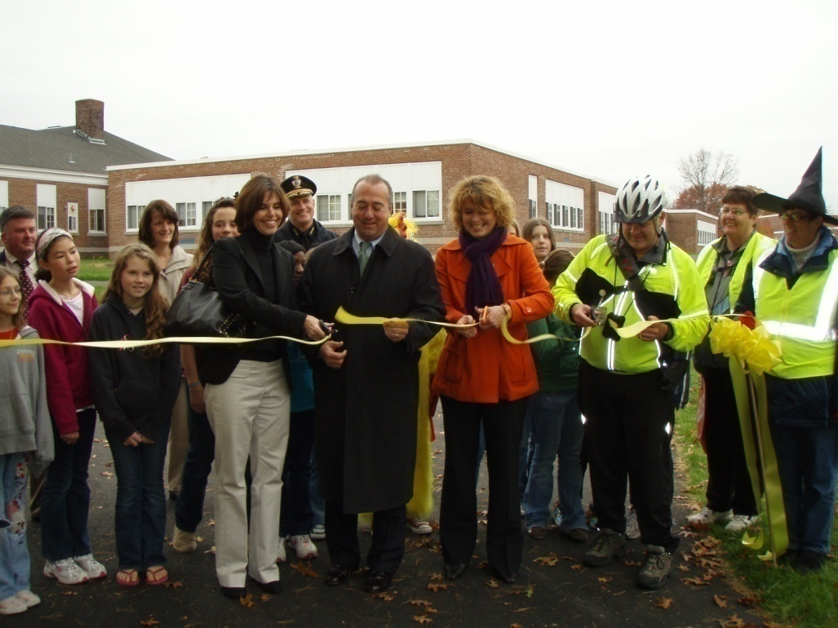
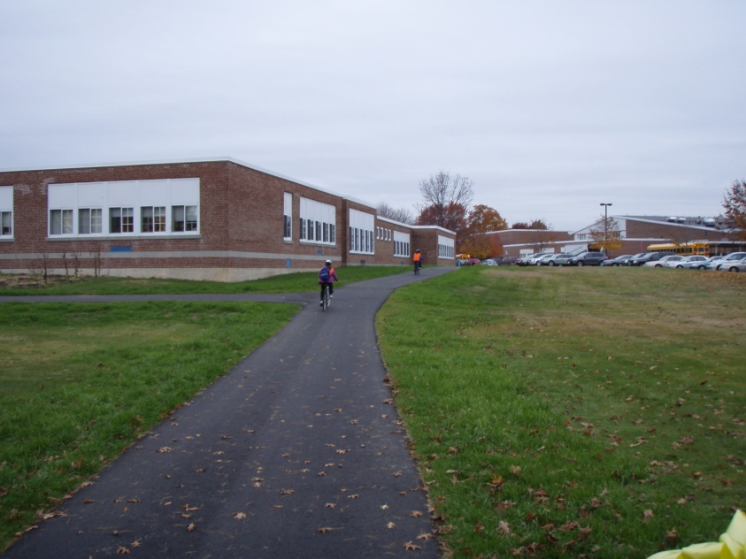

Slide 33
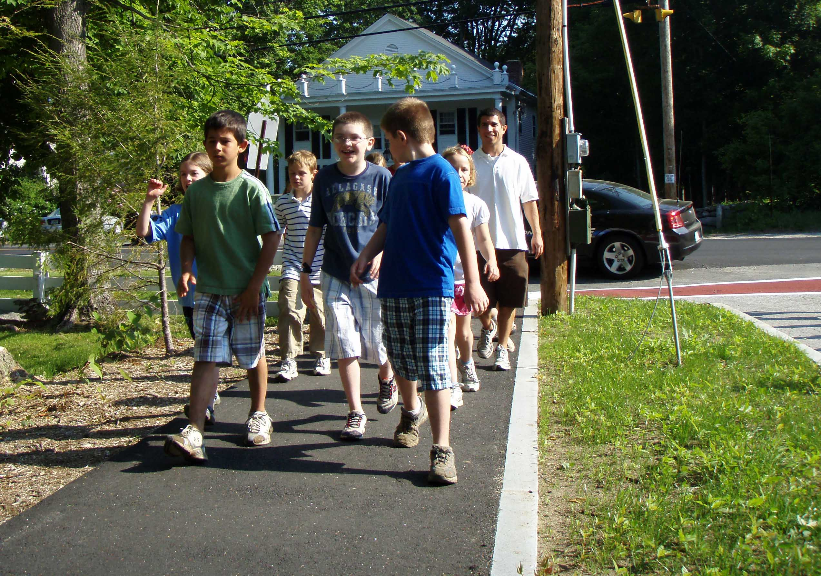

Slide 34
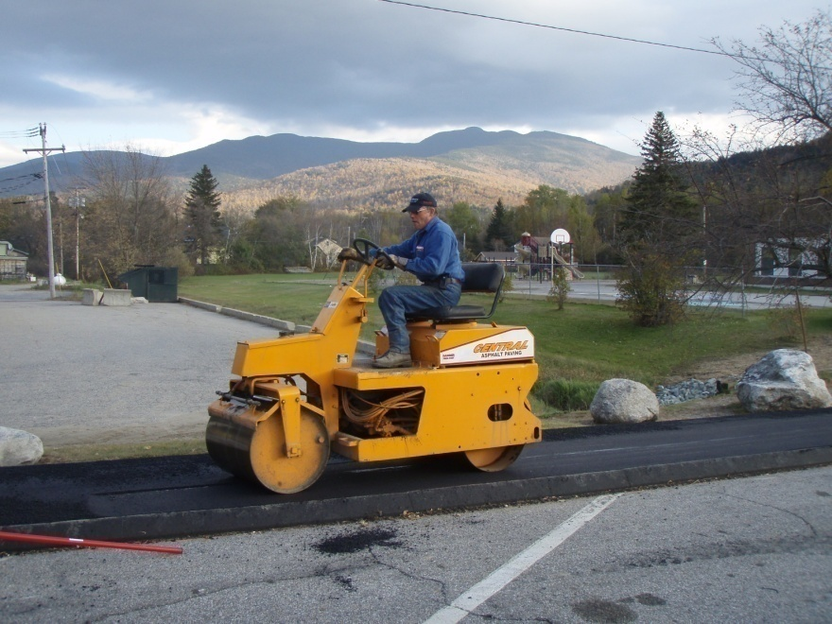
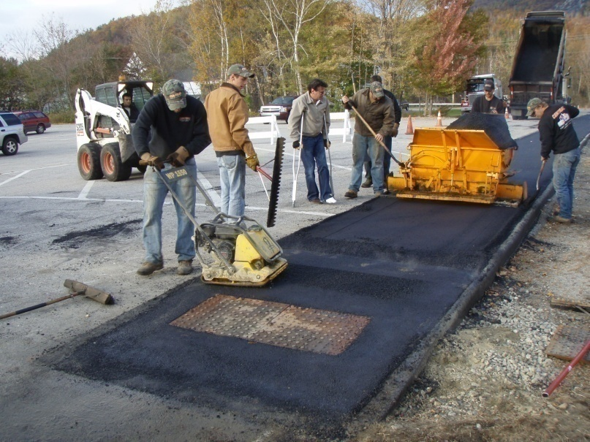
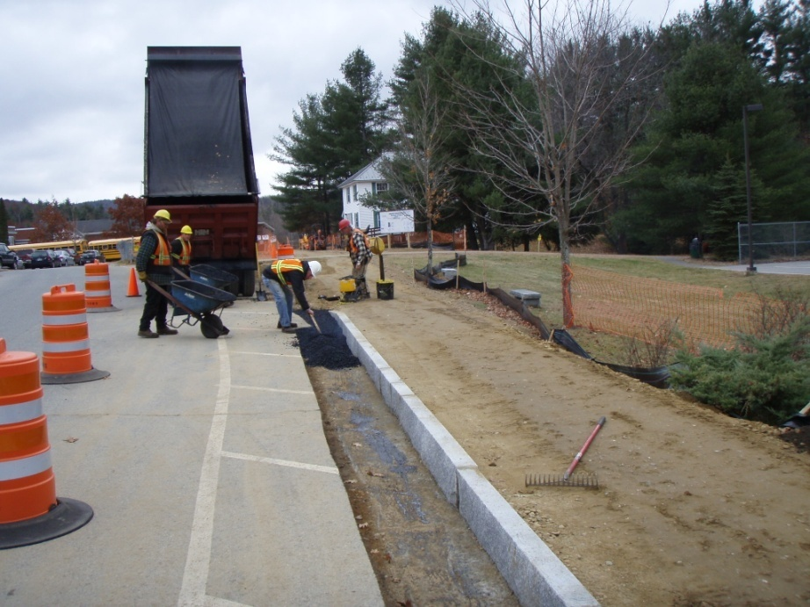
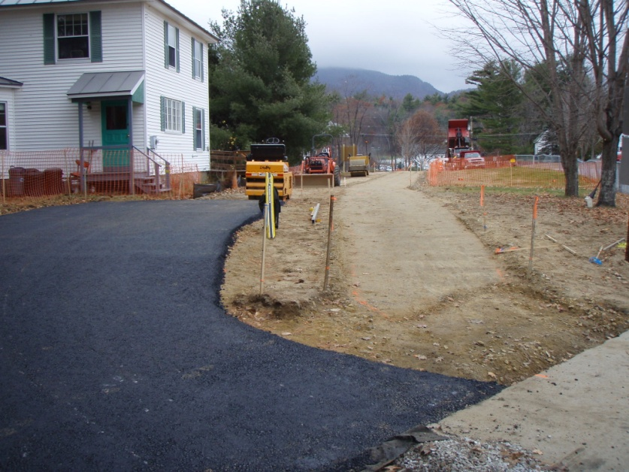

Slide 35
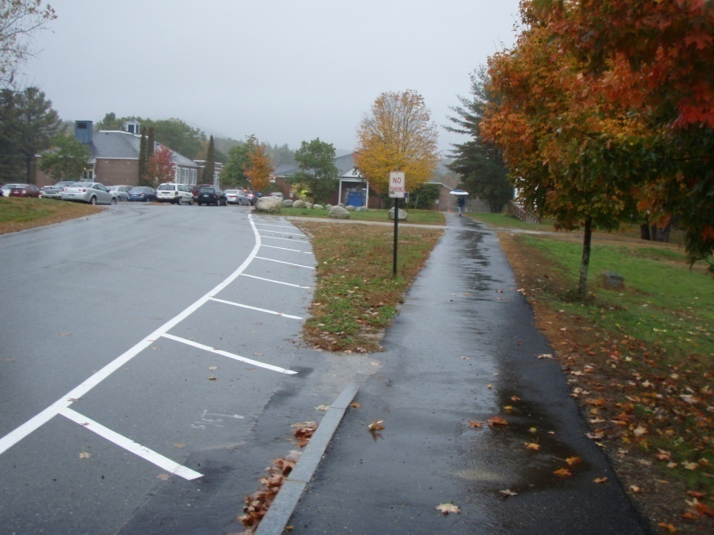
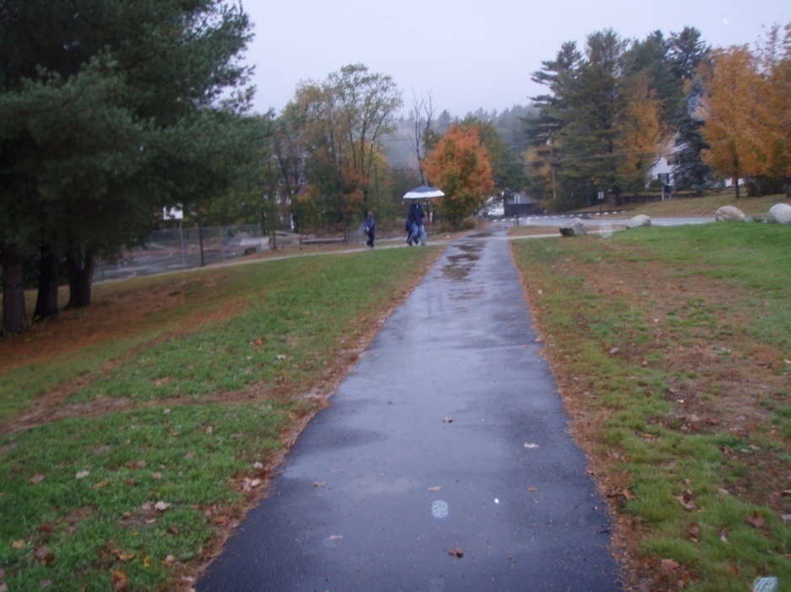
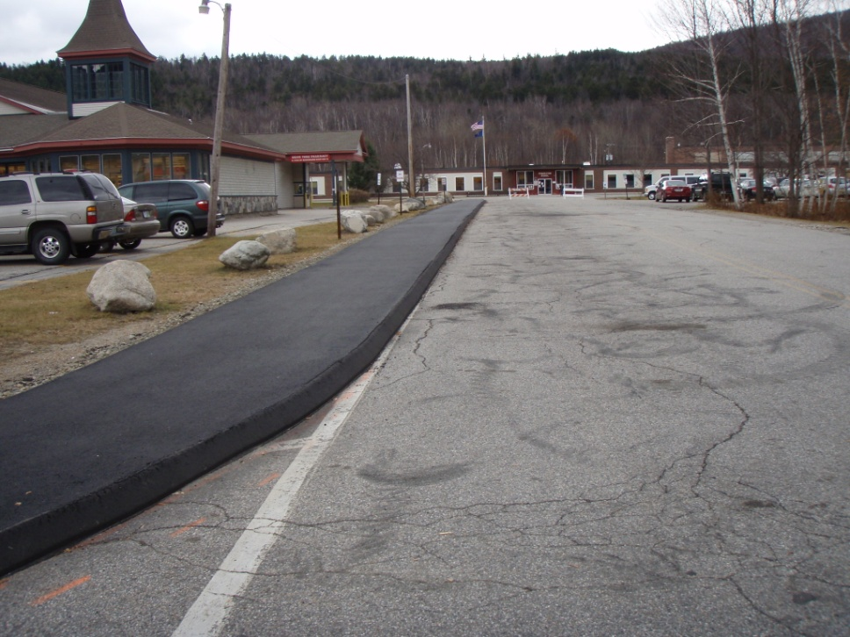

Slide 36
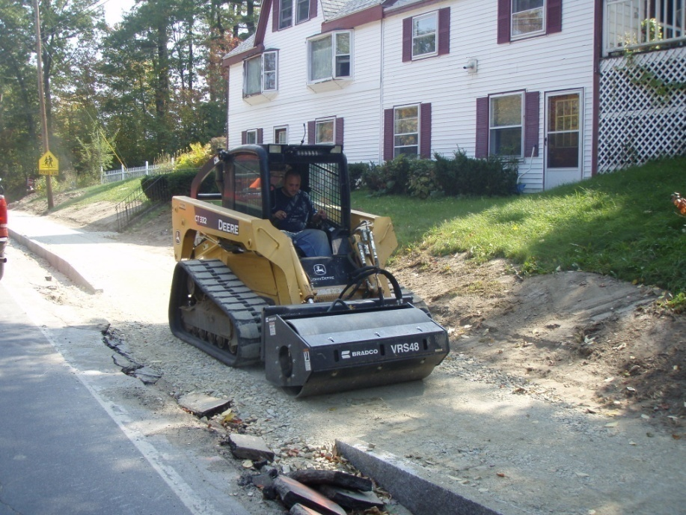
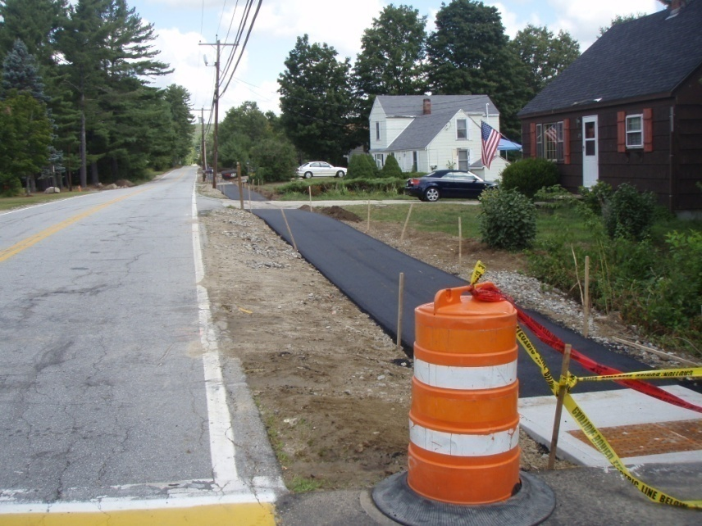
First Projects on Public Roads

Slide 37
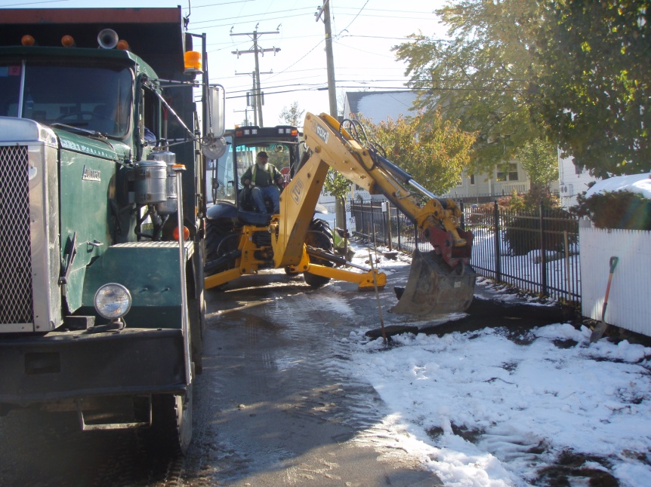
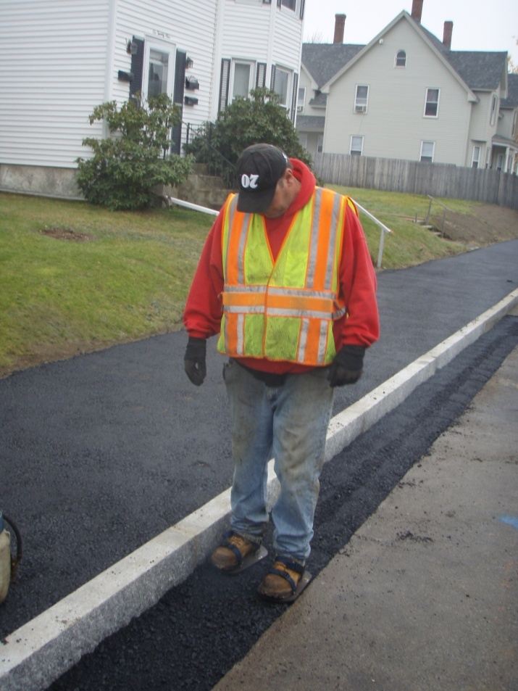

Slide 38
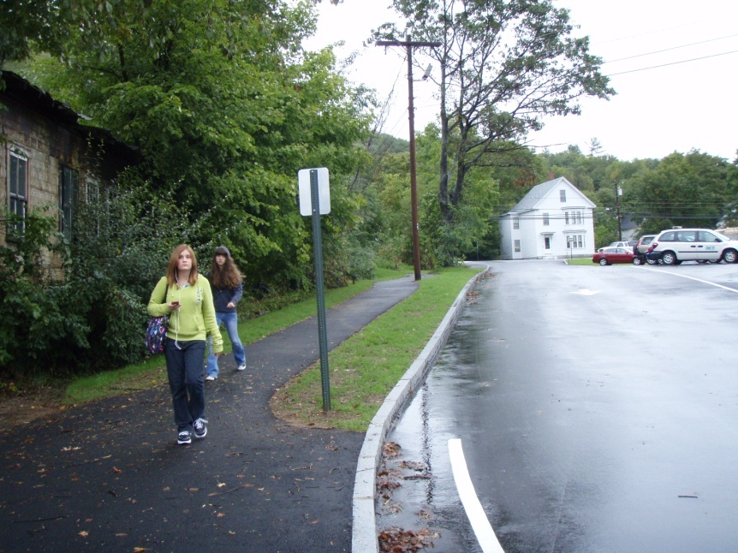


Slide 39



Slide 40



Slide 41



Slide 42



Slide 43



Slide 44



Slide 45



Slide 46




Slide 47

Full Bike Racks
A Sure Sign of Success

Slide 48
Three Types of Grants
Startup: Less than $5,000.
Travel Plan: Up to $15,000 per school.
General Non-infrastructure: Up to $10,000 per school
General Grants: Replaced by Transportation Alternatives Program (TAP). Infrastructure only.

Slide 49




Slide 50

Arriving Safely
Alert and Ready to Learn

Slide 51
Pre-Application Workshop

Slide 52
Three Types of Grants:
Startup: Up to $5,000 per school
Travel Plan: Up to $15,000 per school
General Non-Infrastructure: Up to $10,000 per school

Slide 53
Separate Application Forms
Can be downloaded from SRTS Web site.
Submitted to NHDOT and RPC.

Slide 54
Applications Meeting Eligibility Standards Will be Approved on First Come, First Served Basis.

Slide 55
When Approved:
Local agreement prepared. Executive Council approval usually needed.
Local sponsor appoints “person in responsible charge” (PRC). Must be certified based on day-long training.
Scoping meeting with NHDOT project manager. Notice to Proceed.

Slide 56
Reimbursement Program
Sponsor must incur expenses and then be reimbursed. No money up-front.
Monthly status reports and reimbursement requests needed.

Slide 57
Travel Plan Can Support TAP Application
All SRTS infrastructure funds have been awarded.
TAP reimburses at up to 80 percent.
NH TAP program for infrastructure only.
Watch for announcement of next round in 2018.

Slide 58
Any Questions?

