Slide 1

Town Meeting
March 16, 2024

Slide 2
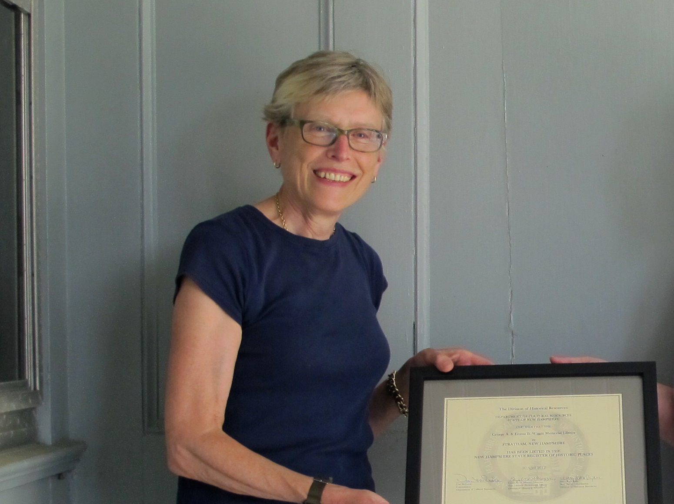
Dedication:
Rebecca Mitchell

Slide 3

In Memoriam:
Joyce A. Rowe

Slide 4
Town of Stratham
Warrant Articles
Town Meeting 2024

Slide 5
Article 11
To see if the Town will vote to raise and appropriate the sum of Eight million four hundred eighty two thousand one hundred sixty dollars ($8,482,160) for general municipal operations. This article does not include appropriations contained in special or individual articles addressed separately.
2024 Operating Budget

Slide 6
2024 Operating Budget
Total $8,482,160
An increase of $270,972 or 3.3%
Notes:
This article funds the Town’s operations each year.
This year’s budget is an increase of 3.3% over last year. This budget does not represent any new programs or initiatives and maintains current services, while meeting the increased cost requirements of doing business including employing people in 2024.
Together with increase revenues (primarily from interest on general funds accounts) from non property tax sources, the overall amount of funds required to come from taxation is $5,131,403. This is a $71,765 increase over what was raised through taxes last year, an 1.39% increase over last year)
RESOURCE INFORMATION – not recommended for basic speaking points – HERE IS A SUMMARY OF THE TYPES OF EMPLOYEE RELATED COSTS AFFECTING THIS BUDGET
Wage rate adjustments to maintain competitiveness
Annual across the Board adjustment of 3%
Market adjustments – DPW and general government positions
Specialized Duty Incentive in Police Department
Increase in call-out rate for Fire volunteers
Other increases (non-employee related) - contracted service; health Insurance premium increase

Slide 7
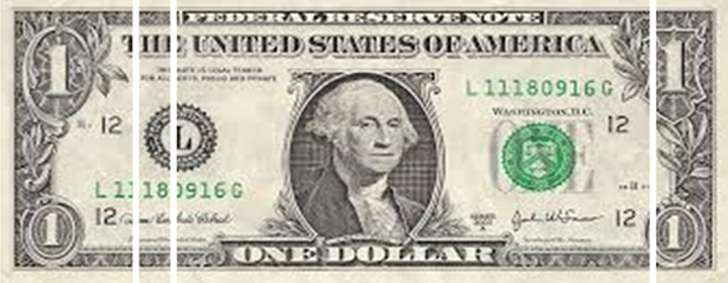
Town Services In Context
Town
County
Local Education
State Education
15%
4 %
73%
8%
2023 Town Tax Rate: $3.15
Notes:
This Article and every article this Town Meeting will vote on today is what is funded through Town’s portion of your tax bill.
The Town’s tax rate of $3.15 is 15% of the overall rate of $20.91, which is the total rate when combined with school and county taxes.

Slide 8
Town Services
15 cents of every tax dollar funds:
  Wiggin Memorial Library
  All public works functions
  Parks & recreation programming and senior services
  Police services
  Stratham Volunteer Fire Department
  Land use regulatory, elections, general administration
  Capital projects and rolling stock.
For a home valued at $600,000, your annual tax for these services is $1,890.
Notes:
Detail of “All public works functions” (including trash and recycling pick-up, transfer station, street clearing operations, and park and playground maintenance)

Slide 9
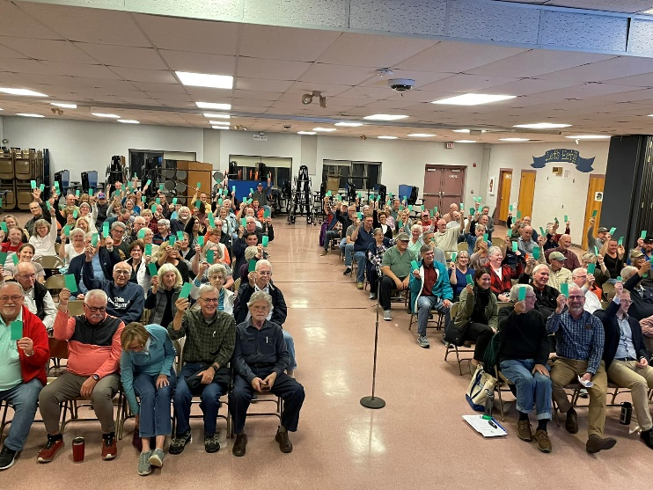

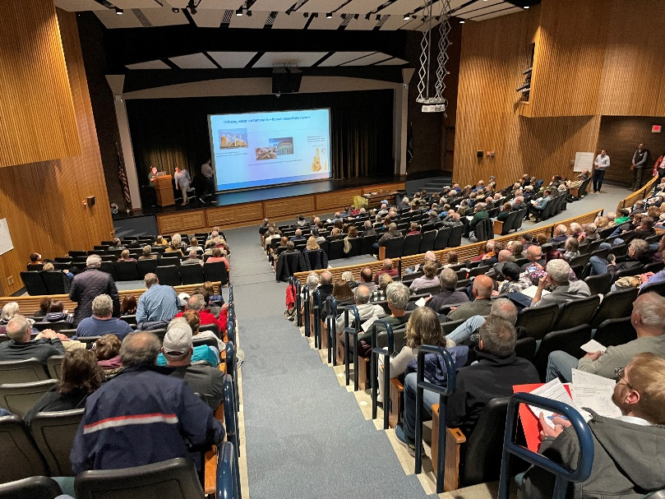
Highlights from 2023
Introduction of Community Power
Increased our Cyber Security Defenses
More disciplines to our assessing services
Grants – $334,000 in grants leveraged
Free water testing for 285 Households
Notes:
Each year we strive to add value to the residents through improved services, more effective service delivery, and stretching local dollars.
In 2023, some of our achievements as a Town government include:

Slide 10
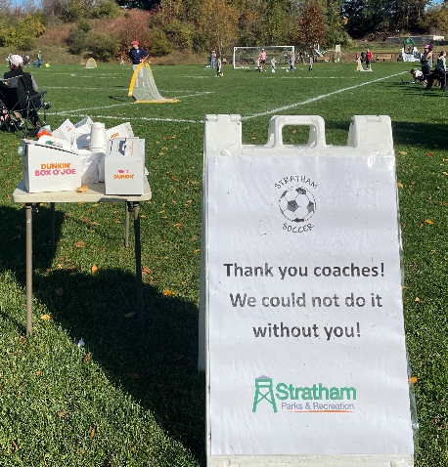
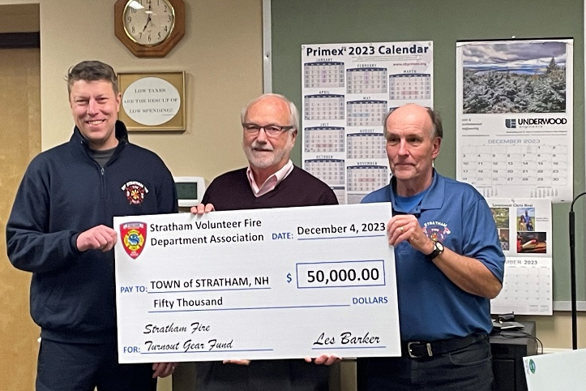
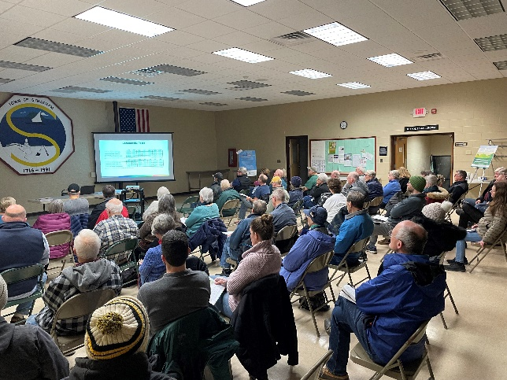
Leveraging Volunteerism -2023
Stratham Volunteer Fire Department
  787 calls; Officer Leadership Training; even more community building
Heritage Commission
  Town-wide inventory of historic resources
Conservation Commission
  Two properties conserved and another to close 2024
Energy Commission
  Community Power!
Notes:
The Town does not run without volunteers who serve on Boards and Commissions and in elected offices. We thank everyone who pitches in year round. Here are some achievements for 2023.

Slide 11
Operating Budget 2024
Notes:
This is a distribution of how your funds in this article are spread out across functions.

Slide 12
Payroll and Benefits
57% of Operating Budget
Notes:
Local government services rely on people to deliver them. In Stratham, 57% of our operating budget funds either payroll or the benefits we offer to attract and retain employees.

Slide 13
Average Annual Growth 2.74%
Year | % Increase
2016 | 2.75%
2017 | 3.83%
2018 | 6.05%
2019 | -1.42%
2020 | 0.15%
2021 | 5.13%
2022 | 2.63%
2023 | 2.00%
2024 | 3.3%
Annual growth has averaged: 2.74%
Change from 2023 to 2024: 3.3%
Notes:
Our goal is to provide a consistent and predictable tax burden from year to year. Lots of planning and ongoing investment in strategies, tools and people allow us to do this.
The average annual growth in the ten years shown here is 2.74%

Slide 14
No Projected Tax Rate Increase
 | 2019 | 2020 | 2021 | 2022
Town | 3.30 | 3.09 | 3.15 | 3.07
2023
3.15
2024
3.15*
*This prelim 2024 tax projection is provided for comparison purposes only; 2024 revaluation will change town’s base valuation.
Notes:
This year’s recommended level of spending to this Town Meeting results in no increase in the tax rate. As you have been reading in the Select Board newsletter, 2024 is a revaluation year. So this projection is in order to give you an apples to apples comparison. We will have a new base valuation in 2024 when the tax rate is set in November.

Slide 15
Article 11
To see if the Town will vote to raise and appropriate the sum of Eight million four hundred eighty two thousand one hundred sixty dollars ($8,482,160) for general municipal operations. This article does not include appropriations contained in special or individual articles addressed separately.
2024 Operating Budget

Slide 16
Article 12
To see if the Town will vote to raise and appropriate the sum of Six hundred seventy eight thousand dollars ($678,000) to implement the Capital Improvements Program for 2024 as presented in the Town Report and recommended by the Planning Board. This is a special warrant article which will be non-lapsing until the specific items are completed or obtained but shall in no case be later than December 31, 2029 per NH RSA 32:7 (VI).
Capital Improvements Program
Notes:
The Town’s Master Plan guides development and land use decisions for the Town. In addition, it identifies strategies, visions, and projects which often require long range capital investment. Long-term financial planning ensures the Town has the needed resources to maintain current services, replace equipment, and upgrade or rehabilitate facilities as needed. The Capital Improvement Plan (CIP) is the tool used to plan these investments, and this Article appropriates funding for the “year one” projects (2024).

Slide 17
Capital Improvements Program (CIP)
Description | 2023 | 2024 | Change
Total | 663,000 | 678,000 | 15,000
Notes:
This is a $15,000 increase over last year’s request for this article

Slide 18
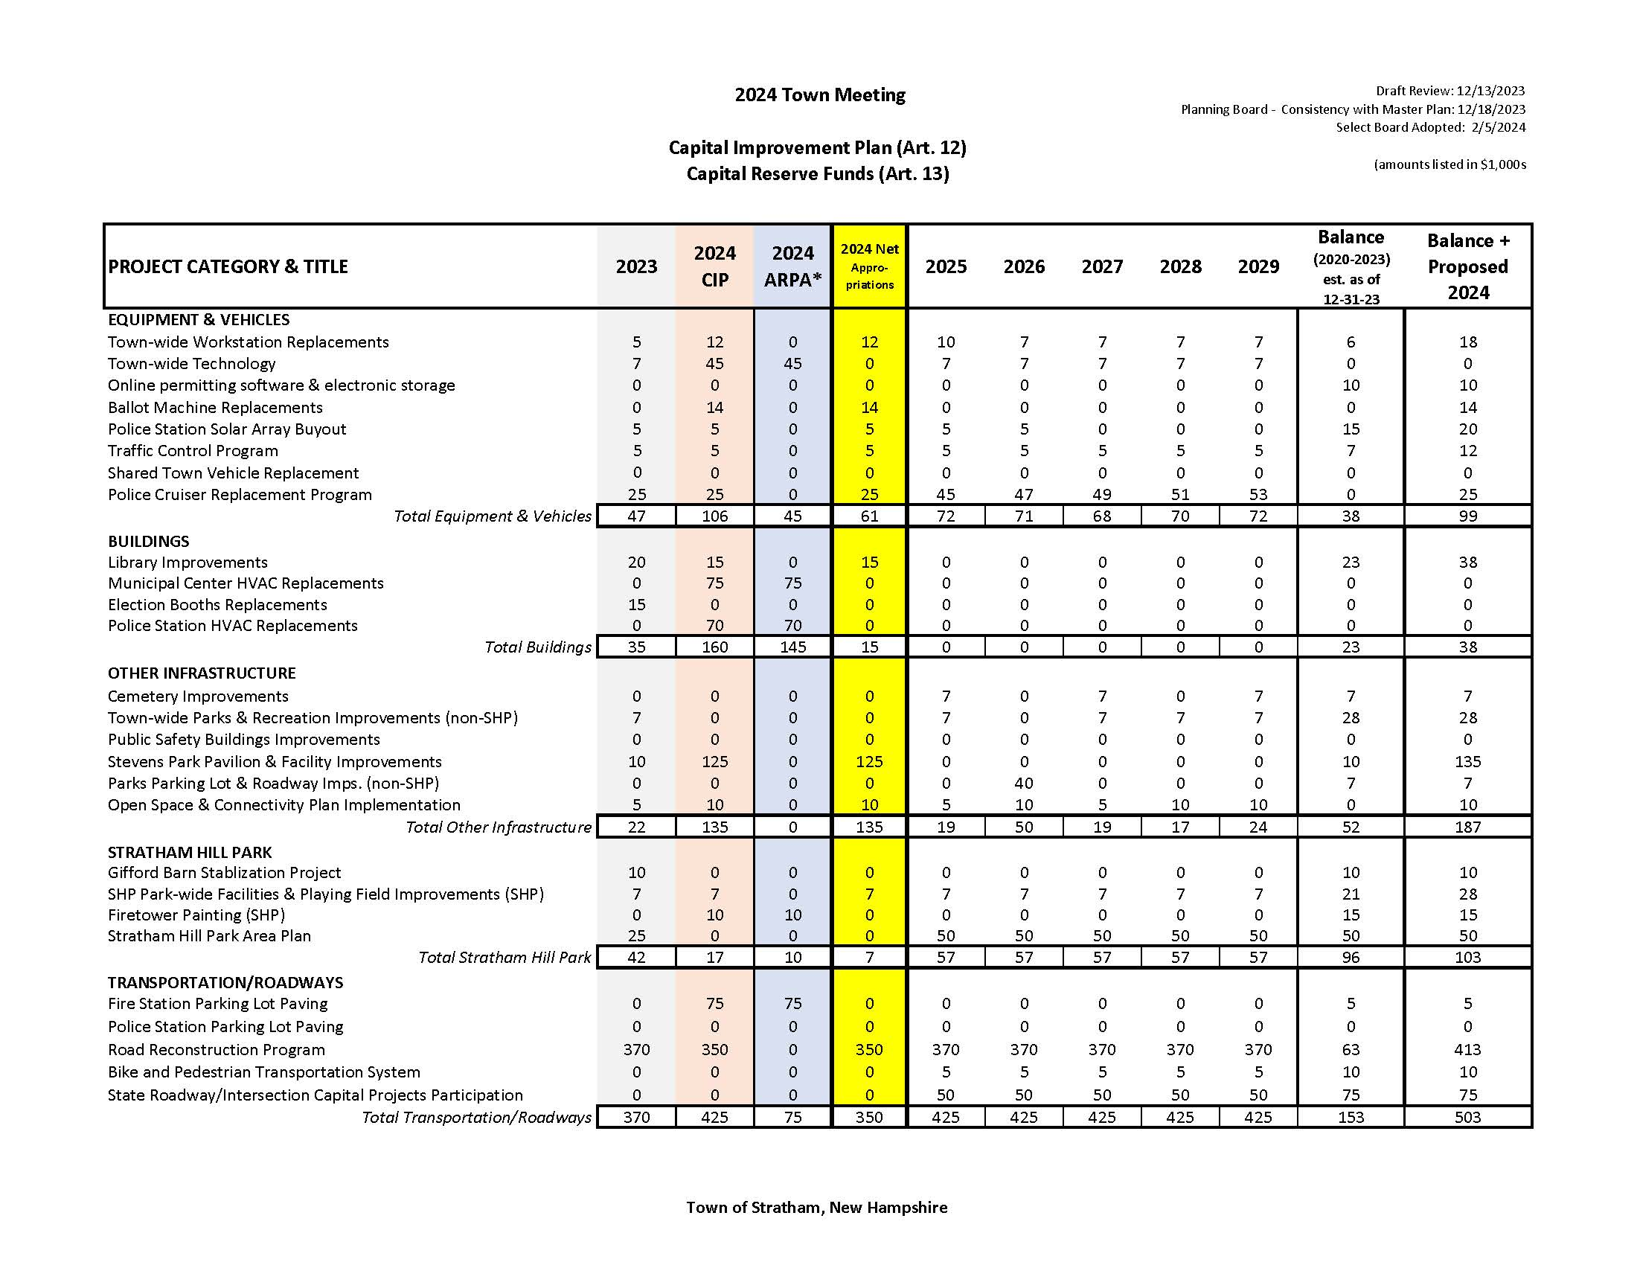

Slide 19
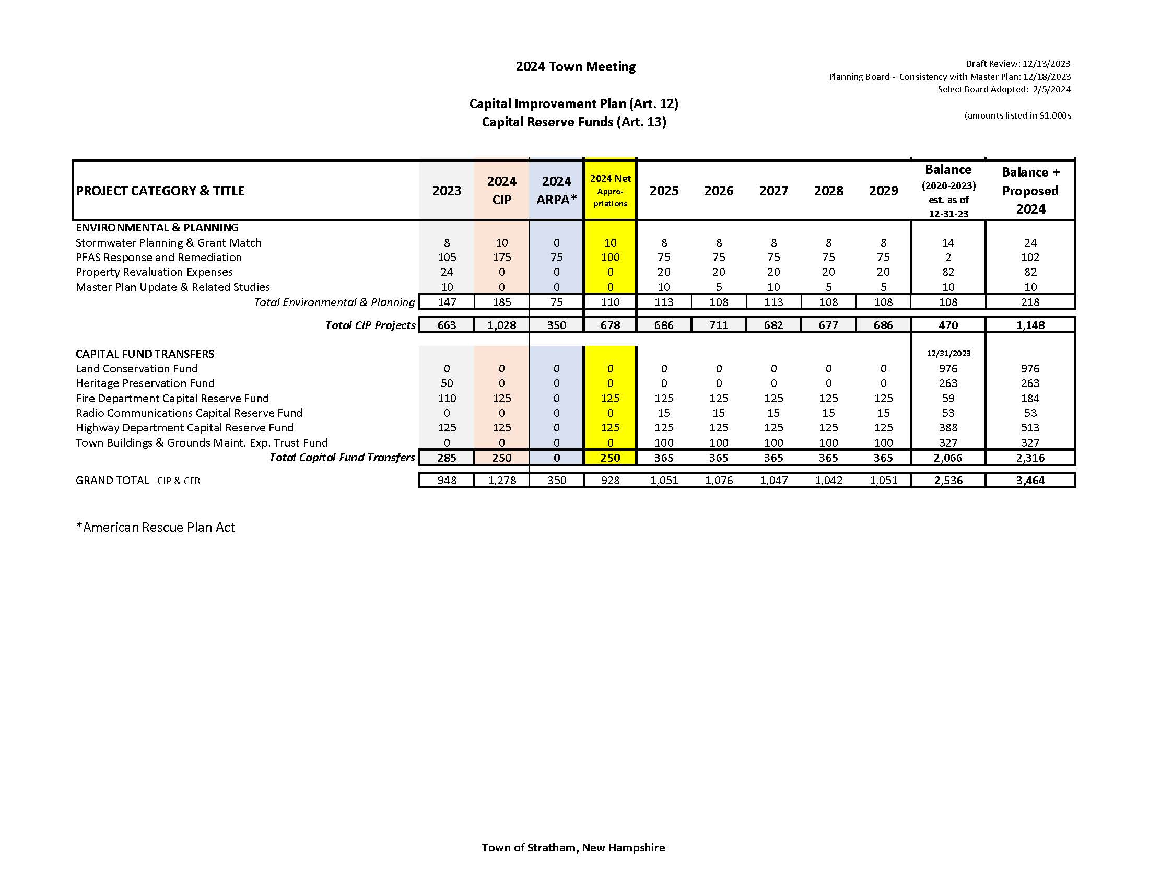

Slide 20
Highlights of 2024 CIP Request
Equipment & Vehicles
Environmental & Permitting
Other Highlights
Library Website
HVAC Improvements Municipal Center and Police Department
Stevens Park Multi-use Recreation Facility Improvements
Town-wide technology improvements
Cruiser Replacement
Ballot Machine replacement
PFAS Site Management
Stormwater Planning and Compliance
Property Revaluation
Notes:
Refer to bullets for examples of projects.

Slide 21
Article 12
To see if the Town will vote to raise and appropriate the sum of Six hundred seventy eight thousand dollars ($678,000) to implement the Capital Improvements Program for 2024 as presented in the Town Report and recommended by the Planning Board. This is a special warrant article which will be non-lapsing until the specific items are completed or obtained but shall in no case be later than December 31, 2029 per NH RSA 32:7 (VI).
Capital Improvements Program

Slide 22
Article 13
To see if the Town will vote to raise and appropriate the sum of Two hundred and fifty thousand dollars ($250,000) to be added to the following capital reserve funds previously established with One hundred fifty thousand dollars ($150,000) to come from the unassigned fund balance and One hundred thousand dollars ($100,000) to be raised through general taxation.
Fire Department Capital Reserve Fund - $125,000
Highway Capital Reserve Fund - $125,000
Total $250,000
Capital Reserve Funds
Notes:
This article is a reduction from last year of $35,000, for at total of $250,000
As a reminder, goals for CRF Funds
1. Plan for future large scale capital expenditures
2. Allow for timely replacement without “spikes” in the tax rate
3. Ensure equipment is replaced based on life-cycle
4. Maintain consistent service and avoid out-of-service time

Slide 23
Capital Reserve Funds (CRF)
Description | 2023 | 2024 | Change
Land Conservation | 0 | 0 | 0
Heritage Preservation Fund | 50,000 | 0 | (50,000)
Fire Department | 110,000 | 125,000 | 15,000
Highway Department | 125,000 | 125,000 | 0
Town Buildings & Grounds Maintenance | 0 | 0 | 0
Total | 285,000 | 250,000 | (35,000)
Notes:
This year we are not recommending funding for the Heritage Preservation Fund as that fund has achieved its goal of a $250,000 balance as a result of previous Town Meeting appropriations.
Balances of these funds can be found on page 55 of the Town Report.

Slide 24
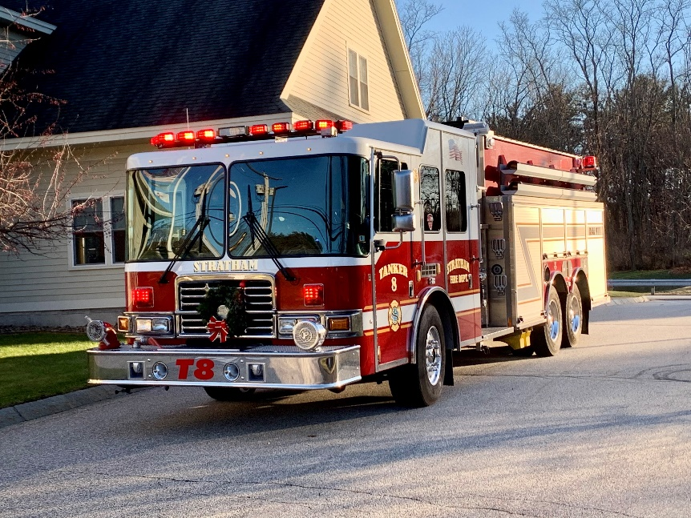
CRF – Fire
Ambulance purchase authorized 2022 – delivery 2024
Fire Engine purchase authorized 2023 – delivery 2025
No purchases planned for 2024
Next purchases scheduled Forestry Squad 2025, Engine 2028
Notes:
See bullets

Slide 25
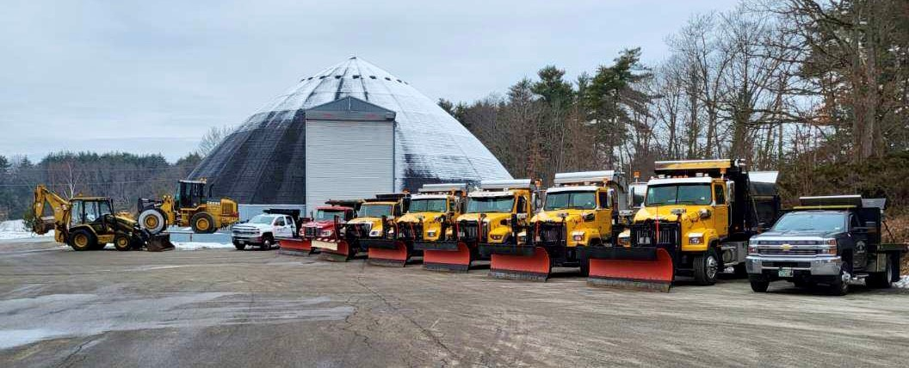
CRF – Public Works
Current balance $386,000
Same annual allocation of $125,000 for several years
Purchased Heavy Duty truck 2023
2024 complete a review of vehicle strategy
Notes:
See bullets

Slide 26
Article 13
To see if the Town will vote to raise and appropriate the sum of Two hundred and fifty thousand dollars ($250,000) to be added to the following capital reserve funds previously established with One hundred fifty thousand dollars ($150,000) to come from the unassigned fund balance and One hundred thousand dollars ($100,000) to be raised through general taxation.
Fire Department Capital Reserve Fund - $125,000
Highway Capital Reserve Fund - $125,000
Total $250,000
Capital Reserve Funds
Notes:
Goals for CRF Funds
1. Plan for future large scale capital expenditures
2. Allow for timely replacement without “spikes” in the tax rate
3. Ensure equipment is replaced based on life-cycle
4. Maintain consistent service and avoid out-of-service time

Slide 27
Article 14
To see if the Town will vote to raise and appropriate the sum of Thirty six thousand five hundred dollars ($36,500) for the following purposes:
2024 EMS Supplies $16,500
2024 EMS/EMT/First Responder Training $10,000
2024 ALS Services Contract $10,000
and to further authorize the withdrawal of Thirty six thousand five hundred dollars ($36,500) from the Stratham Fire Department EMS Special Revenue Fund created for these purposes during the March 17, 2000 Annual Town Meeting and as amended during the March 11, 2005 Town Meeting. No additional funds from general taxation are to be used.
Raise and Appropriate from EMS Special Revenue Fund
Notes:
The Town has an Emergency Medical Services Special Revenue Fund which is the repository of revenues from our ambulance billings. The state law requires the Town meeting to vote on appropriations from special revenue funds. Once again this year, we are recommending authorization to appropriate from this fund for two areas
EMS Training
EMT Requalification Licenses and Continuing Education Requirements New EMT Classes for New Members
ALS Re-imbursement
During transport of Medicare or Medicaid patients only the transporting service may bill. Depending upon the call Exeter Hospital ALS (advanced life support) will transport with us.
Stratham bills Medicare/Medicaid for services rendered by Stratham FD and Exeter ALS. We provide re- imbursement for ALS.
New this year is an additional appropriation of $16,500 for EMS supplies used in the course of daily operations. This appropriation allows the cost for these supplies to be funded from revenue developed as a result of offering the service rather than through taxation as was done previously.

Slide 28
Appropriate from the EMS Special Revenue Fund
2024 EMS Supplies $16,500
2024 EMS/EMT/
First Responder Training $10,000
2024 ALS Services Contract $10,000
Notes:
New this year is an additional appropriation of $16,500 for EMS supplies used in the course of daily operations. This appropriation allows the cost for these supplies to be funded from revenue developed as a result of offering the service rather than through taxation as was done previously. With this change, we will not need to raise these monies through taxation in the operating budget.

Slide 29
Article 14
To see if the Town will vote to raise and appropriate the sum of Thirty six thousand five hundred dollars ($36,500) for the following purposes:
2024 EMS Supplies $16,500
2024 EMS/EMT/First Responder Training $10,000
2024 ALS Services Contract $10,000
and to further authorize the withdrawal of Thirty six thousand five hundred dollars ($36,500) from the Stratham Fire Department EMS Special Revenue Fund created for these purposes during the March 17, 2000 Annual Town Meeting and as amended during the March 11, 2005 Town Meeting. No additional funds from general taxation are to be used.
Raise and Appropriate from EMS Special Revenue Fund

Slide 30
Article 15
Shall the following provisions pertaining to elections be adopted? All voting shall be by paper ballot and all ballots shall be hand counted only, rather than by use of optical scanning or any other types of programmable electronic counting devices. This shall constitute a return to hand counting ballots and the immediate discontinuance of all electronic voting machines and electronic devices authorized for use by trial in RSA 656:40. Should this article be passed, it should be enacted by the Town of Stratham immediately.
Shall votes be counted by paper ballot and hand counted only?

Slide 31
Article 16
Other Business

Slide 32
TOWN MEETING 2024
Meeting Close &
Acknowledgements

Slide 33
Thank you
Residents of the Town of Stratham
Town Meeting Attendees
Stratham Memorial School
Election day Volunteers & Election Officials
Town staff
Wiggin Memorial Library for Voter Information Night
Annual Report Contributors

Slide 34
Town Meeting
March 16, 2024

Slide 35
Tax Rate Estimation:
Tax effort overall - $5,131,403 ($71,765 or 1.39% increase over last year)

