Slide 1

Town of Stratham
Warrant Articles
Town Meeting 2023

Slide 2
This 2023 Town Meeting
March 14th Election
  1 - Election of Officers
  2 -10 - Zoning Articles
March 18th Business Session
  11 – Operating Budget
  12 – Capital Improvements
  13 – Capital Reserve Funds
  14 – EMS Special Revenue Fund
  15 – Fire Engine #1 Replacement
  16 – Optional Veterans’ Tax Credit
  17 – All Veterans’ Tax Credit
  18 – Motor Vehicle Registration
  Fee and Capital Reserve Fund
  19 – Establishment of Fees

Slide 3
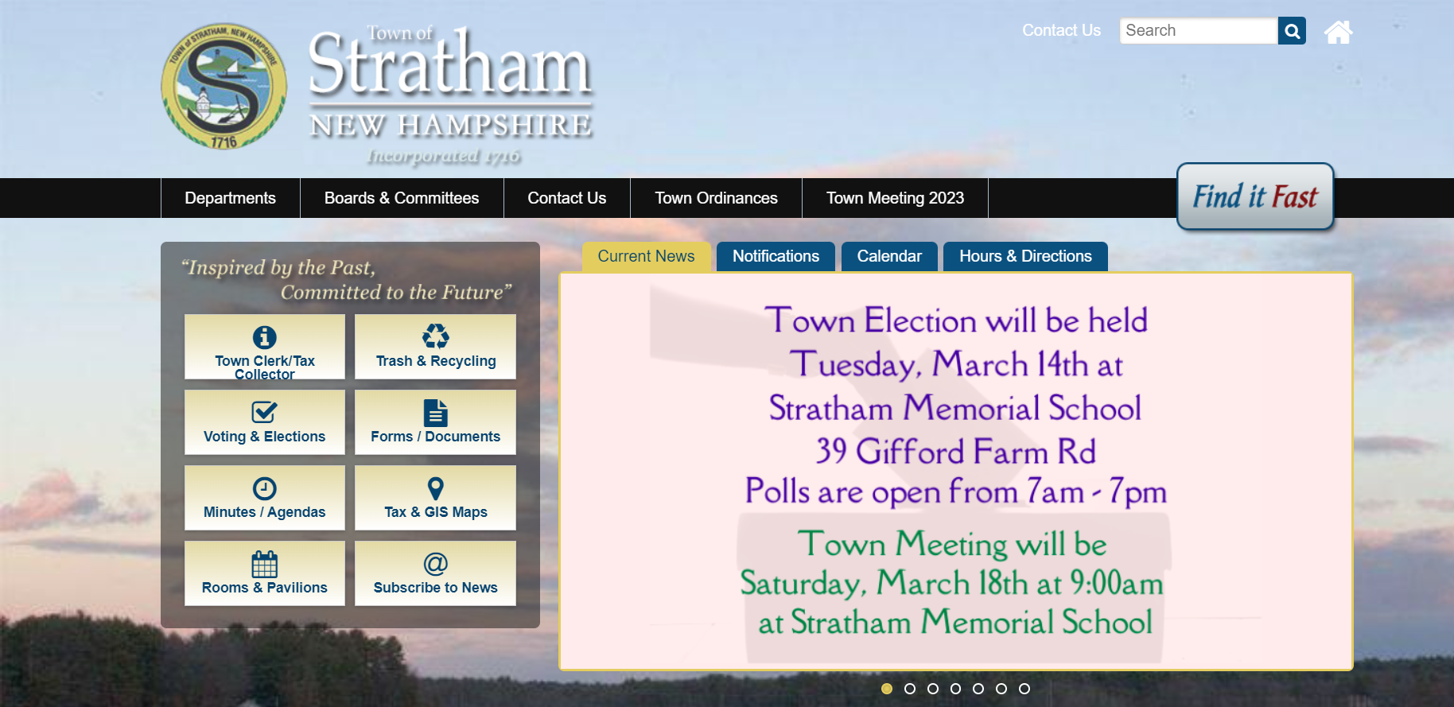
Additional Documentation

Slide 4
Additional Documentation

Slide 5
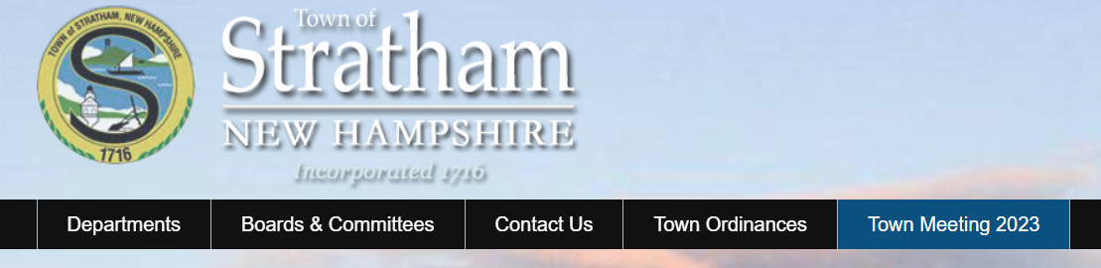
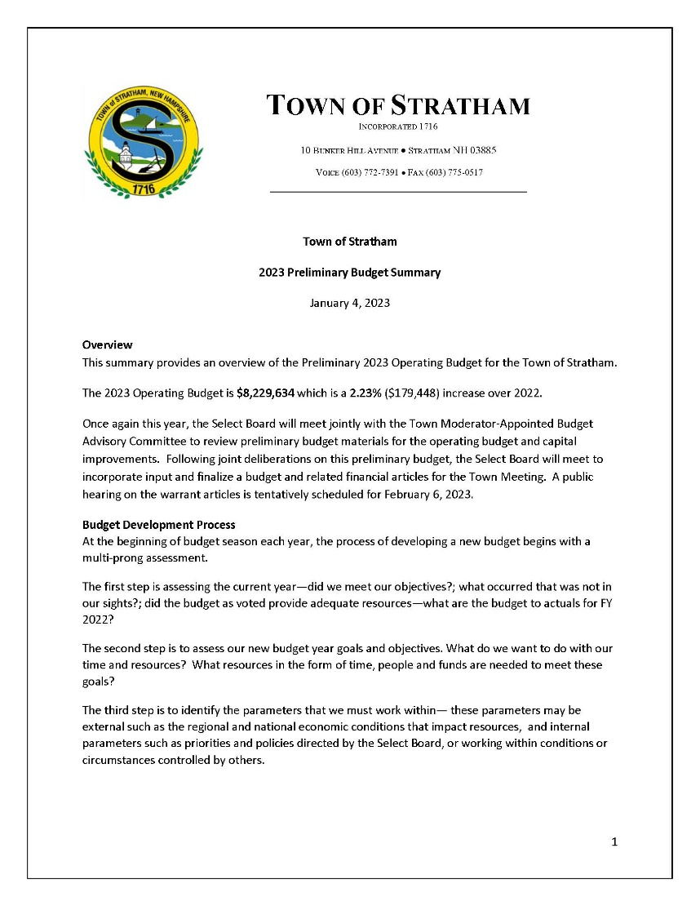
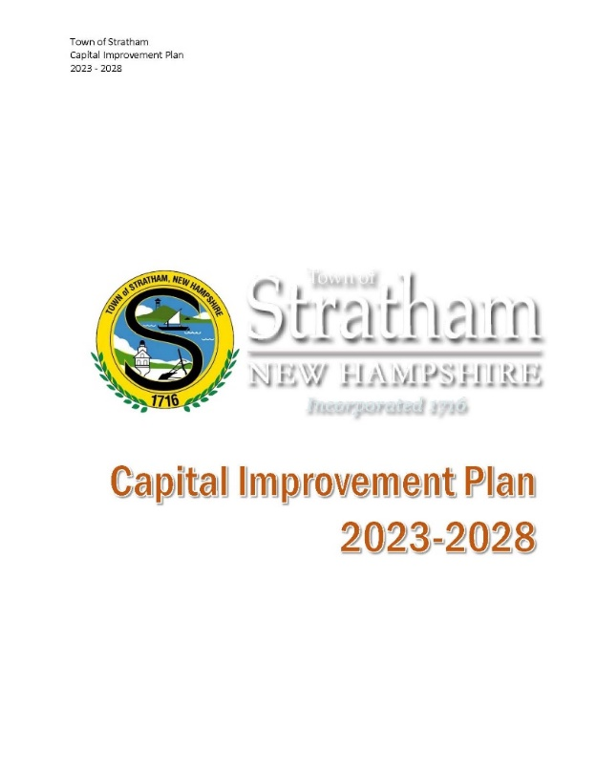
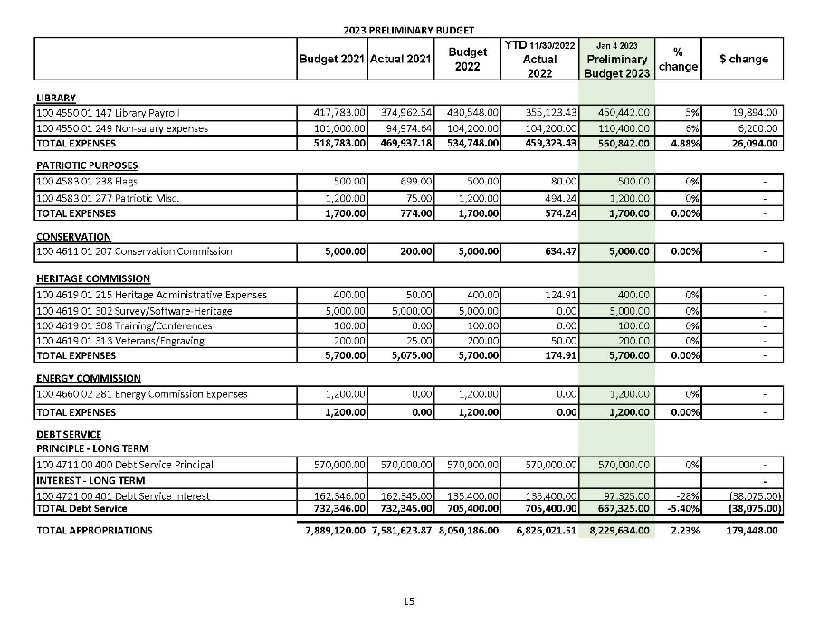
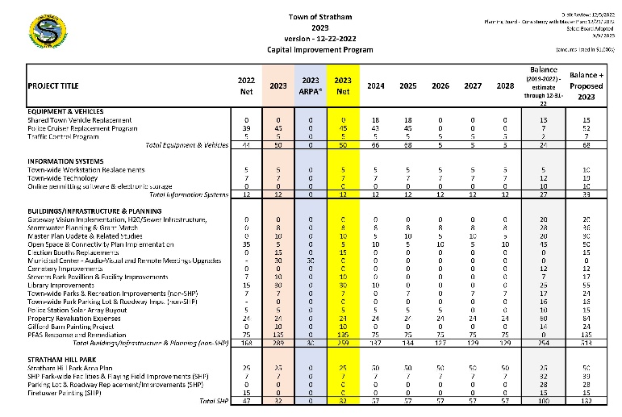
Budget Documentation

Slide 6
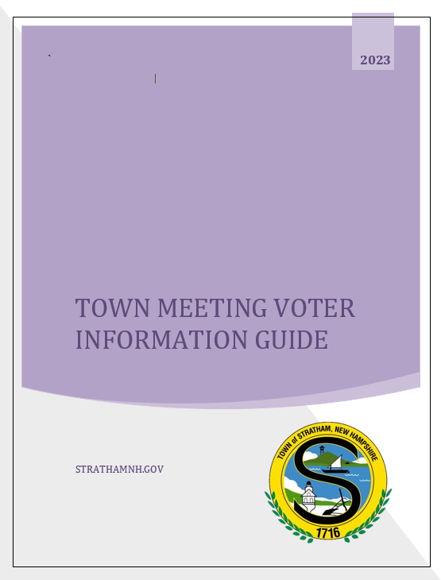

Slide 7
ARTICLE 11: 2023 Operating Budget
To see if the Town will vote to raise and appropriate the sum of Eight million two hundred eleven thousand one hundred eighty eight dollars ($8,211,188) for general municipal operations. This article does not include appropriations contained in special or individual articles addressed separately.

Slide 8
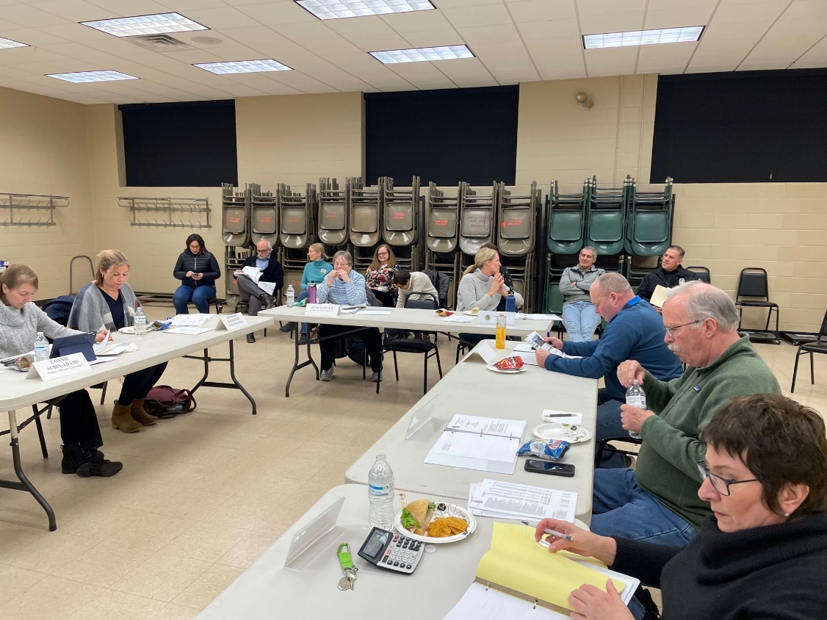
Budget Process & Schedule
Budget Advisory Committee - Appointed by the Moderator - Makes recommendations to the Select Board
October – Budget Submissions
November – Preliminary Budget Developed
January
  Advisory Committee Process
  Select Board Receives Input and Finalizes
February – Public Hearing on Warrant (February 6, 2023)
March – Information Night and Town Meeting

Slide 9
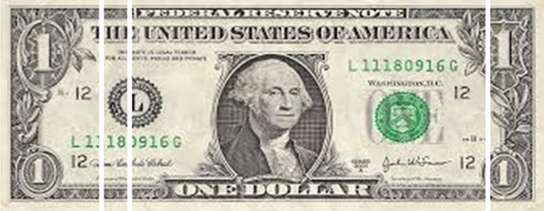
Town Services In Context
Town
County
Local Education
State Education

Slide 10
Town Services In Context
Town
County
Local Education
State Education
16%
4%
72%
7%

Slide 11
Town Services
This portion of your bill funds your:
  Wiggin Memorial Library
  All public works functions (including trash and recycling pick-up, transfer station, street clearing operations, and park and playground maintenance)
  Parks & recreation programming and senior services
  Police services
  Stratham Volunteer Fire Department
  Land use regulatory services, elections, general town administration
  Capital projects and rolling stock.
For a home valued at $500,000, your annual tax for these services is $1,535.

Slide 12
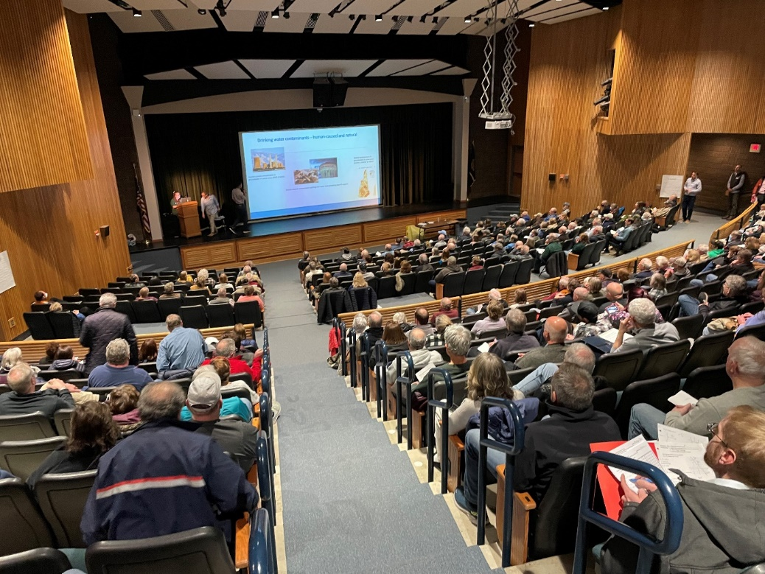
Focuses
Water Quality Issues
  Raising awareness about water quality
  Town Center PFAS Contamination
Retaining and attracting qualified and dedicated public servants
Modernizing our accounting practices and budgeting tools
Ensuring effective communication and involving the residents
Open Space Plan and Connectivity
Maintaining high quality services

Slide 13
2023 Operating Budget
$8,211,188 - Total
$161,002 - Increase
2.00% over last year

Slide 14
Payroll Costs as a Percentage

Slide 15
Operating Budgets Overtime
Annual growth has averaged 2.37%
Change from 2022 to 2023: 2.00%

Slide 16
Tax Rate Impact (estimated)

Slide 17
Tax Rate History:
 | 2019 | 2020 | 2021 | 2022 | 2023
Town | 3.30 | 3.09 | 3.15 | 3.07 | 3.18

Slide 18
Budget Factors in 2023
Benefits administration: multi-effort to managed health costs
  2021 introduction of 2 new deductible medical plans supported with the added benefit of employer funded Health Reimbursement Accounts (HRA)
  2022 introduction of Flexible Spending Account (FSA)
  Employee Benefit Discussion Meetings
Increased Control and Improved Estimation of HR Costs
    Overall 9.11% reduction in the budget that funds the employer payroll taxes and employer funded benefits
    Greater budgeting efficiency in payroll lines
Increased Services in Police and Fire
    Addition of hours to improve our Fire inspection
    Addition of Animal Control Services

Slide 19
ARTICLE 12: Capital Improvements Program
To see if the Town will vote to raise and appropriate the sum of Six hundred sixty three thousand dollars ($663,000) to implement the Capital Improvements Program for 2023 as presented in the Town Report and recommended by the Planning Board. This is a special warrant article which will be non-lapsing until the specific items are completed or obtained but shall in no case be later than December 31, 2028 per NH RSA 32:7 (VI).

Slide 20
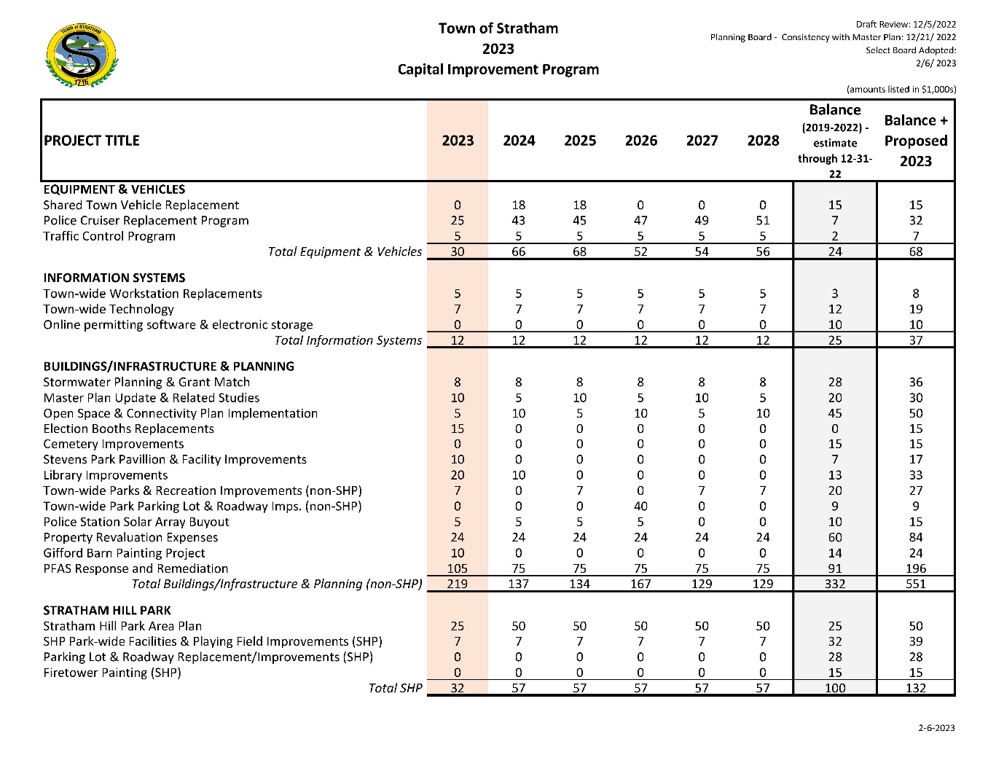
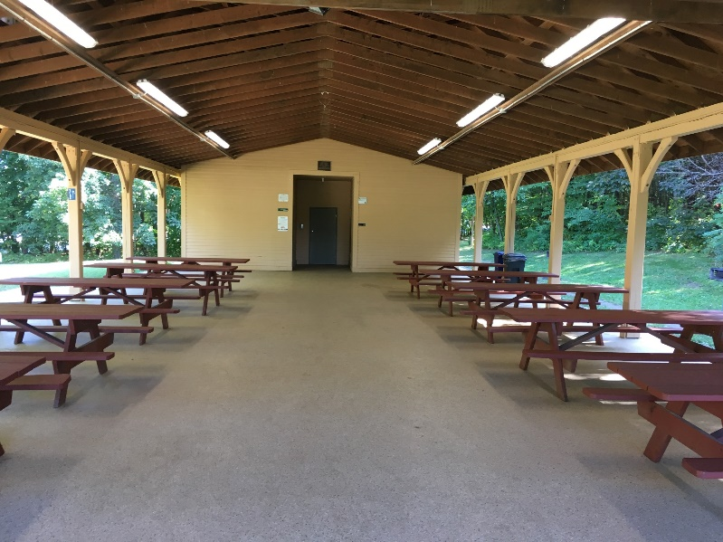
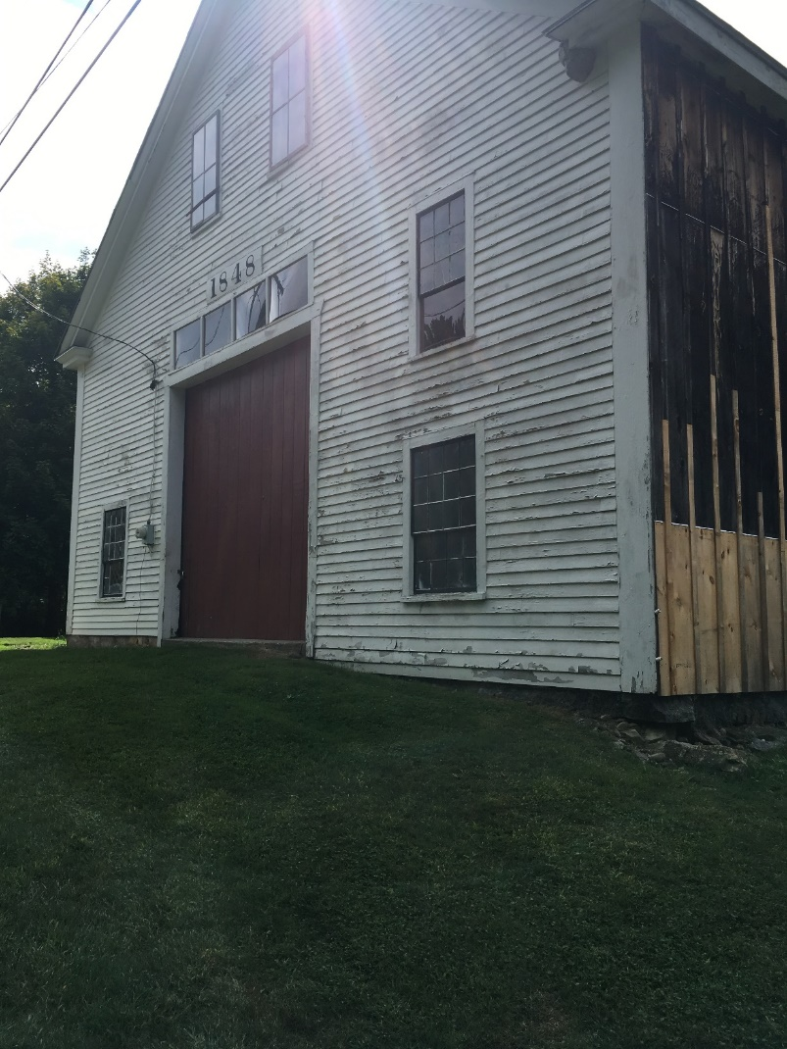

Slide 21
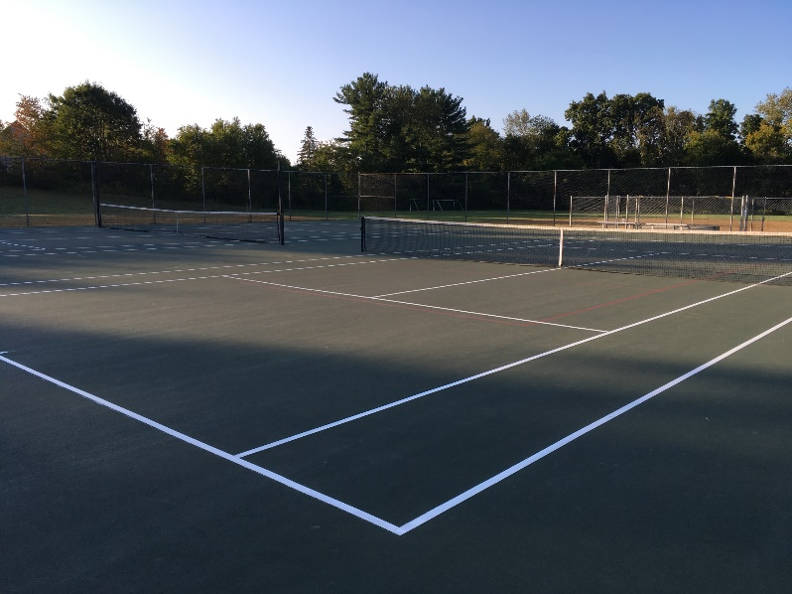
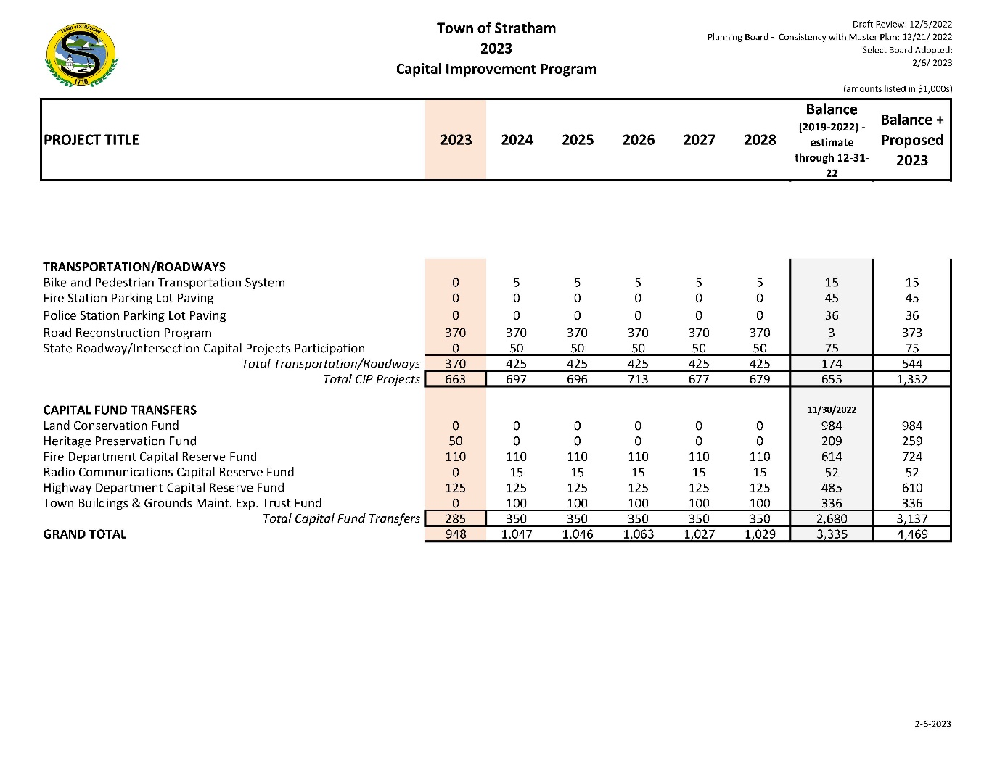
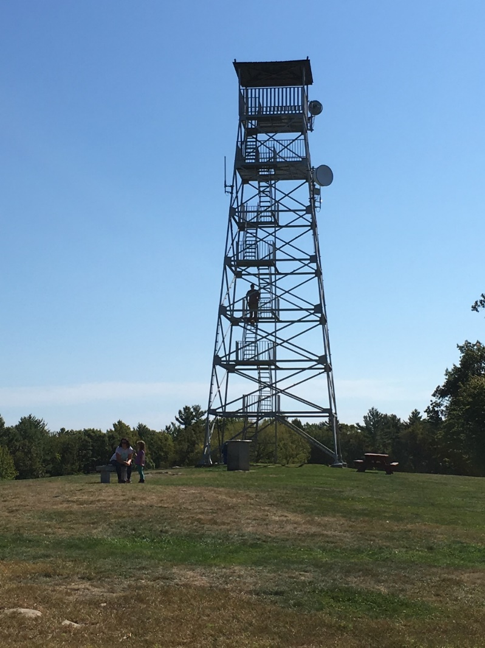

Slide 22
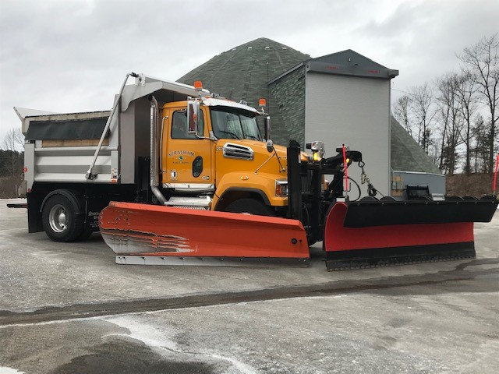
ARTICLE 13: Appropriate Funds to Capital Reserve Funds
To see if the Town will vote to raise and appropriate the sum of Two hundred and eighty five thousand dollars ($285,000) to be added to the following capital reserve funds previously established with One hundred fifty thousand dollars ($150,000) to come from the unassigned fund balance and One hundred and thirty five thousand dollars ($135,000) to be raised through general taxation.
Fire Department Capital Reserve Fund $110,000
Heritage Preservation Capital Reserve Fund $50,000
Highway Vehicle/Equipment Capital Reserve Fund $125,000
Total $285,000

Slide 23
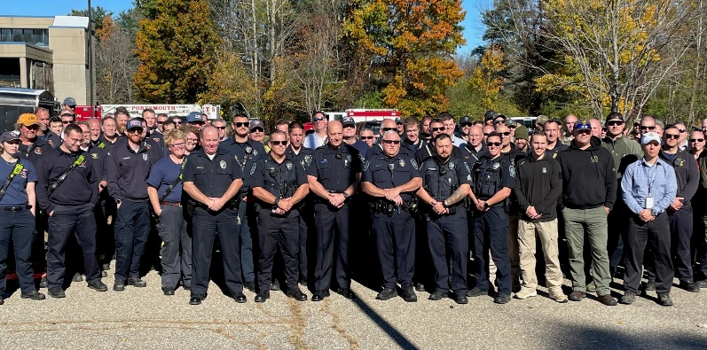
ARTICLE 14: First Responder Training & ALS Service Contract
To see if the Town will vote to raise and appropriate the sum of Twenty thousand dollars ($20,000) for the following purposes:
2023 EMS/EMT/First Responder Training $10,000
2023 ALS Services Contract $10,000
and to further authorize the withdrawal of Twenty thousand dollars ($20,000) from the Stratham Fire Department EMS Special Revenue Fund created for these purposes during the March 17, 2000 Annual Town Meeting and as amended during the March 11, 2005 Town Meeting. No additional funds from general taxation are to be used.

Slide 24
ARTICLE 15: Fire Engine #1 Replacement
To see if the Town will vote to raise and appropriate the sum not to exceed Nine hundred and fifty thousand dollars ($950,000) for the replacement of Fire Engine #1 and to further authorize the withdrawal of Two hundred and fifty thousand ($250,000) from the Stratham Fire Department EMS Special Revenue Fund, created March 17, 2000 and amended March 11, 2005 to include the purpose of purchasing Fire Department vehicles and equipment. The balance will be raised from the SVFD Fair Trust Fund ($80,000) and the remaining balance not to exceed ($620,000) from the Fire Department Capital Reserve Fund. This special warrant article will be non-lapsing per RSA 32:7, VI and will not lapse until the purchase has been completed, or December 31 2028, whichever is sooner. No additional funds from general taxation are to be used.

Slide 25
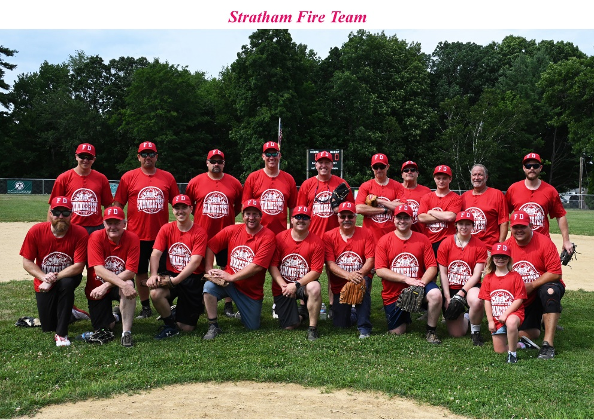
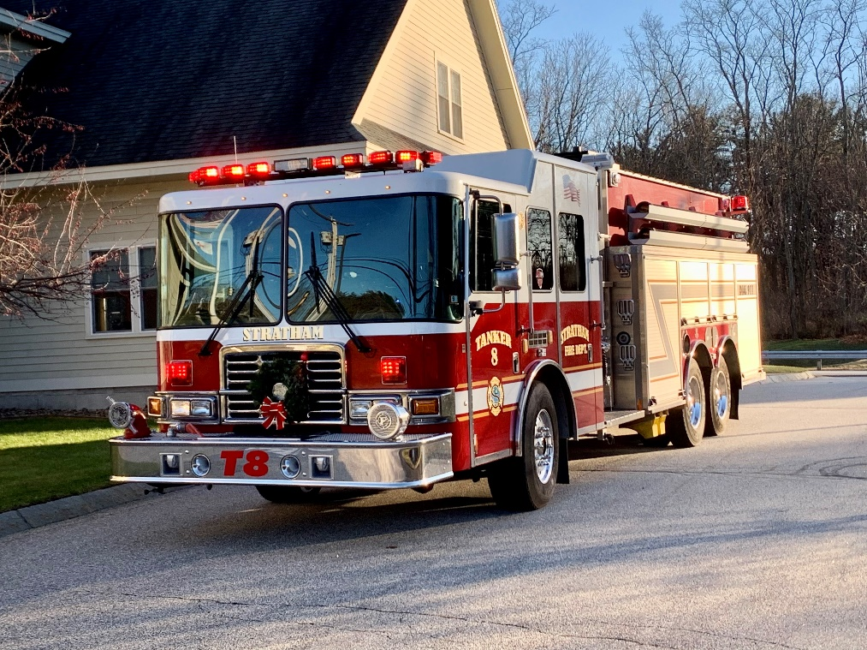
  Engine 1 Purchase 2023
    Needed to provide continued reliability and safety.
    20 year replacement (NFPA 1911 Standard)
      Replacement received/in service sometime in 2025.
      (Current Eng-1 will actually be 25 years old at planned replacement delivery date)

Slide 26
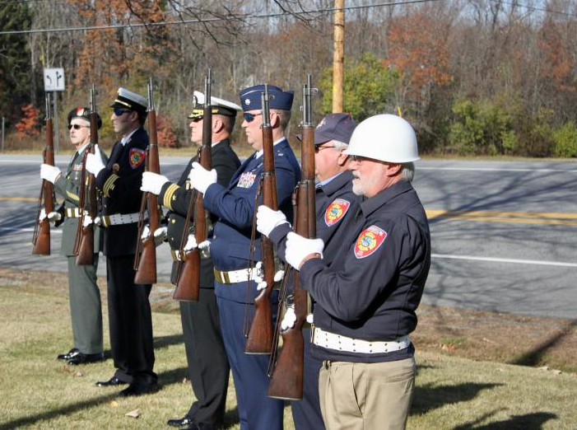
ARTICLE 16: Optional Veterans’ Tax Credit (72:28, II)
To see if the Town will readopt the optional Veterans’ Tax Credit in accordance with RSA 72:28, II, for an annual tax credit on residential property of $600.

Slide 27
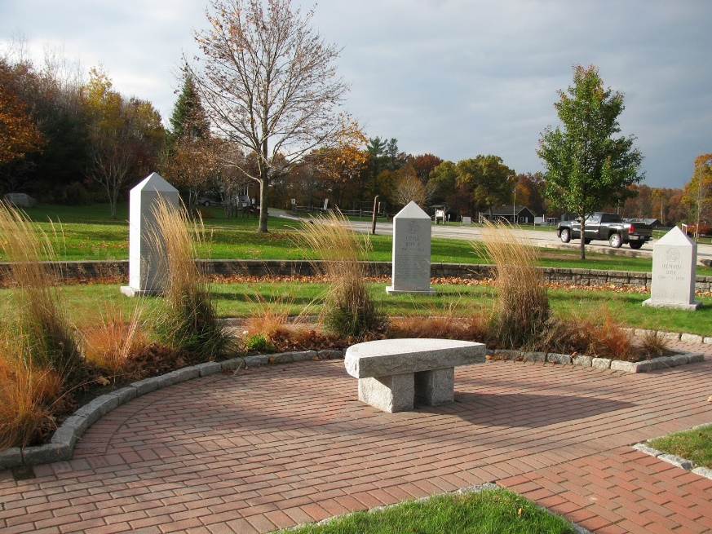
ARTICLE 17: All Veterans’ Tax Credit (72:28-b)
To see if the Town will readopt the All Veterans' Tax Credit in accordance with RSA 72:28-b, for an annual tax credit on residential property which shall be equal to the same amount as the standard or optional veterans' tax credit voted by the Town under RSA 72:28.

Slide 28
ARTICLE 18: Motor Vehicle Registration Fee and Capital Reserve Fund
To see if the Town will vote to collect an additional motor vehicle registration fee of $5.00 per vehicle for the purpose of supporting a Municipal Transportation Improvement Fund as set forth in RSA 261:153 VI, and further, to vote to establish said fund as a capital reserve fund governed by RSA 35 and to appoint the Select Board as agents to expend from this capital reserve fund for the purposes for which it was established. Proceeds from the Municipal Transportation Improvement Fund are to be used to support eligible local transportation projects as permitted under RSA 261:153 such as public transportation, roadway improvements, signal upgrades, and development of new bicycle and pedestrian paths.

Slide 29
ARTICLE 18 continued:
Additional $5.00 Fee deposited in Municipal Transportation Improvement Fund
to support public transportation, roadway improvements, signal upgrades, and development of new bicycle and pedestrian paths.
Estimated $50,000 collected each year.

Slide 30
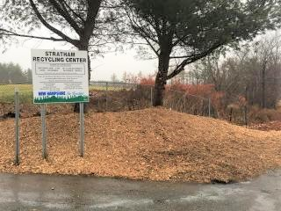
ARTICLE 19: Establishment of Fees
To see if the Town will vote to adopt RSA 41:9-a, to allow the Select Board to establish or amend fees following a public hearing process. Fees authorized under the section include fees related to regulatory programs adopted by the Town and fees used for the use of revenue producing facilities.

Slide 31
David Moore, Town Administrator
(603) 772-7391 ext. 187 dmoore@strathamnh.gov

